Slide 1
Assessment Tools for CBME and the Core Outcomes
Olivia Rae Wright, MD
Velyn Wu, MD
April 10, 2024
Notes:
Competency Based Medical Education (CBME) emphasizes frequent, low-stakes assessments incorporating direct observation. This shift in paradigm will require many programs to make adjustments to their assessment process. This webinar will identify several workplace-based assessment tools and strategies for direct observation. We will introduce assessment tools from the STFM CBME Taskforce and discuss a proposed pilot for use of a mobile app. Our focus will be on assessment methods already in use and new ones that can be readily implemented.

Slide 2
Faculty Development Webinars
stfm.org/cbmewebinars
What You Need to Know About ACGME and ABFM Expectations for a Shift to Competency-Based Medical Education
Reflections, Goals, & Objectives – Oh My! Best Practices for Creating ILPs
Let’s Talk About Entrustment
Assessment Tools for CBME and the Core Outcomes
Building CBME Into Faculty Development
Advisors and Coaches: The Evolving Role of Faculty and Resident Relationships
Individualized Learning and Resident Assessment: A CBME Orientation for Residents
Fostering Master Adaptive Learning and a Growth Mindset in Your Program
How to Effectively Use Electives to Help Residents Attain Competency in the Core Outcomes
The Role of Resident Portfolios in Competency-Based Assessment
Managing Assessment Burden in CBME
How to Have Reflective Feedback Conversations and Develop a Culture of Effective Feedback
Notes:
STFM has planned a series of CBME webinars. These are co-branded and co-marketed with AFMRD. We have had record-breaking registration for the live events and excellent viewership of the recordings.
Each webinar has at least one member of the task force. We’ve also included presenters from an open call we put out for CBME subject matter experts.

Slide 3
Objectives
Upon completion of this session, participants should be able to:
Identify at least two assessments tools already in place in their programs that could be used for CBME
Identify additional assessment tools from the STFM Taskforce that can be incorporated in their home programs
Describe the benefits of workplace-based assessment and direct observation tools
Update their assessment systems to include more workplace-based assessment using direct observation
Notes:
Our objectives for today’s session.

Slide 4
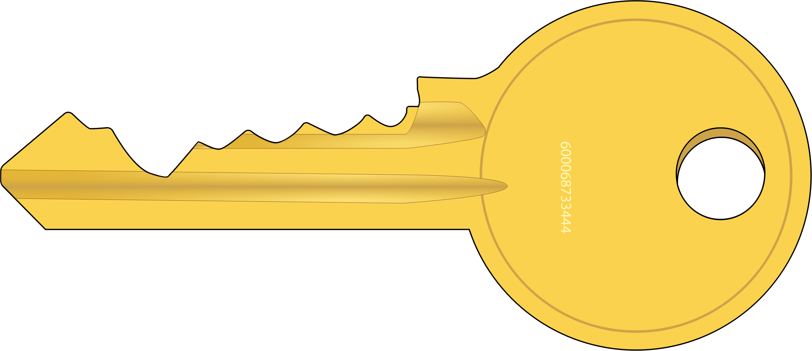
Key Points for CB Assessment:
Target Outcomes
More formative, less summative
More frequent assessments
Modify existing assessment tools first
More direct observation
Incorporate entrustment scales
Make it easy on the CCC
Faculty/resident development for shared mental model
Notes:
Meaningful assessment is always a challenge. When we discuss Competency Based Assessment, there are a few key ideas to keep in mind.
We will touch on each of these today.

Slide 5
15 Outcomes from ABFM
5 added per year starting June 2024
5 more for 2025
Final 5 2026
Competence in these reported to ABFM for each graduating resident
Notes:
ABFM has published 15 Outcomes that must be satisfied by each graduating resident in order to be board certified. They will be phased in over 3 years, starting with this year’s graduating class. We need our assessments to address these Outcomes to insure progress toward competence.

Slide 6
What do we mean by Assessment?
Assessment system
Assessment tools
Assessment question types and rating scales
Notes:
There is the overarching system, that contains specific tools and those tools in turn have a variety of question types and rating scales. If we break this down a bit more…

Slide 7
High Functioning Assessment Systems:
Create a well rounded picture of each resident
Contain both Formative and Summative components
Identify areas where the program can improve
Lead to assessment of progressive competence towards autonomy
Minimize bias
Notes:
Assessment systems are the full package, providing a well rounded picture of the resident over time. A high functioning system will will allow ongoing improvement toward competency in the Outcomes, guided by the progressive skills found in the Milestones. If there are holes in the system where residents are not getting timely feedback so they can improve, the programs may need to make changes with collaboration between the CCC and PEC.
High functioning systems use tools that are objective, with multiple observations from multiple perspectives to minimize bias. Systems require both formative and summative components.

Slide 8
Formative
Summative
Coaching
Helps you bridge the gap
Evaluations
Tells if you’re there yet
Notes:
What do we mean by formative and summative?
Formative assessment is usually in the form of Feedback. This is the ongoing coaching that happens in the moment so residents can improve. The faculty empowers residents to provide much of that feedback themselves in a spirit of continuous learning and self-reflection. Feedback from faculty members in the context of routine clinical care should be frequent, and need not always be formally documented. Formative evaluations help residents identify their strengths and weaknesses and target areas that need work.
Summative evaluation is evaluating a resident’s learning by comparing the residents against the goals and objectives of the rotation and program, respectively.
Summative evaluation is utilized to make decisions about promotion to the next level of training, or program completion.
End-of-rotation and end-of-year evaluations have both summative and formative components. Information from a summative evaluation can be used formatively when residents or faculty members use it to guide their efforts and activities in subsequent rotations and to successfully complete the residency program.
Feedback, formative evaluation, and summative evaluation compare intentions with accomplishments, enabling the transformation of a neophyte physician to one with growing expertise.

Slide 9
Formative is most valuable
Formative
Summative
Direct observation
Real time feedback
Incorporates teaching
Bi-directional
Occurs at the end of a learning process
Assesses if the objectives are met
Used for decisions of promotion
Notes:
A competency-based system prioritizes Formative assessment. Why?
Formative assessment associated with direct observation allows us to observe the competent performance of skills rather than inferring competency.
It incorporates real time feedback as a form of both assessment and teaching at the point of care.
It is bi-directional, and allows an immediate opportunity for improvement as the resident can engage with questions on how to improve.
Summative Evaluation and Assessment is still important, of course, but you might consider less focus here as it occurs after the process. It is most useful for consideration of meeting the rotation and program objectives, and to help the CCC with decisions regarding promotion and any additional learning experiences that might be needed going forward.
You might consider referencing the Objectives together with a report of the daily feedback as the summative eval. If you have criteria for successful completion, it can be referenced here, in the summative evaluation, as progress toward any associated outcome.

Slide 10
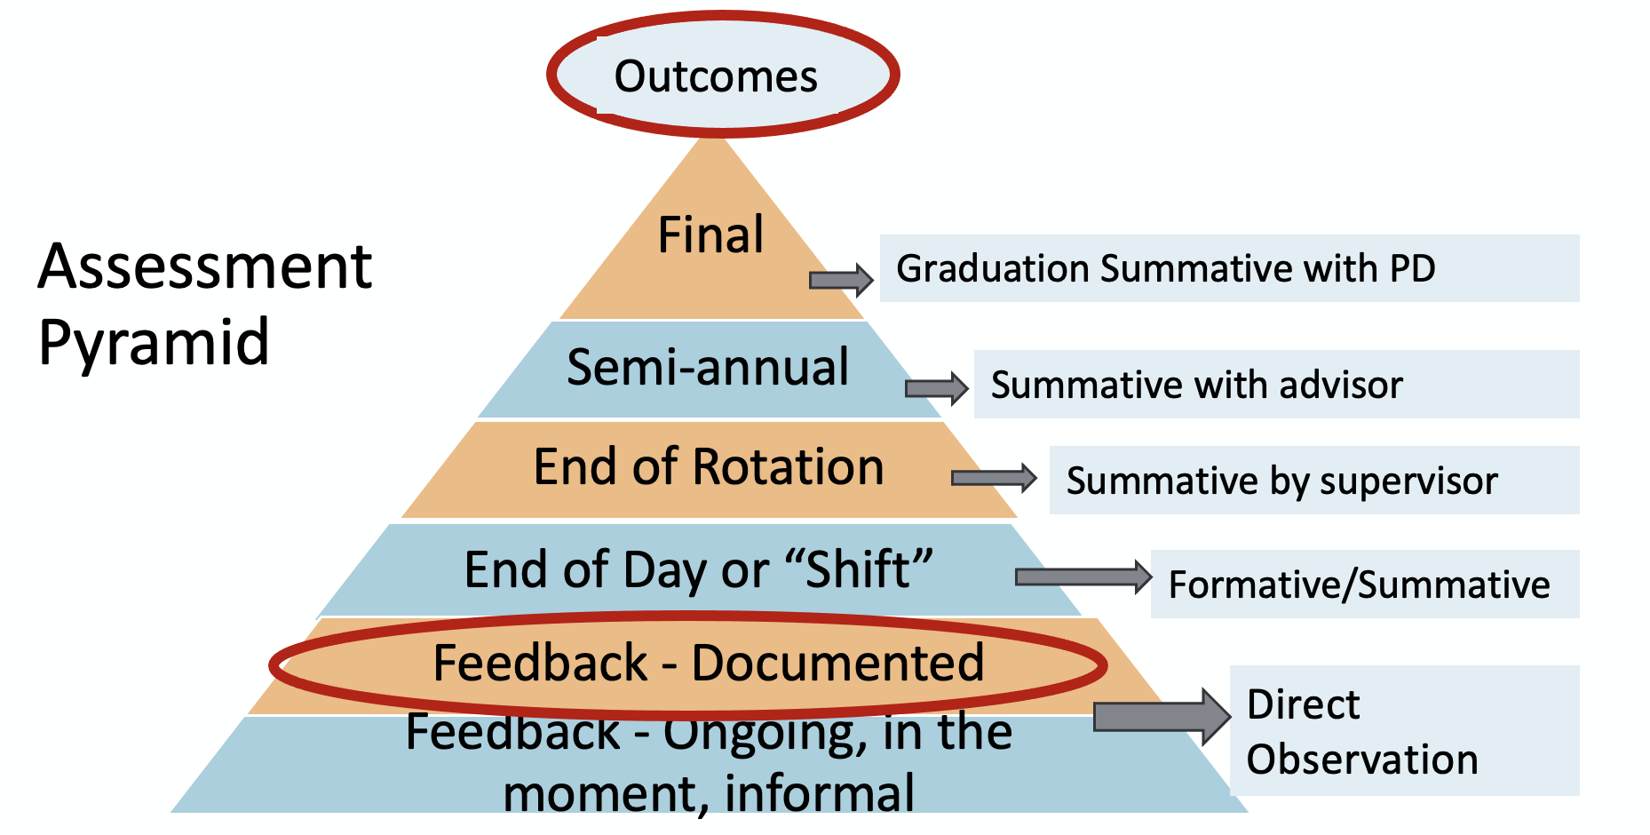
Notes:
Here’s another way to look at this in the form of a pyramid. If we start at the base, there is more volume. Here is where feedback lives. There is the feedback we give all the time as we discuss cases and answer questions that is more informal. The next level is documenting that feedback so progress can be tracked in real time. This is where most programs will need more work and is the key to competency-based assessment.
The next level includes the daily assessment or shift assessments that are often used after a full or half day of clinic. These are based on multiple encounters and do not necessarily involve direct obs, but can be used formatively if feedback is given directly to the resident on the same day, so a discussion and teaching can be included while it’s still fresh.
The next level is more summative and occurs at the end of the learning experience or rotation. This is where the performance over a period of time is summarized and not usually given directly, but can be more helpful is it is. This is more complicated when there have been multiple supervisors/ assessors involved. Ideally, this evaluation will not be a surprise to the resident and there would not be any of those, “no one told me…” conversations. If we are giving feedback all along and documenting what was given and what was discussed, there should be no surprises.

Slide 11
You need the right tools!
Notes:
So how can we do that and stay sane?
It starts with the right tools for the right person in the right setting.

Slide 12
Poll
To what extent do you feel that your current assessment tools are working well for your residents?
Very satisfied: our tools are efficient and provide meaningful feedback.
Mostly satisfied: meaningful feedback but needs to be more efficient.
Mostly dissatisfied: Many of our tools are ineffective, or confusing.
Notes:
Simplify, address what’s really needed, make it easy to complete in the moment.

Slide 13
Assessment tools should be:
Valid
Acceptable
Reliable
Feasible
Effective
Equivalent
Notes:
Validity – Measures what it’s supposed to measure. Need clear expectations for both, more formative and skill based.
Reliability – Training the evaluators for consistent interpretation. More evals, questions types with anchors or training in words to use for narrative feedback.
Equivalence – Same results if repeated in different circumstances, different rotations, for example.
Edu effect – motivates the learner
Catalytic effect - Helps improve the system overall
Acceptable – to all stakeholders. They find the results credible, not just the tools themselves, but how they are used.

Slide 14
Assessment tools should minimize bias:
Examine existing tools for potential bias
Use rating scales that minimize bias
Incorporate narrative assessment
Use group process for high stakes decisions
Faculty/assessor training
Notes:
Rating tools that minimize bias:
Use behavioral anchors.
Should relate back to the stated SMART objectives. Need a shared understanding of expectations.
Narrative assessment should also be focused on what was observed whenever possible. Less inference is better.
Group process such as CCC to limit individual influence.
Training to use the rating scales and narration using best practices.

Slide 15
Frequency of use – How many and how often?
2023 survey of US residencies -median of 50-75 evaluations/assessments done per resident at graduation
Canadian model recommends >500!
Goal is….more!
Notes:
As you think about the tools in your system, consider how often you want to assess your resident? In theory, the more the better.
In the Canadian system, they often have 500 to 1500 assessments over 3 years! We are not suggesting that should be your goal. We are suggesting that we need more than what we have now.
Why is more better? More assessments provide more data, which means more reliability when summarized. More settings provides a more well rounded picture, and more direct observation provides more validity.
Consider starting with a goal of 1 per half day of clinic per preceptor, and at 1 daily on inpatient rotations and build from there.
How do we do that?

Slide 16
Do more with Less…
Focus on tools that capture in the moment performance
Tools should be brief and easy to use
Use more tools that can be accessed on a mobile app
Eliminate tools that aren’t reliable, valid, etc.
Edit existing tools, modify if needed
Notes:
“Do more with less”, what do we mean by that?
Tools are generally in the form of the various paper and electronic forms we use to capture performance data.
Focus on tools that capture in the moment performance. That means use more formative and less summative.
To make that feasible, tools will need to be brief and easy to use.
One way to accomplish that at the point of care, is by using a mobile app for assessment.
You may need new tools, but can start by editing what you have to capture only the data that is found to be useful. Ideally faculty and residents would work together on this.
If you are using some tools just because they are what you have always used, now is a good time to prune them.

Slide 17
Update your question types/rating scales
Multiple choice
Yes/No
Checklists
Likert scale – Disagree/Agree
Linear scale - Unfavorable/Favorable
Frequency scale - Never/Always
Direct and Custom Milestones
Text/narrative comments
Behavioral Anchors
Entrustment Type Scales
Notes:
How do we decide which tools to edit and how might we do that?
You might start by looking at your question types.
MC is a good way to assess general knowledge, such as with standardized exams, but not so great at assessing clinical reasoning.
Y/N types are good for either they did it or they didn’t, but not as useful for more complex tasks that have a degree of success.
Checklists can be a good way to assess skills that require multiple steps. More common with procedures.
Likert scales. Linear scales and frequency scales are meant to address degrees, but tend to be less reliable and more subjective.
Using Milestone levels directly is very useful to the CCC if there is a clear shared mental model of each level. We need to discuss what success looks like in advance and make sure the assessors are all using it the same way.
Custom Milestones may be easier to interpret for the assigned evaluator and associated educational experience. Will still likely require a more skilled evaluator and not generally as useful for assessment associated with direct observation.
Question types using the scale types on the right are generally considered the most useful overall.
Narrative comments are usually the most meaningful to the learner/resident. Learners often don’t even look at ratings, and only focus on the comments that were written.
Questions using behavioral anchors that describe exactly what is expected for any given score can take away a lot of subjectivity. These should be matched to the learning objectives. Doing so may allow better, more meaningful objectives.
Entrustment and entrustabilty was the focus of last month’s outstanding Webinar. We are going to talk today a bit about entrustment type scales.

Slide 18
Addressing Outcomes: Modify Existing Tools
1
Needed complete guidance (completely dependent)
3
I needed to prompt, intermittent direction
4
5
They performed (completely independent)
2
I had to talk them through, guided direction
I needed to provide minor direction
Add Entrustment Type
Scale
Notes:
A true entrustment scale is forward looking. It might start with, ”I trust the resident to competently perform a vaginal delivery without supervision.”
We can also use a similar type of scale to assess performance of a procedure or clinical activity that just occurred.
These scales are based on direct observation and use objective language that minimizes subjectivity. They are behaviorally anchored scales that are used to measure the progression to competence.
They are not dependent on the level of training.
It may require preparing residents and faculty for a different approach.
You can use these types of scales to replace many if not most of your rating scales on your existing evaluation forms.

Slide 19
Addressing Outcomes: Modify Existing Tools with Entrustment
Add Outcomes based questions to existing forms
Upon completion of this Adult Medicine Rotation, the resident is entrusted to diagnose and manage acute illness and injury for hospitalized adults:
only as an observer
with guided direction under direct supervision
with prompting and intermittent direction using some direct and indirect supervision
using minor direction with mostly indirect supervision
without supervision required, they are competent to perform independently
Notes:
You might also use an entrustment type of scale to assess progress towards an Outcome using a summative assessment such as an end of a rotation evaluation. You can add the Outcome to this summative form followed by the entrustment scale. This lends itself well to an inpatient or ER rotation.
For example,
Pre-med
Med student
Intern
Upper level resident
Graduating resident
*Though each resident is on their own trajectory, it might make a difference to the next attending and inform any additional experience if the resident is not on track.

Slide 20
Improve your Narrative Comments:
Okay Comments | Better Comments
Communication skills need work | Tendency to use too much medical jargon when explaining issues to patients. Ex: In the patient with an abnormal lesion on the chest x-ray you said, “It could be an infiltrate, a granuloma, a malignancy…”
Read more | Focus on reading……..what?
Great case presentations | Case presentations in clinic are succinct and include all relevant info Ex: Patient with depression and back pain… you were able to focus on the issues relevant to the question asked by the patient regarding opioid use when presenting the case.
Notes:
Narrative comments should be as specific as possible, and include examples if appropriate. This is how residents can use assessment to improve and not just feel judged. This is especially important if the feedback was not given directly. Comments may be more brief if already discussed and agreed upon.
Narrative comments can be used alone or added to any question type. They can be used both by supervisors and by peers or staff as part of a 360 eval process.

Slide 21
Behavior not Attitude
Attitude - Unprofessional
Behaviors + Effect:
Arrives consistently late (staff work late to accommodate)
Does not follow up on results (near misses of critical labs)
Does not answer pages (fellow residents have to cover)
Does not pre-round (slows down team rounds)
Performs assigned “tasks” in a timely manner…
Notes:
Referring to attitudes such as, the resident is unprofessional ,is more subjective. It comes across as judgmental, and as inference.
Behaviors are associated with action verbs and are based on observation, “I observed that…”
Pairing with the effect it has, also provides context.
This is useful for both informal feedback as well as assessment.

Slide 22
Tailor assessment tools to the evaluator
Notes:
All of this is more relevant if we match the tool to the user.

Slide 23
Examples
Assessor/Evaluator | Tool Type
Core Faculty | Direct Observation Progressive Scale All tools
Community Faculty | Direct Observation Text comments/Short
Staff | 360 Evaluation, very specific Qs Use prompts/Text
Notes:
Your core faculty should be able to reliably assess residents using all of your tools. If not, either the tool is not reliable or the faculty needs more training to use effectively. If tools are not getting used, why not? Is the tool confusing? Not really valid? Not readily accessible? Too long? High stakes decisions should involve trained core faculty with more robust tools whenever possible.
Collecting input and evaluations from community faculty is even more challenging. If possible, find out what the challenges are and adjust as needed. Consider having a paper form hand delivered by the resident. This way the resident is engaged and accessibility is not an issue. The resident might even help the attending load a mobile app that uses voice to text. Best types of tools for this group are usually short, allow comments and use behavioral anchors that are easy to interpret. Determine what you really want to know from them and keep it brief.
Staff evals for a 360 view are also challenging. Using behaviors as prompts works well here too, as with community faculty. Questions regarding communication, teamwork and professionalism are the most important, and you may want to limit to these areas to keep the process easier.

Slide 24
Common Tool types
Focused direct observation
Global rating
End of Rotation Evaluation
Multi-source/360° evaluation
Patient surveys
Case/procedure logs
Cognitive
Performance data
Self-assessment
Notes:
This is a brief overview of types of tools commonly used in FM and addressed in the ACGME Assessment Guidebook.
We have already discussed a little about End of rotation evals, and 360 evals.
A competency-based evaluation system also includes patient evals or surveys. These can be either customized by the program or more often generated by the health care system that sponsors the program. Either way, the most important step is having someone review the results with the resident.
Case and procedure logs are less important now for ACGME requirements, but still may be needed for credentialling.
Cognitive assessments can be oral or written and can be tied to specific Outcomes or Sub-competencies.
Performance data such as meeting metrics need to be collected and reviewed with the residents.
Self- assessment should be occurring with every encounter and summarized as part of the resident’s Individual Learning Plan.
All of these are needed for a well-rounded competency-based assessment system. However, using focused direct observation is the most vital for growth.

Slide 25
Direct observation – why?
Incorporates teaching
Earlier improvement
More objective/mitigates bias
Notes:
So again why is direct observation so important?
It allows more objectivity, it includes feedback for earlier improvement and it incorporates teaching.

Slide 26
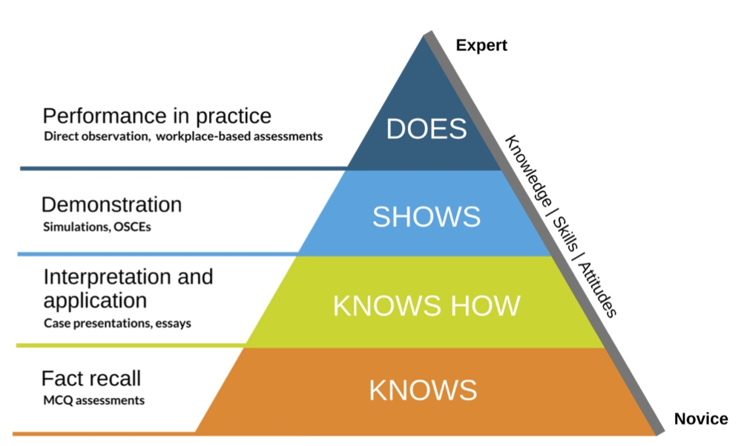
Notes:
Direct observation is also consistent with Millers assessment pyramid. Residency should focus more on the Does section.
Most assessment should be based on asking questions and observing.
The lower levels of this pyramid are generally for medical students or to assess R-1s upon entry to the program.

Slide 27
Direct Observation
Procedures
1:1 precepting
OSCE/simulation
Encounter “snapshots”
History
PE
Clinical reasoning
Teamwork
Professionalism
Shared decision making
Notes:
Where is direct observation most frequently used?
Most programs use direct obs to assess procedural skills. There are lots of tools such as BSQs or PCATs that are available in the AFMRD toolbox.
Programs often use OSCE for incoming residents or other simulated assessments that are custom or part of programs like ACLS.
Programs also use direct observations to assess residents for clinical skills using 1:1 precepting in some form. This is great, but very resource intensive.
We recommend doing encounter snapshots instead, where a regular preceptor can just observe a portion of the encounter such as Hx, PE, etc. This may require reconfiguring how you schedule your preceptors.
The hope is that doing smaller portions allow it to be done more frequently

Slide 28
Using a Mobile App
Taskforce looked at examples
Decided to focus on what was already in use
Create a tool that addresses Milestones and Outcomes
Can be used in the moment, inpatient and outpatient
Incorporates feedback
“Snapshot” approach
This Photo by Unknown Author is licensed under CC BY
Notes:
One way to do more in the moment assessments immediately following direct observation is by using a mobile app.
The task force looked at several including:
DOCC app from ACGME – does not reliably work. Good content but not customizable and does not address Outcomes. It’s free but not really ready to go.
The M3 app -mobile medical milestones – Lots of programs use this now. Good for addressing Milestones, but does not yet address Outcomes. Does not easily integrate with other assessments for an assessment system.
SIMPL - Society for Improving Medical Professional Learning Workplace Assessment Platform (SIMPL) Used for addressing EPAs for surgery and soon to be used by peds. Designed for this purpose. Need to pay. Might be several years before ready for FM.
And finally, we looked at the Mobile Apps within New Innovations and MedHub
We decided to focus our efforts here and create a new On Demand form that addresses Milestones and Outcomes. On that could be used in the moment, in both the inpatient and outpatient settings, and that incorporates feedback. We also wanted something that would allow for use during encounter snapshots if only a portion of the visit was observed.

Slide 29
What’s Ready Now?
New Innovations and MedHub
Existing mobile apps
On demand forms
“Active Assessment Using Direct Observation”
Maps to Outcomes and Sub-competencies
Reporting available
More to come!
Notes:
If your program uses either NI or MedHub, you are likely aware of the mobile apps they support. You may or may not have used them or may have used them and don’t really like them.
These apps require creating an On Demand evaluation, usually done by the residency administrator or coordinator with faculty guidance, often the APD.
We’ve created one for you for both NI and MedHub, called Active Assessment Using Direct Observation.
It maps answers to the Outcomes based on the encounter type. The form also links to the sub-competencies. MedHub has mapped them for you once you access the form. NI provides instructions for sub-competency mapping, but is done by the program when first used. Both have the Outcomes embedded for you already.
Both applications can easily create summative reports for periodic tracking and for the CCC.
MedHub is using the language “EPAs” but they have updated with the new Outcomes language for reporting. Users won’t see the difference, this only shows up in reporting. New Innovations has created a custom report for the Outcomes that is similar to what you see with the Milestones when the CCC meets.

Slide 30
Recommended Tools by Outcomes
https://stfm.org/teachingresources/resources/cbme-toolkit/assessment-tools-strategies/
*Outcome Assessment Starter Pack
Notes:
For more details, you can go to the STFM website for CBME and access the toolkit using the link you see here. This sight contains a document titled the Outcome Assessment Starter Pack which has details about assessment including links to some recommended tools and instructions for both New Innovations and MebHub. We plan to do ongoing updates as needed as well.

Slide 31
Recommended tools by Outcome
Practice as personal physicians, providing first-contact access, comprehensive, and continuity care, to include excellent doctor-patient relationships, excellent care of chronic disease, routine preventive care and effective practice management | Direct observation tools with focus on chronic disease and preventative care Shift evals in continuity clinic Continuity/panel reports Chart review with focus on quality metrics and problem/med list updates Patient evaluations Billing and coding reports Shift evals in continuity clinic Completion and assessment of PDSA/QI project
1
Sub-comps (Level 4):
PC-2,4,5 SBP-2 PBLI-1 ICS-1
Notes:
Here is an excerpt from the Starter Pack. You see the first Outcome in blue. Below this are the associated Sub-competencies for Level 4. We only list Level 4 based on conversations with ABFM leadership to be consistent with expectations for graduation. This is also how the Mobile App assessment is set up.
To the right are some recommended tools. This is not exhaustive; you may have some that are better already. These recommendations are based on a review of the literature and include guidance from ACGME. Links and examples to most of these are also available in the Starter Pack. We are happy to add more as we find them.
This first Outcome covers a lot. Will need multiple assessment types and data points to addresses fully.

Slide 32
Recommended tools by Outcome
Diagnose and manage acute illness and injury for people of all ages in the emergency room or hospital | Direct observation in the ER, hospital setting “Shift” assessments in the acute setting Successful completion of ACLS, other SIM training Chart Stimulated Recall (CSR) 360 evals including hospital staff re: collaboration, discharge planning End of rotation evaluations for ER and inpatients
2
Sub-comps (Level 4):
PC-1,4 MK-2 ICS-1
Notes:
Here are some recommended tools for the second Outcome. Also know that the NI Tools noted in the Starter Pack are just examples, but can be accessed by going to the Help tab on the NI website. Detailed instructions are included in the Starter Pack as well.

Slide 33
Recommended tools by Outcome
Provide comprehensive care of children, including diagnosis and mgt of the acutely ill child and routine preventive care | Direct observation in the ER, hospital setting Direct observation well child care, acute illness in the clinic setting Successful completion of NRP, PALS, or other SIM training “Shift” assessments for dedicated care of this age group Chart reviews - immunizations rates Chart stimulated recall
3
Sub-comps (Level 4):
PC-1,2,3,4 MK-1,2 SBP-2 PBLI-1 ICS-1
Notes:
Here we. Have recommended tools for Outcome 3.
Think about setting for this one. Outpatient peds, inpatient peds, continuity clinic, ER.

Slide 34
Recommended tools by Outcome
Develop effective communication and constructive relationships with patients, clinical teams, and consultants | Direct observation using a Mobile App Direct observation tools with focus on communication, PCOF is one example. Hand-off observation using I-pass Consultant feedback/assessment Multi-source Feedback/360 Eval- patient evals, peer evals, staff evals-Inpt/OutPt Chart reviews that look at documentation Chart Stimulated Recall (CSR)
4
Sub-comps (Level 4):
PC-2,3,4 SBP-2 ICS-1,2,3
Notes:
Recommendations for Outcome 4
This is where MSF or 360 evaluations really help.
Can use observations related to just history or hand-offs for example.

Slide 35
Recommended tools by Outcome
Model Professionalism and be trustworthy for patients, peers, and communities | Multi-source/360 assessment including admin staff Compliance with program and institutional rules including confidentiality Written exam (customized by program) Measure responsiveness to feedback Add questions to evals addressing trustworthiness Professionalism Modules or Simulation completion Participation in ILP as a master adaptive learner Portfolio review
5
Sub-comps (Level 4):
MK-1 SBP-4 PBLI-2 Prof-1,2,3 ICS-1,2,3
Notes:
And for Outcome 5.
This one can be addressed by commenting on how well feedback was received and how engaged the resident is in creating and updating their ILP
All 15 are available and will updated periodically.

Slide 36
Summary of Tools
Frequent use at multiple points using multiple methods
More formative with direct observation
Align with Goals and Objectives
Incorporate Milestones and Target Outcomes
Use progressive entrustment type scales
Notes:
An assessment system and it’s tools should:
Start with competency based goals and objectives that are discreet and measurable and align with G and O so associated with shared expectations.
Use a variety of tools. Use multiple observations from multiple evaluators in multiple settings and do so frequently
Personal, timely, specific, provide opportunity to reflect. Direct observation with direct feedback works best when possible
Incorporate progressive Milestones and use entrustment scales when it makes sense.
Start thinking about incorporating Outcomes along the way as well.

Slide 37
Moving forward: Overcoming the Barriers:
Gradually update and prune your existing tools
Use more efficient tools: shorter, in the moment
Use mobile assessment tools
Match the tools to the evaluator
Train the supervisors and the learners
Notes:
We know this may seem daunting.
It does not need to all happen right now. It’s a gradual process that starts with identifying your program needs and gaps.
More assessments require tools that are quick ad easy to use.
Changing the culture to include more direct obs and regular use of a mobile app will take some time.
It all starts with faculty development and resident training to created a shared mental model.
Your CCC depends on it!

Slide 38
How does this affect the Clinical Competency Committee?
Assure assessments address competence.
Are they on track?
Make recommendations to PD regarding final competence in the Family Medicine Outcomes.
Notes:
Why does the CCC depend on it. We don’t want the CCC to be going by their gut. We need our CCCs to have enough data to make a summative assessment of a residents progress for both promotion and graduation. Are they on track? If not, how can the program help and intervene early enough in the process to make a meaningful difference.
In the end, the PD has to feel comfortable saying the resident is competent for independent practice in all of the Outcomes. The CCC is the conduit to that.

Slide 39
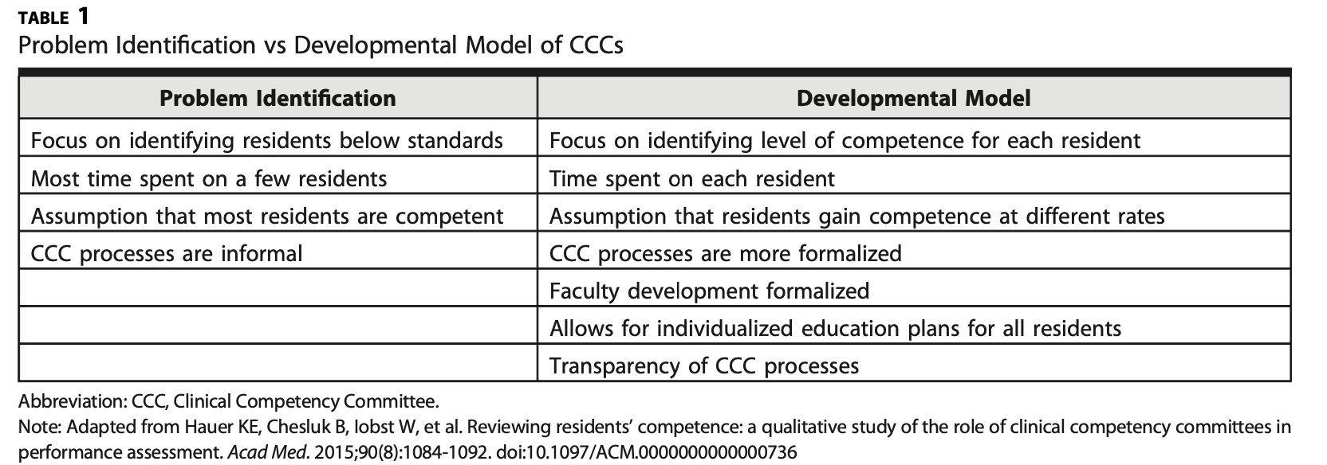
CCC Models
Notes:
Finally, a competency based assessment system is based on a developmental model, rather than a problem based model.
A CCC developmental model…

Slide 40
Objectives met?
Poll
Can you identify at least two assessments tools already in place in your programs consistent with CBME principles?
Will you utilize tools provided by the STFM Taskforce that can be incorporated?
Do you see benefits of using direct observation tools?
Will you update your assessment system to include more direct observation?
Notes:
We hope this met your expectations and you are now more able to meet the stated objectives. One one way to find out is to ask!

Slide 41
Notes:
We are now happy to answer any questions.

