Slide 1


Impact of Fee For Service on the Organization & Psychology of Primary Care
Asaf Bitton MD, MPH August 15th, 2024
Notes:
Disclosure- AL and PCP, not CMMI

Slide 2
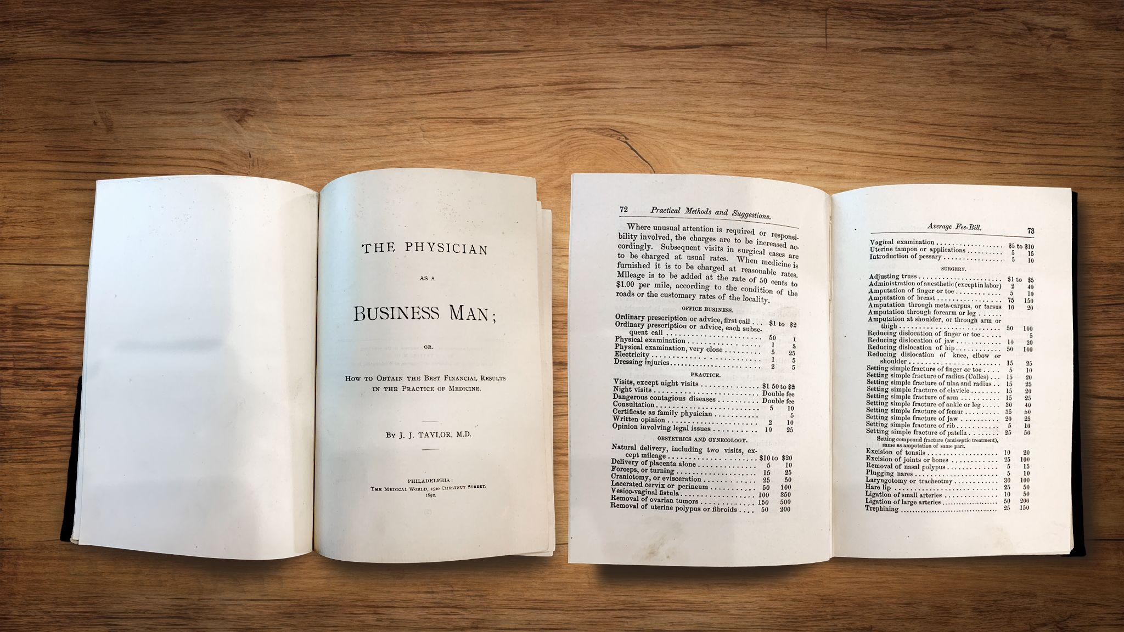
Fee Schedules Have Been Around
Since the 19th Century
The Physician as
a Business Man
J.J. Taylor, M.D.
1892

Slide 3

RBRVS Study in the 1980s
Notes:
1985-88 3 yr study at Harvard led by Bill Hsiao – empirical data on what resources are needed to provide care. Never clear this was meant or fully encompassed primary care.
1989-92 implementation into CMS

Slide 4
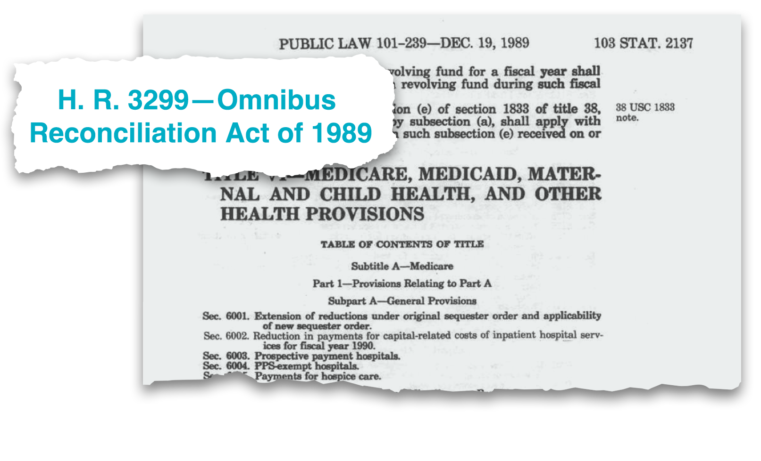
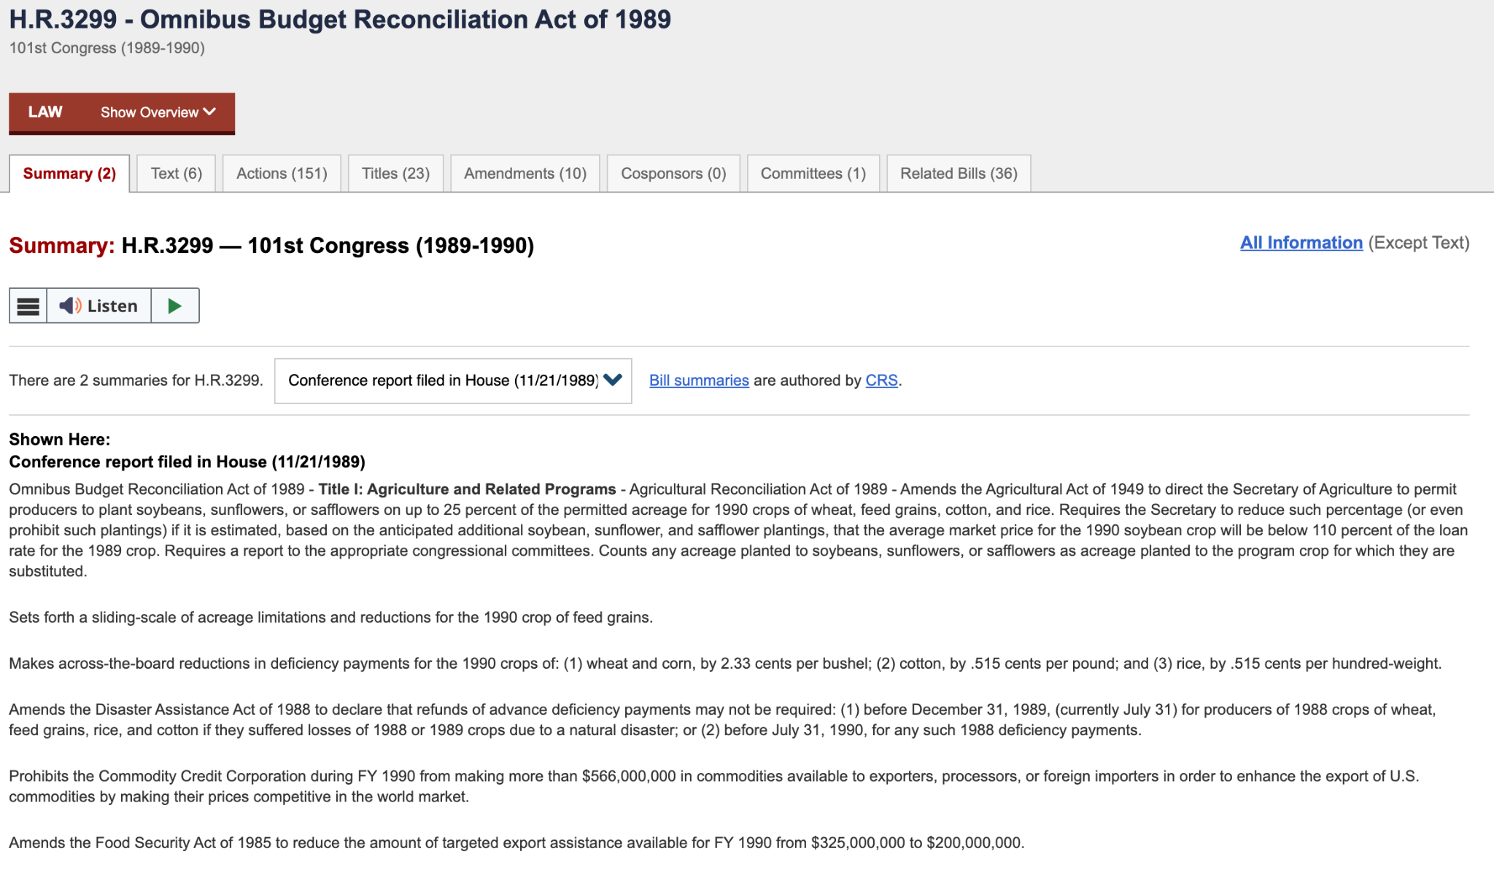
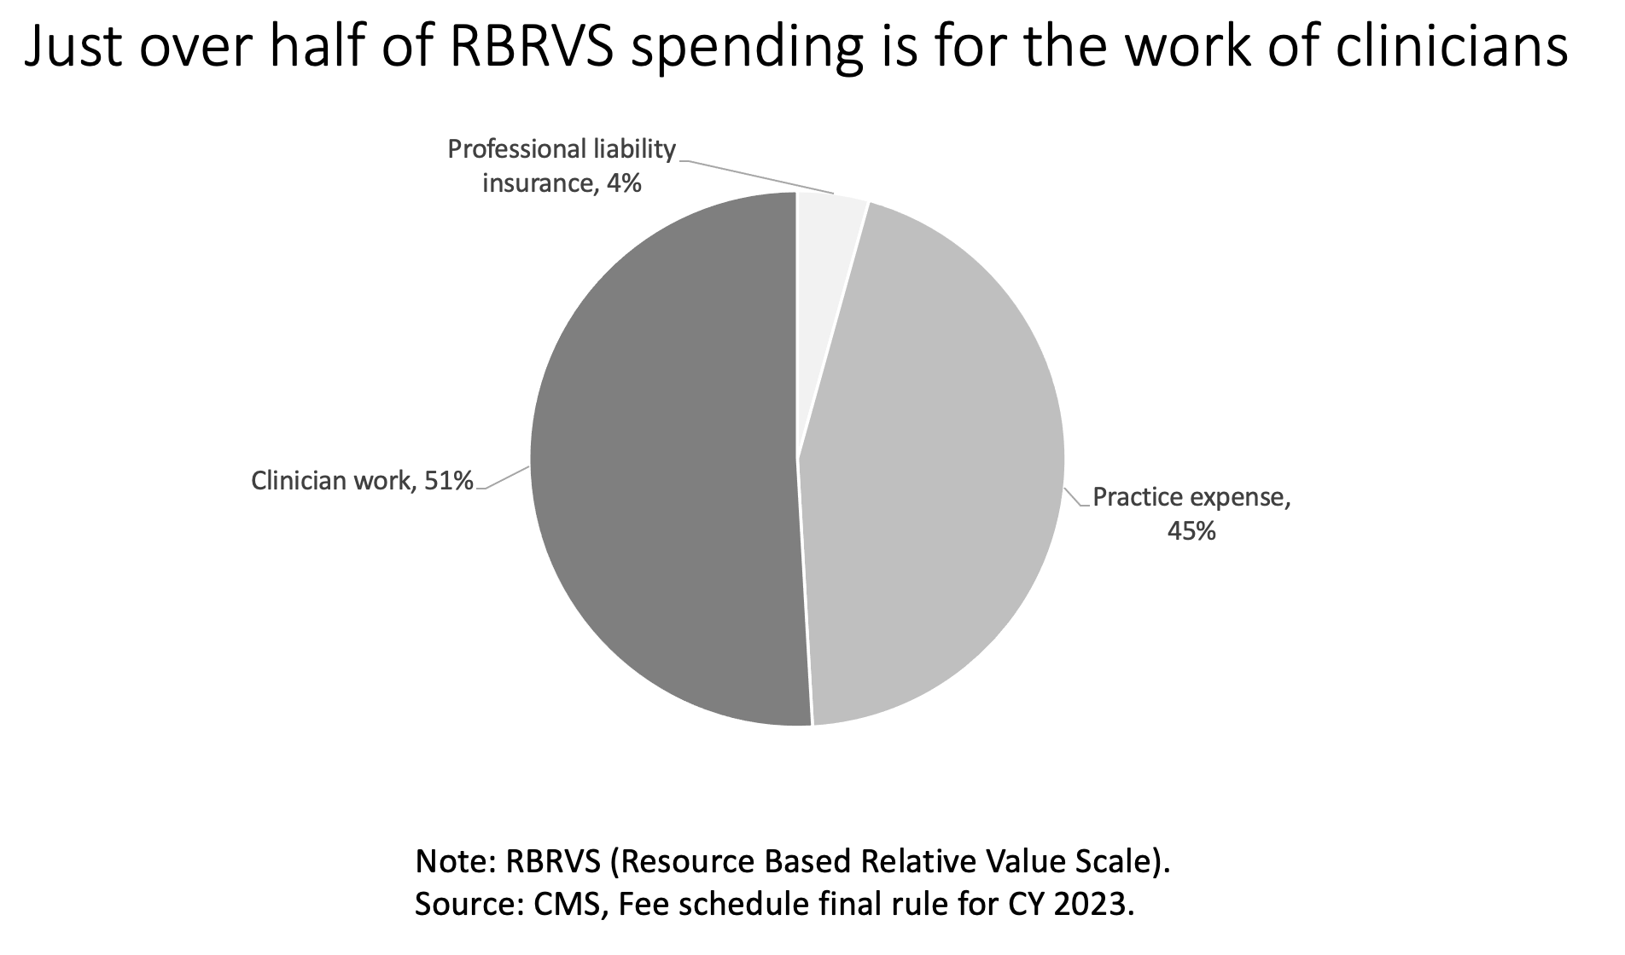
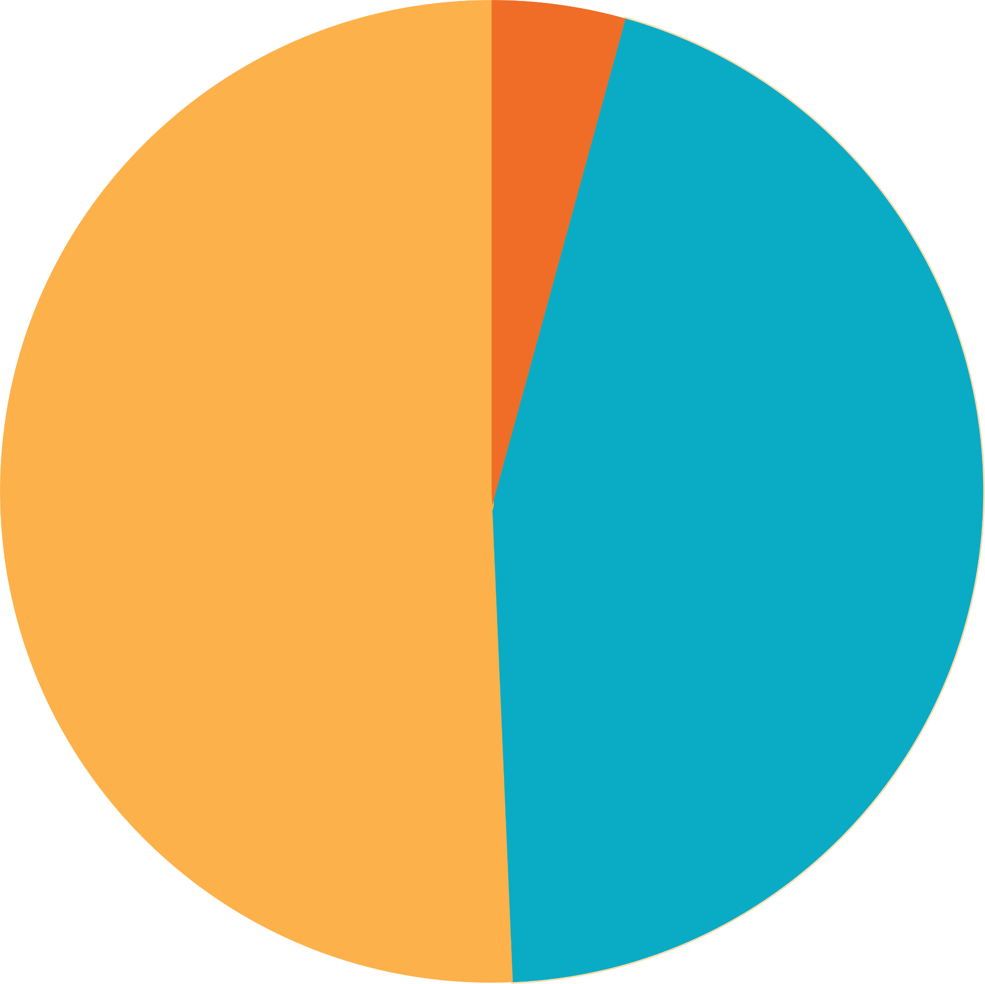
OBRA 1989
New payment system codifying fee schedule:
Relative Physician work (using RBRVS)
Practice Expense
Professional Liability
Just over half of RBRVS spending is for the work
of clinicians
Professional
liability
insurance
4%
Clinician work
51%
Practice
expense,
45%
Note: RBRVS (Resource Based Relative Value Scale). Source: CMS, Fee schedule final rule for CY 2023.

Slide 5
Medicare Physician Fee Schedule (MPFS)
>9,000 CODES
Mostly CPT
(level 1)
Some CMS level 2
Together form overall Healthcare Common Procedure Coding System (HCPCS)
Located in Medicare Part B
$93 Billion / year
Vast majority of fees are for single service, a few are care bundles.
Medicare pays 80% and Individuals (usually coinsurance) pay 20%
Any updates or changes must be cost neutral

Slide 6
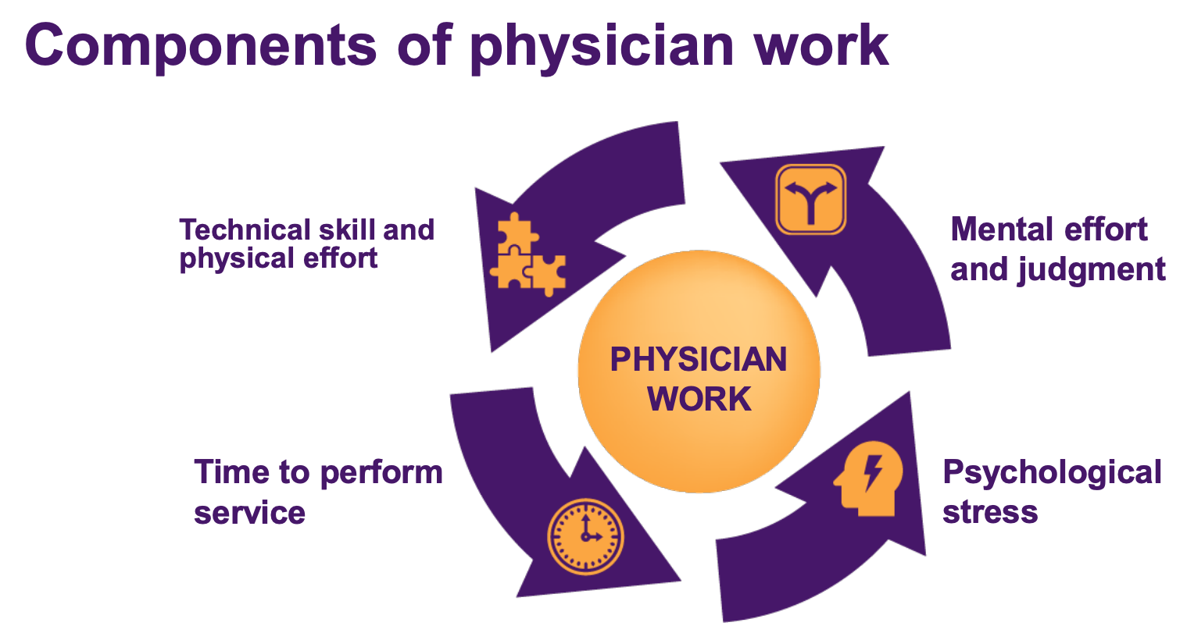
MPFS Continued
Fee Schedule attempts to value clinical work = time and intensity
Relative value of services are not based on:
  necessity of the service
  quality of the service
  health outcomes from the service
https://www.ama-assn.org/system/files/rbrvs-ruc-process.pdf
Notes:
SOURCE: https://www.finance.senate.gov/imo/media/doc/051723_phys_payment_cc_white_paper.pdf
SOURCE: https://www.ama-assn.org/system/files/rbrvs-ruc-process.pdf

Slide 7


The Relative Value Scale Update Committee (RUC)
AMA committee comprised of 32 members
22 are appointed by major specialty societies
Only 4 represent primary care
CMS requires a process to create the fee schedule, per OBRA
RUC reviews new and existing procedural codes to (re)determine their relative value
The relevant specialty societies propose and advocate for a relative value for each code based on survey data from the societies’ members
Source: https://www.ama-assn.org/about/rvs-update-committee-ruc/composition-rvs-update-committee-ruc
Notes:
Source: https://www.ama-assn.org/about/rvs-update-committee-ruc/composition-rvs-update-committee-ruc

Slide 8


The Relative Value Scale Update Committee (RUC)
Center for Medicare reviews recommendations, historically approving 87% of them.
Some years, the acceptance rate is as high as 95%.
⅔
majority
Any relative value with at least a two-thirds majority is passed on to CMS as a recommendation, cognizant of budget neutrality.
The committee votes on each code’s relative value

Slide 9
The effects of the RUC reach far beyond Medicare’s Fee Schedule
Medicare Advantage, Medicaid Managed Care, and most Commercial insurers use the MPFS to determine fees
Notes:
Consider adding something about our value proposition here. What we’re saying that’s new is the relative emphasis on design and test. Consider moving this sentence elsewhere in the slide.

Slide 10




Documented Concerns With The RUC Process
Distortions of time/intensity of work - valuation not based on need or utility, solely on work | Bias toward procedures and expensive therapeutics over relationships, coordination, and diagnosis | Specialty/Primary care imbalance on committee | Data problems - survey concerns and lack of unbiased empirical data
Notes:
Effort > Effect

Slide 11





Policy Challenges
Potential for Regulatory Capture | Incomplete transparency on key area of payment policy | Entrenching paucity of payment for primary care | Major challenges paying for interprofessional teams to care for communities | Insufficient form, level, and flow of funds to primary care
Notes:
Reg Capture – Professional interest over public interest at large

Slide 12


Primary Care Faces a Broken Production Model
20th Century Payment
21st Century Primary Care
Notes:
Effort > Effect

Slide 13

A Problem With the Distribution of Money
Notes:
Effort > Effect

Slide 14
Doing the Math
You can’t run an
Advanced Primary Care
practice on FFS…

Slide 15
Prospective Payment is Necessary
Threshold effect at about 63% of payment through prospective capitated payment

Slide 16
A Way Forward for Payment
Notes:
Effort > Effect

Slide 17

Possible Primary Care Futures
“Devolution”
Retail / Virtual / Urgent Care clinics
Concierge care + Segmentation
Widespread access/equity pitfalls
“Evolution”
Patient-Centered Medical Home next steps – high variation & continued new market entrants to fill gaps left by workforce shortage and high needs
Incremental payment reform on FFS chassis using electronic quality measures
“Revolution”
Advanced Integrated Primary Care Teams Through Payment Reform and Care Model Innovation, Addressing Population Health & Social Drivers of Health
Measure What Actually Matters / Better IT + AI / Prospective Risk-Adjusted Global Payment
Notes:
Effort > Effect

Slide 18
Proposition: The Demise of Primary Care Has Been Too Often and Erroneously Foretold….
There are proximal tipping points that can supercharge the ability to deliver better primary care
  Prospective Payment
  AI / EHR reform
Every high-performing health system in the US and the world has a strong primary care foundation
People (and companies, and some countries) will pay for high-quality primary care when they know they will get it (i.e. concierge, PE, employer-based)
There are medium term shifts in workforce composition that can enable teams to care for people
→ What’s the counterfactual to primary care??
Notes:
Effort > Effect

Slide 19
Areas Needing Near-Term Research & Policy Change
1
How can primary care work (especially by integrated teams) be valued differently and adequately?
4
What are effective models that leverage the growing NP/PA workforce better (i.e. networks of care) while prioritizing continuity?
2
5
How to catalyze safe, equitable, and effective uses of AI to create time and space for primary care teams to do more than document?
How to translate and transmit prospective payment into MA and commercial plans?
3
What are effective ways for engaging purchasers to drive primary care investments and payment change?
6
What are the best ways to scale what already works in primary care?
Notes:
Effort > Effect

Slide 20
THANK YOU!
Asaf Bitton MD, MPH
abitton@ariadnelabs.org

