Slide 1
The Impact of Continuity on Outcomes
Bob Phillips
Executive Director, Center for Professionalism & Value in Health Care
American Board of Family Medicine Foundation
Professor, Georgetown and Virginia Commonwealth Universities

Slide 2

The Therapeutic Uses of Ache
Of all the conditions I do see that no one ever taught me about, ache is by far and away the most common…Sometimes people point at it and roar, ‘Fix that—it must be a disease.” Nonetheless, It requires careful midwifery.

Slide 3
58 yo Female, difficult Blood Pressure
Blood pressure and anxiety both difficult to wrangle
  Trials of multiple agents would not reduce blood pressure
  Patient had obvious struggles with anxiety but refused medication
2 years later, reveals that she was sexually abused by her father
  Difficulty with trust (including in me) and had not taken any of the medications offered
  Affecting relationships in her family and huge source of her anxiety

Slide 4
58 yo Female, difficult Blood Pressure
4 years later, able to forgive her father
  Began taking medication, doing yoga and mindfulness practice
  Began exercising, losing weight
  Blood pressure normalized
  “friendly” divorce -- realized she was not a good partner to her spouse
  Cared for her father after he developed dementia until his death
Ache often needs a trusted midwife to get to healing
I’m sure you have similar stories…

Slide 5

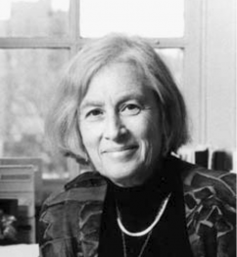
www.starfieldsummit.com
Barbara Starfield, MD MPH (1932 – 2011)
Department of Health Policy and Management of the Johns Hopkins Bloomberg School of Public Health

Slide 6
Primary Care Orientation of Health Systems: Rating Criteria
Practice Characteristics
  First-contact
  Longitudinality (continuity over time)
  Comprehensiveness
  Coordination
  Family-centeredness
  Community orientation
Source: Starfield. Primary Care: Balancing Health Needs, Services, and Technology. Oxford U. Press, 1998.
Starfield 11/02
PC 2367 n
Starfield 11/02
02-406 sc
Notes:
Each country was also rated 0, 1, or 2 with regard to its achievement of the cardinal features of primary care practice. A score of 0 indicates poor achievement of the feature; a score of 1 indicates intermediate achievement, and a score of 2 indicates high achievement of the feature.
First contact is the seeking of care for each newly occurring problem or need from a primary care practitioner rather than a specialist. Longitudinality is person-focused (not disease-focused) relationships over time with the primary care source. Comprehensiveness is the provision, by the primary care source, of services for all health-related needs except those too uncommon in the population for competence to be maintained. Coordination is the integration of care by the primary care source when services outside of primary are required.
Two related characteristics were also rated. Family centeredness is the extent to which services are provided in a family context. Community orientation is the extent to which data on community health needs are taken into account in planning for primary care services.
Source: Starfield B. Primary Care: Balancing Health Needs, Services, and Technology. New York: Oxford University Press, 1998.

Slide 7
“The good physician knows his patient through and through, and his knowledge is bought dearly….the secret of the care of the patient is in caring for the patient.“
Peabody FW. The care of the patient. JAMA 1927; 88:877-882
Peabody FW. The care of the patient. JAMA 1927; 88:877-882
“Continuity is a mechanism to achieve knowledge;
Longitudinality is the mechanism for achieving understanding.”
Barbara Starfield
https://www.annfammed.org/content/1/3/144/tab-e-letters#continuity-and-longitudinality

Slide 8

Continuity_of_Care_Bibliography.pdf (rocketcdn.me)

Slide 9
Importance of Continuity
Significantly lower
  Total costs
  Hospitalizations
  ED Visits
  Overuse of Healthcare
  Mortality
Significantly higher
  Cancer screening
  Childhood health screenings
  Vaccinations
  Medication adherence
  Early disease diagnosis
  Patient Satisfaction
  Physician Satisfaction
True across multiple countries, one of the explanations of why other countries have better health outcomes than we do

Slide 10
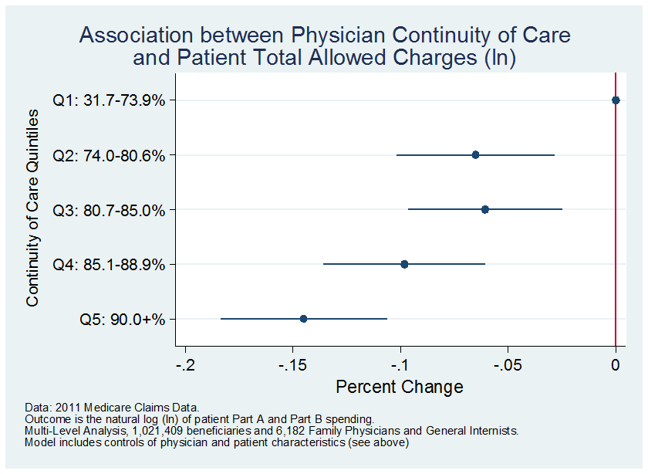
Annals of Family Medicine. 2018;16:492-497
15% ↓ costs
25% ↓ odds hospitalization
See also: BMJ 2017;356:j84
http://dx.doi.org/10.1136/bmj.j84

Slide 11
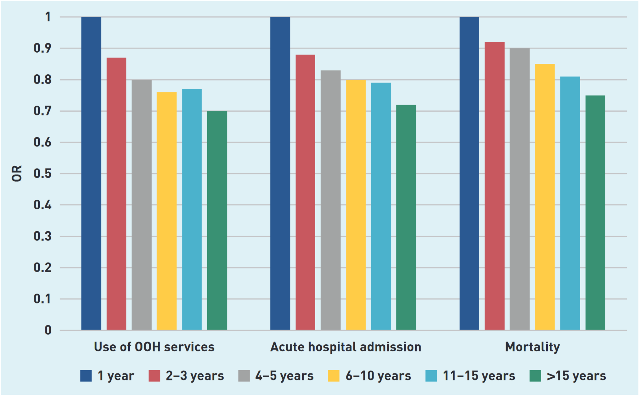
Norway
25% reduction in likelihood of dying this month
http://bjgp.org/content/early/2021/10/04/BJGP.2021.0340.abstract
Longitudinality matters

Slide 12
Basu S, Berkowitz SA, Phillips RL, Bitton A,
Landon BE, Phillips RS. Association of primary care physician supply with population mortality in the
United States, 2005-2015 [published online
February 18, 2019]. JAMA Intern Med.
Primary Care and Mortality
Every 10 additional primary care physicians per 100 000 population was associated with:
  51.5-day increase in life expectancy (county)
  117.3-day increase in life expectancy (Primary Care Service Area)
  Similar to Barbara Starfield’s findings 20 years ago

Slide 13
Technology to Enhance Continuity
If generalist health relationships are a growing scarcity…
If huge swaths of our country, our population don’t or won’t have access…
What is the best use of technology to support & enable existing relationships? Not just access

Slide 14
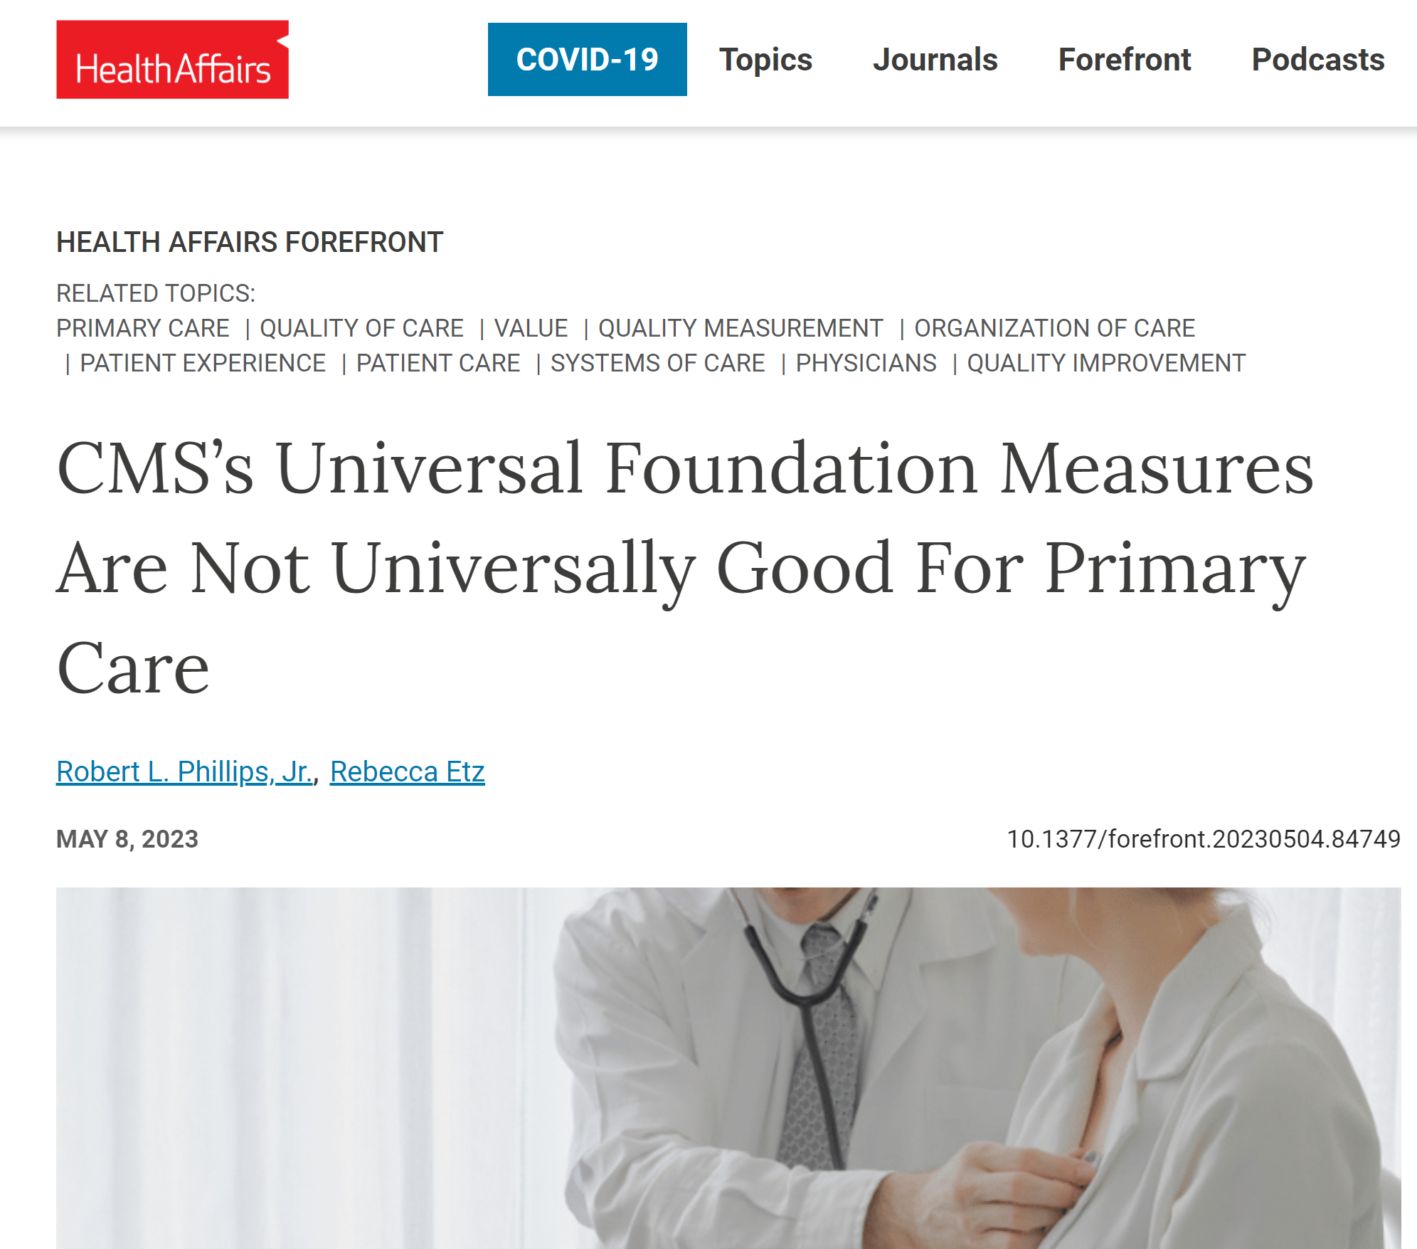
Measures that Matter
Motivational alignment: The NASEM report says that the current measure ecology is a “recipe for burnout, as it pits professional motivation against financial reality and time pressures. Measurement needs to be meaningful to those who deliver care and efforts to reduce measurement burden must be accompanied by efforts to increase the relevance of measures to domains of care that affect person-centered and community health outcomes.

Slide 15
Why is it important to champion continuity?
Allows competing measures: My health system nearly created a quality measure “Number of new visits per month”
Prioritizing for training: Preparing the next generation
Implementing Continuity: CMS has refused to adopt continuity for 4 years, but Covered California is adopting
More likely a systems issue than a clinician issue
  Need system level measurement and prioritization
  Need advocacy tools for clinicians to use in systems
ABFM currently measuring for all Diplomates possible

Slide 16
Going Nationwide
Sufficient Medicare data to measure Continuity for 64,000 Diplomates
Goal to rank Health Systems, however 58% are NOT in a Health System!
Rank | Health System Name | Number of Diplomates
1 | Kaiser Permanente | 2632
2 | Catholic Health Initiatives | 827
3 | Trinity Health | 695
4 | Ascension Health | 590
5 | Sutter Health | 579
6 | Mercy Health | 496
7 | Carolinas HealthCare System | 447
8 | Allina Health System | 424
9 | Baylor Scott and White Health | 405
10 | HealthPartners, Inc | 366

