Slide 1

family medicine thrives with team support
- a story of an Aledade
ACO Practice
Samuel L Church, MD, MPH, FAAFP
Synergy Health, Inc
Hiawassee, GA

Slide 2

Practice Profile

Slide 3
Synergy Health at a glance
  Rural HPSA Practice, service area includes 4 counties
  1 physician, 2 PAs, 2 part-time specialists, ~20 staff
  Medicaid Provider, 80% Medicare, ~2000 patients
  Serve 6 counties for child maltreatment evaluation
  Office and hospital practice, full scope (no OB), house calls
  Medical students and FM residents most of the time
  Work commute ~10 minutes

Slide 4
Value-based care Journey
Notes:
Add quality / value graphic

Slide 5
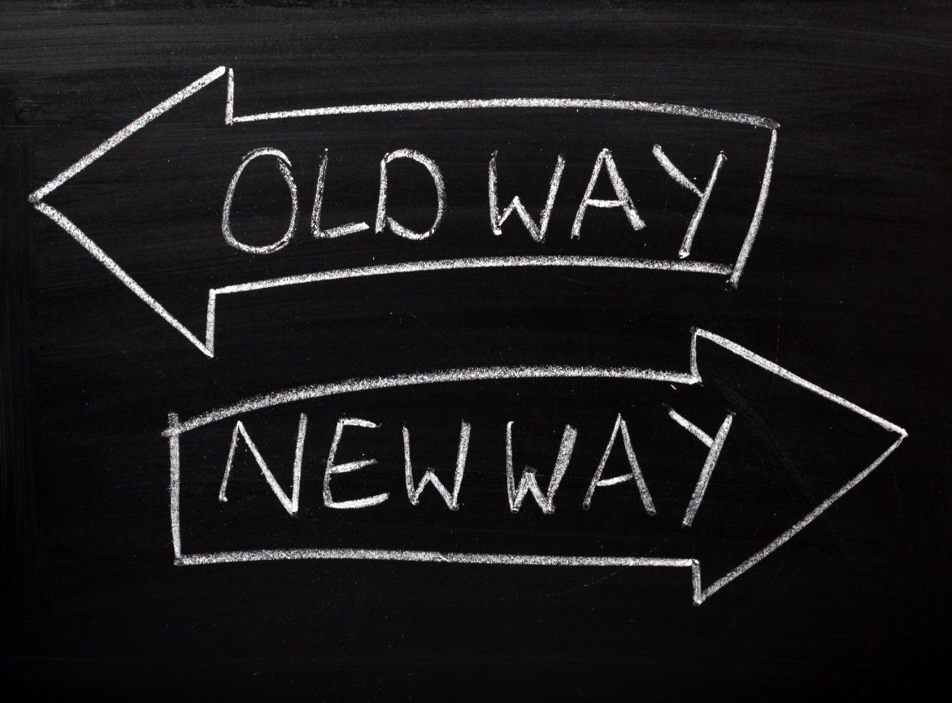
Doctor does most all work
Clerical staff support
Paper Charts
Efficient?
EHR
Expansion of support roles
Incentive/ Penalty based care delivery (eg depression screening)
Scribes, unique workflow
Hospitals expanding footprint
QPP/MACRA
MIPS
PCMH
Chronic Care Management codes
Ongoing practice flexibility
PTN
MIPS Bonus Pessimism
Expansion of team leadership
Quest for data
Aledade
Revealing and improved data
Data driven care
ADT Feeds/HIE
Proactive training for docs and team
Adovacy with CMS
Notes:
Do not go through each list….
That was then….this is now.
My journey through health care delivery in the past 20 years is likely similar to many of yours, so I’m not going to take through the alphabet soup journey of programs and struggles.

Slide 6

Doctor does most all work
Clerical staff support
Paper Charts
Efficient?
EHR
Expansion of support roles
Incentive/ Penalty based care delivery (eg depression screening)
Scribes, unique workflow
Hospitals expanding footprint
QPP/MACRA
MIPS
PCMH
Chronic Care Management codes
Ongoing practice flexibility
PTN
MIPS Bonus Pessimism
Expansion of team leadership
Quest for data
Aledade ACO
Revealing and improved data
Data driven care
ADT Feeds/HIE
Proactive training for docs and team
Adovacy with CMS
Notes:
Data feed – makes patient behavior more transparent, charges and payments from other resources known (eg home health)

Slide 7
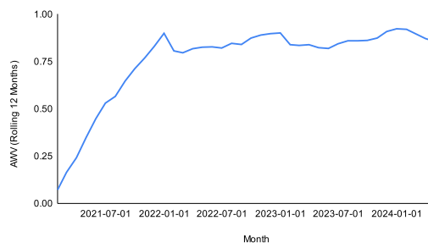
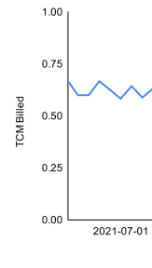
Aledade Impact….by the numbers
Annual Wellness visits
Transition of Care Visits

Slide 8
Keys Practice to success
Patient Centered
“Patients Before Profit”
Team Leadership
Proper Coding
Operational Partnerships
Utilization Full Training Potential of Staff
Healthy Revenue Cycle
Optimize Processes
Notes:
This features embody PCMH….and more.
And when these features are combined with a growth mindset practice, patients benefit.
And while I may have been an outlier practice in some of these areas, Aledade has augmented my practice in every one of these areas. And there is an intentional effort for practices and their teams to be coached in all of these areas. This slide is from me, not Aledade. It is way of trying to articulate how far reaching their impact is on my practice.
Proper Coding
CPT and ICD 10
Team Leadership
It sets the tone for everything
Operational Partnerships
Data and Support impossible alone, poorly done with hospital systems
Utilization Full Training Potential of Staff
Leverage of New Processes
A healthy revenue cycle enables competitive pay and attracts top talent.
I’d like to share with you a few other specifics on how this is happening…..SLIDE CHANGE

Slide 9
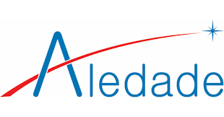
Summary of Aledade support
Patients
Physician
Practice
Expanded outreach programs
Education / resource support
Improved communication
Targeted education by peers, regularly
Support not control by team
Patient-centered outcome emphasis
Valued
High value data analysis / AI Power
Regular staff training
Expanded staff support
Workflow guidance/support
Ongoing program expansion
Dramatic revenue stream unlock
Notes:
Communication –
Sometimes we know about patient discharges before the get home !!!
4. Some programs such as SW / IRIS Healthcare support for advance directives and customized support for patients identified at high risk for renal
Hiring posting / temp workers during staffing strains or if needed for outreach campaigns

Slide 10
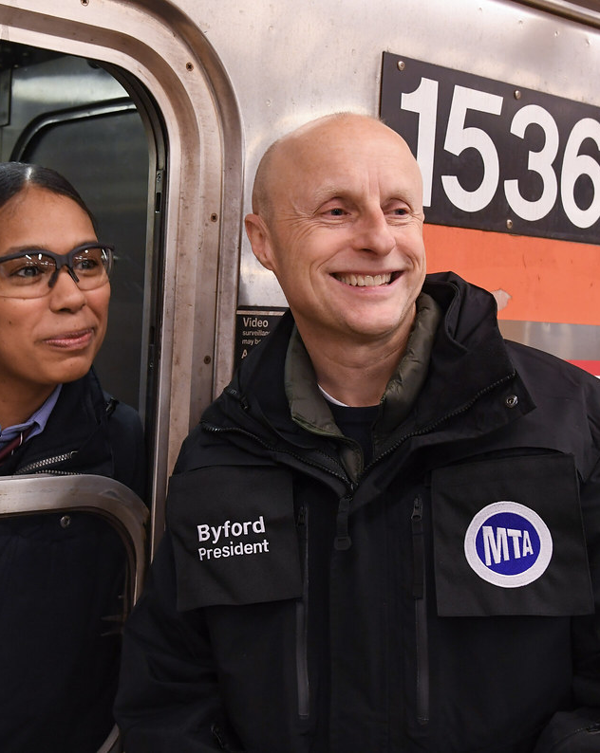
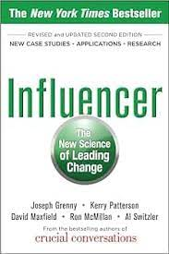
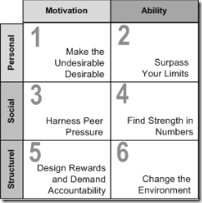
Become a “train Daddy” for Medicine
Notes:
In closing, I’d like to pull some of this together and encourage everyone in this room to be part of something bigger….Not because it’s the right thing to do. But because you are among some of the few people who are equipped to do this bigger thing….of influencing the future. Of setting the stage for family physicians to fill the role of THE LEADERS of the medical home and team. We are at a critical juncture to influence this….and that influence must occur at every level..
Oh….and there are many barriers to affect the change we need for our patients, but partners like Aledade are critical as we seek to influence our patients, our leaders, and our physicians.
We must embrace this role as leaders and change agents….all of the time, no matter your current or future role in medicine.
. And if done well, we will have the resources to move this along. The system, which includes us, disables many of the young physicians….rather than equipping and empowering them.
We need to be a bit like this guy…. This is Andy Byford
Andy Byford ; former Commissioner of Transport for London and now serving as executive vice president in charge of high-speed rail for Amtrak on 10 April 2023.
He’s also known as “the train daddy.” All who come across family physicians, when confronted with a healthcare solution to solve, should think of us as the “Medicine Mama’s and Daddy’s.” The go to. Aledade and similar systems support family physicians in this work. But we need to continue intentionally equipping our next generation, not just with administrative support, but with expanded expertise in the broadening definition of healthcare. The more we narrow our scope of work, the more we cripple our specialty and influence, but more importantly, confine the approach to healthcare delivery evolution to managers and non-family medicine/holistic approaches.
What's next ? leadership training, well trained scribes for all, integration of AI, expansion of scope, better CPT coding (and easier)/leverage of proven workflows improve outcomes and revenues (BP log review, care
management, more).....advocacy -- for the right things that will drive change in primary care delivery and workforce.
I don’t know what’s next, but I do know the we need to be the ones leading the way.
What's next ? leadership training, well trained scribes for all, integration of AI, expansion of scope, better CPT coding (and easier)/leverage of proven workflows improve outcomes and revenues (BP log review, care
management, more).....advocacy -- for the right things that will drive change in primary care delivery and workforce.
Thank you for your time and I look forward to partnering with you.

Slide 11
THANK YOU
Samuel L Church, MD, MPH, CPC-I, CRC, FAAFP
706.835.8962 c
schurch@synergymd.org

