Slide 2
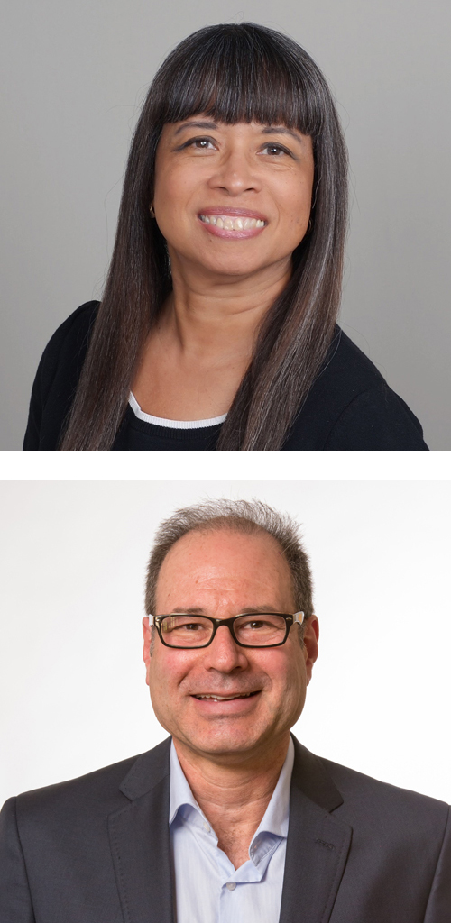
Embracing Every Voice: Creating a Culture of Inclusivity in Interprofessional Settings
Kathryn Fraser, PhD; Halifax Health FMR Jeffrey Ring, PhD

Slide 3
Embracing Every Voice: Creating a Culture of Inclusivity in Interprofessional Settings
Kathryn Fraser, PhD and Jeffrey Ring, PhD
STFM Conference on Practice and Quality Improvement 2024

Slide 4
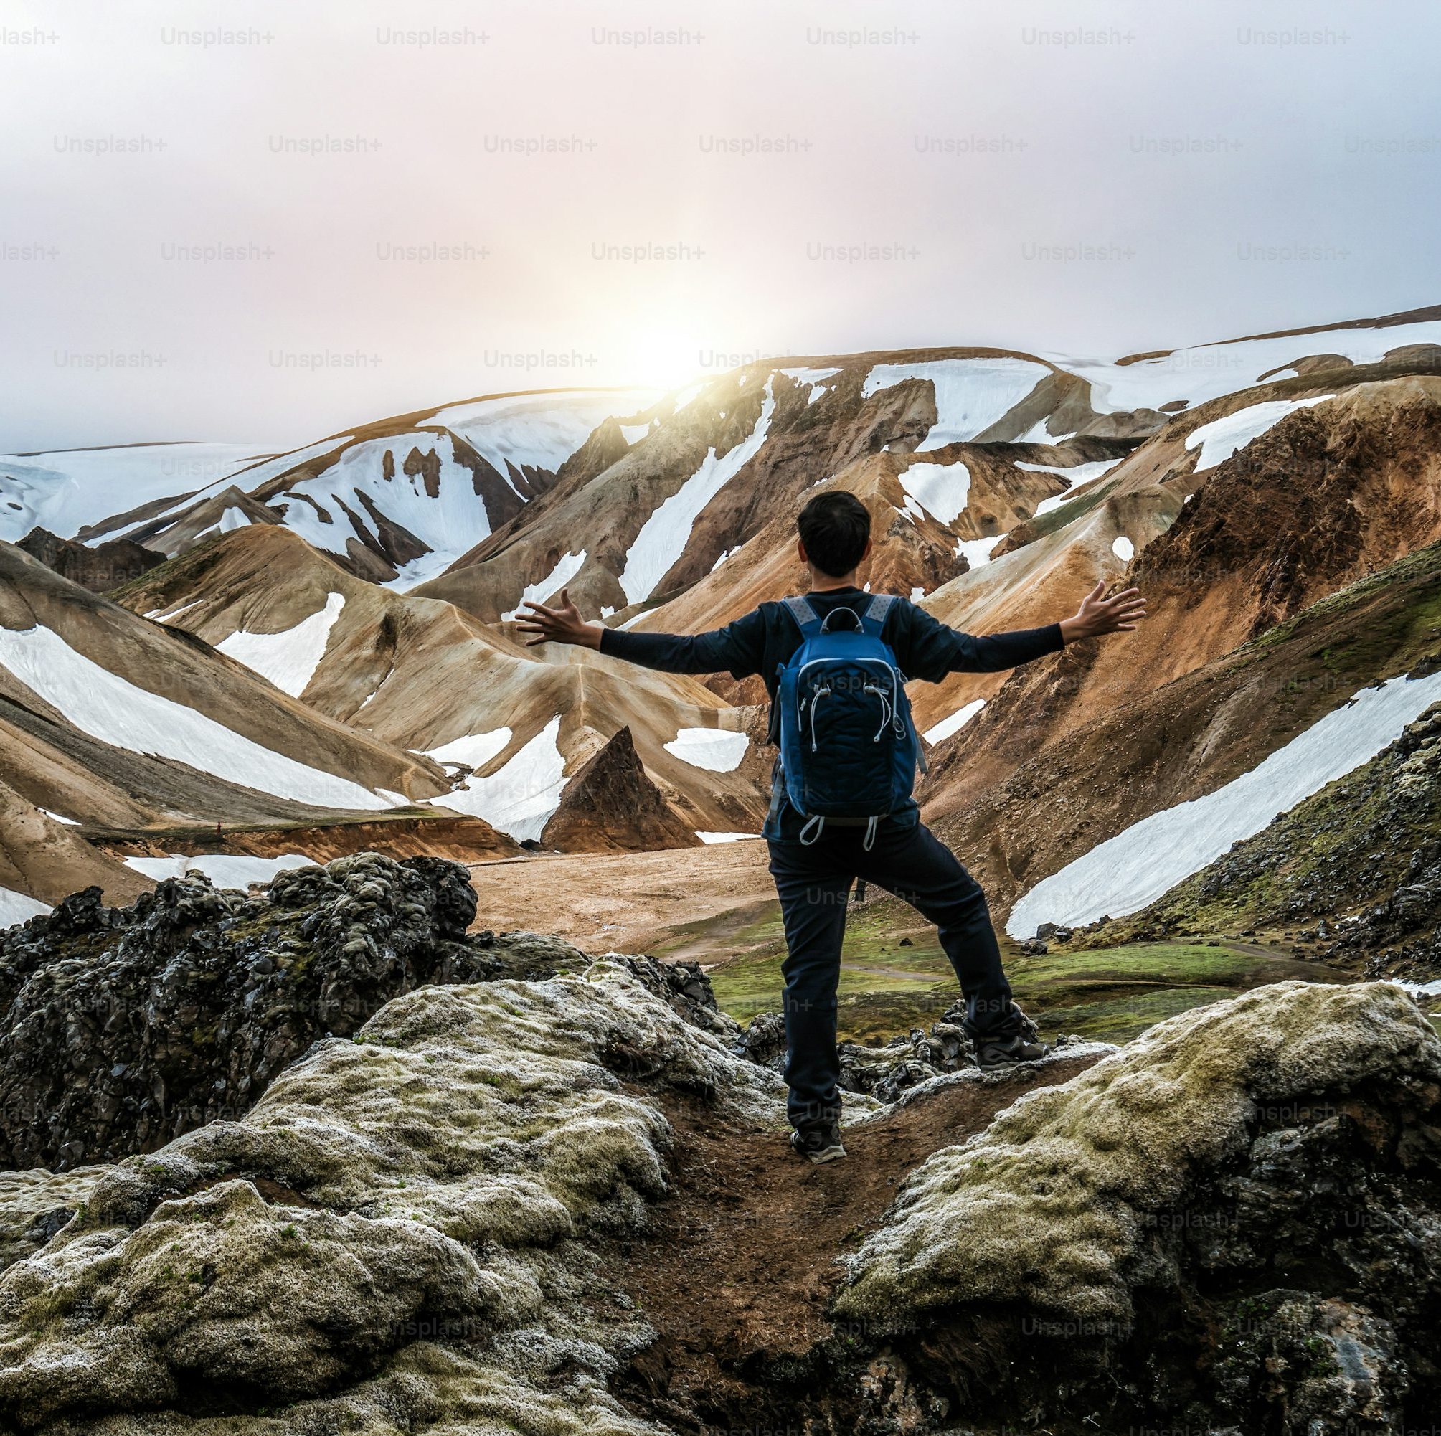
No Disclosures

Slide 5
Objectives
Identify ways that interdisciplinary work groups can enhance productivity, innovation and effective patient care
1
Describe common challenges that interdisciplinary teams face through a lens of equity and inclusion
2
Effectively harness self-reflection to create enhanced communication and collaborations that will benefit their organizations
3

Slide 6
A Jeff and Kathryn conversation
What are indicators of successful inclusive interprofessional team?
What are the barriers to building successful interdisciplinary teams in medical education?

Slide 8
Fostering Interprofessional Collaboration in Health Care
Medicine is steeped in hierarchy and inequity.
We are challenged to bring people together across disciplines.
Trust, vulnerability and psychological safety are core.
Fostering inclusivity can help get through biases and blind spots.
Goal: develop equitable ways of working that maximize everyone’s skills and talents.

Slide 9
Fostering Interprofessional Collaboration
Fostering collective capability (Soubhi, 2009)
Ability of group of professionals to balance 2 interdependent levels of organization of practice
What professionals know
What they collectively do over time

Slide 10
Developing an inclusive environment
Inclusivity promotes success and helps organizations thrive.
Exclusivity promotes stagnation, lack of growth and divisiveness.
Organizations should be intentional when teaching interprofessional teams to work to their highest potential.
Team members should
actively listen to diverse perspectives
share their own experiences
engage in collaborative discussions and practices

Slide 11
Valuing diversity (Straatman, 2023)
Recognize differences between people
Acknowledge differences as a valued asset
View diverse representation as critical step towards equity
Create a home for each person—don’t just let them in, help them feel comfortable

Slide 12
Data on value of diversity https://greatergood.berkeley.edu/article/item/how_diversity_makes_us_smarter
“being with similar others leads us to think we all hold the same information and share the same perspective.” (Neale and Northcraft 2006)
“When a black person presented a dissenting perspective to a group of whites, the perspective was perceived as more novel and led to broader thinking and consideration of alternatives than when a white person introduced that same dissenting perspective.” (Antonio 2004)

Slide 13
Data on value of diversity https://greatergood.berkeley.edu/article/item/how_diversity_makes_us_smarter
“They found that papers written by diverse groups receive more citations and have higher impact factors than papers written by people from the same ethnic group.” (Freeman and Huang, 2014; n=1.5M)
“Sommers composed the six-person juries with either all white jurors or four white and two black jurors. As you might expect, the diverse juries were better at considering case facts, made fewer errors recalling relevant information, and displayed a greater openness to discussing the role of race in the case.” (2006)

Slide 14
Strategies/Best practices
Humility
Grace
Power shifting
Move outside of comfort zone
Emotional intelligence
Systems perspective
Strive for systemic change

Slide 15
Final conversations…
“Why be a star when you can make a constellation?”
Mariam Kaba.
kathryn.fraser@halifax.org
ring4jeff@gmail.com

Slide 16
Evaluation
Please be sure to complete an evaluation for this presentation.

Slide 17
Thank You
Click to edit

