Slide 1
Rural and Metro Physician Associate Programs
University of Minnesota Medical School
Creating a longitudinal integrated curricula that puts family medicine in the driver's seat
Kirby Clark MD
Director RPAP/MetroPAP
Faculty St. John’s Family Medicine Residency Program

Slide 2
Rural/Metro Physician Associate Program
RPAP was founded in 1971 as a collaboration between the Minnesota legislature and University of Minnesota Medical School
Pioneer in longitudinal medical education
9-month clinical learning course for 3rd year medical students across Minnesota rural and urban underserved clinics and hospitals
Fulfills a majority of students’ graduation requirements - family medicine, surgery, emergency medicine, psychiatry, pediatrics, and obstetrics/gynecology
MetroPAP started in 2010 - urban underserved locations - same platform

Slide 3
Rural/Metro Physician Associate Program
Over 1800 students have graduated from the programs, and ~300 over the past 8 years
In 2018 added 3 medical specialty clerkships to portfolio- psychiatry, pediatrics and obstetrics/gynecology
“Care Gap Curriculum”, pivots annually, longitudinal training in:
  mental health
  addiction medicine/safe prescribing
  neurological care
  POCUS 2024 + Geriatrics 2024
Added course training in procedures with an eye toward rural access to surgical services
Past 5 years RPAP/MetroPAP has substantially expanded its network of rural training sites throughout the state and fosters partnerships with a breadth of large and small healthcare organizations

Slide 4
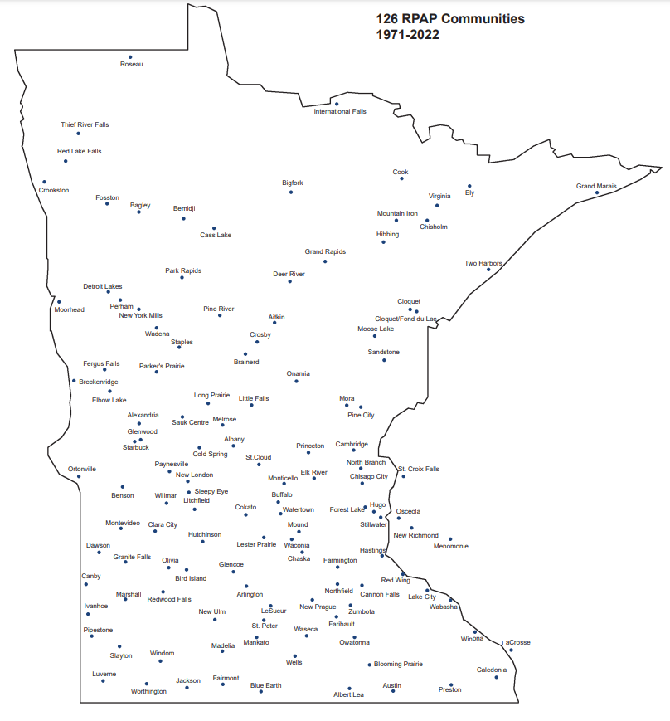
Communities
–Strong, FM represented organizations part of the medical education continuum

Slide 5
Workforce Outcomes
Internationally recognized medical education program that models return on investment - rates rate much higher than statistically matched University of Minnesota students who do not participate in the program for:
  In-state practice
  Rural Practice
  Primary care
“Care Gap”/Scope of practice influence– addiction medicine
  Compared to classmates in a traditional curriculum, program participants reported significantly higher self-perceived ability managing addiction concerns upon completing the longitudinal curriculum
  Fam Med. 2023 Jul;55(7):476-480. doi: 10.22454/FamMed.2023.234746. Epub 2023 May 31.
Impact Over 3 Years of a Family Medicine-led Addiction Medicine Curriculum for Medical Students

Slide 6
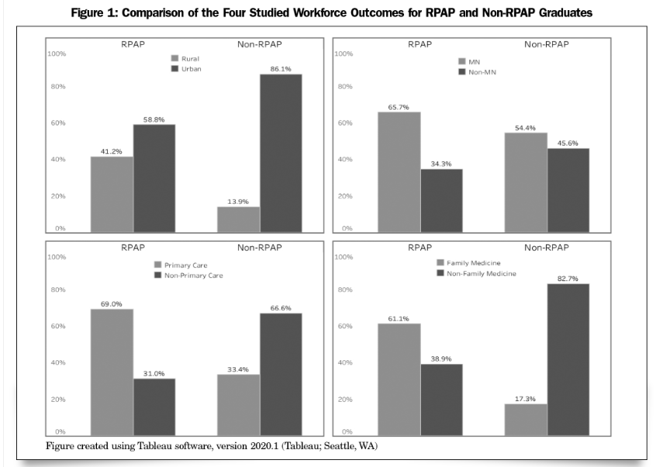
https://journals.stfm.org/familymedicine/2021/november-december/butler-2020-0520/

Slide 7
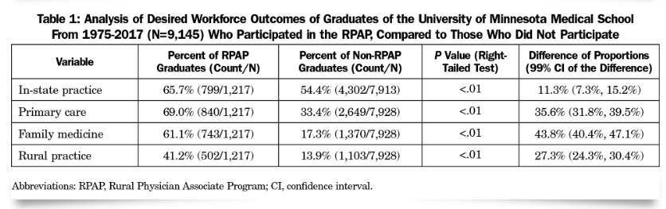
https://journals.stfm.org/familymedicine/2021/november-december/butler-2020-0520/

Slide 8
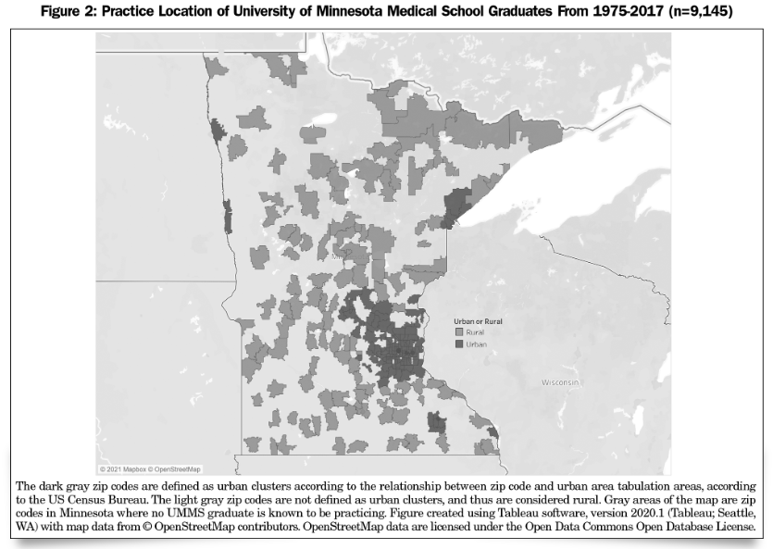
https://journals.stfm.org/familymedicine/2021/november-december/butler-2020-0520/

Slide 9
Residency Match Statistics - Five Year Average
100% Matched into preferred specialty
92% Matched into one of their top 3 residency programs
98% of participants highly recommend the program
74% Matched into a “primary care” specialty*
*family medicine, internal medicine, pediatrics, medicine-pediatrics
53% Matched into the specialty of family medicine

Slide 10
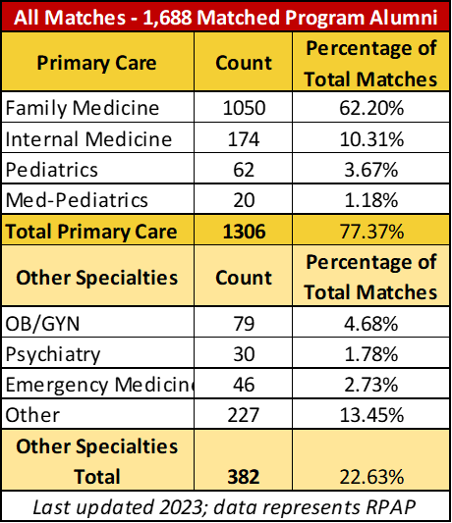
Residency & Practice Statistics
RPAP graduates have matched into:
Family Medicine
Internal Medicine
Pediatrics
Medicine-Pediatrics
Surgery (General & Sub-specialist)
OB/GYN
Psychiatry
Emergency Medicine
Anesthesiology
Dermatology
Neurology
Ophthalmology
Orthopedics
Otolaryngology
Pathology
Physical Medicine
Radiology
Urology

Slide 11
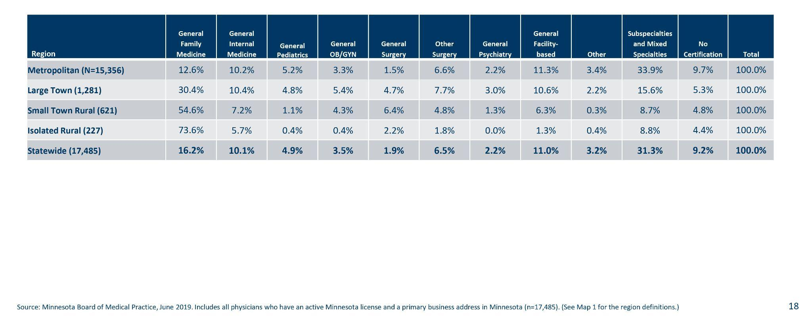
Physicians by medical specialty and RUCA
RUCA = Rural-Urban Commuting Area Codes

Slide 12
Recommendations
Hear and amplify the voice and scope of practice needs of communities
Recruit inspiring family physicians to form longitudinal relationships with students
Cultivate authentic patient care roles for students
Inspire conversations between community members and medical school leaders/lawmakers
Build an inclusive curricular tent that invites all future family physicians AND future family physician advocates (who end up in a different specialty)

