Slide 1
Collaborative
Maternal Child Healthcare
Our journey at
Boston Medical Center and Boston HealthNet
Charles Telfer Williams, MD
Vice Chair, BUMC Dep’t of Family Medicine
Medical Director, Boston HealthNet
Family Medicine Leadership Consortium
16 August 2024 – Washington, DC

Slide 2

Notes:
Mention the other golden rule “those with the gold make the rules” and the “platinum rule – do onto others as they would have you do unto themselves” In other words ask people and listen.
Preamble
United Nations –
Norman Rockwell “The Golden Rule” painting 1961 (1985 mosaic)
The mosaic, executed in 1985 by Coop Mosaic Artistico Veneziano and made of Murano glass tile, is a representation of Norman Rockwell's painting The Golden Rule, Norman Rockwell had previously made a 10 foot charcoal drawing of "The Golden Rule" for the United Nations. Done during the time of Henry Cabot Lodge the drawing was never finished. In an article entitled, "I Paint the Golden Rule," Rockwell stated, "Like everyone else I am concerned with the world situation and like everyone else, I'd like to contribute something to help. The only way I can contribute is through my pictures. So for a long time I had been trying to think of a subject that might be of some help. Then one day, (I don't know why or how), I suddenly got the idea that the "Golden Rule - Do unto others as You Would Have them Do Unto You: - was the subject I was looking for. Right away I got intensely excited. But how could I picture the Golden Rule? I began to make all sorts of sketches. Then I remembered that down in the cellar of my studio was the ten-foot long charcoal drawing of my United Nations picture, which I had never finished. I hauled it upstairs. In it I had tried to depict all the peoples of the world gathered together. This was just what I wanted to express about the Golden Rule." The charcoal drawing showed the Security Council in session with the peoples of the world behind them. For the people the deliberation of the council could mean peace or war. Rockwell confessed that it was he who failed to complete the painting, "I failed to carry the picture further, not because I had lost faith in the UN, but because I had lost confidence in my ability to express what I wanted to say in the picture." Once he reviewed his original drawing he knew this could be the basis for his painting.
The painting appeared on the April, 1961 cover of the Saturday Evening Post In the upper right-hand corner, the artist inserted a portrait of his late wife, Mary, holding the grandson she never saw. After The Golden Rule appeared as a magazine cover, Rockwell was presented with the Interfaith Award from the National Conference of Christians and Jews, a citation that he treasured.
We've all heard of the Golden Rule, which goes something like this: Do unto others as you would have them do to you. In other words, treat other people--in business and in life--the way you yourself would want to be treated.
Well, Dave Kerpen, author of the book The Art of People, (2016) says that following the Golden Rule is all wrong. Instead, we should follow what he calls the Platinum Rule.
Says Kerpen, "We all grow up learning about the simplicity and power of the Golden Rule: Do unto others as you would want done to you. It's a splendid concept except for one thing: Everyone is different, and the truth is that in many cases what you'd want done to you is different from what your partner, employee, customer, investor, wife, or child would want done to him or her."
So Kerpen came up with the Platinum Rule: Do unto others as they would want done to them. Says Kerpen, "The Golden Rule, as great as it is, has limitations, since all people and all situations are different. When you follow the Platinum Rule, however, you can be sure you're actually doing what the other person wants done and assure yourself of a better outcome."
In his book, Kerpen quotes a story that Dale Carnegie told in his book How to Win Friends and Influence People which illustrates the Platinum Rule:
Personally I am very fond of strawberries and cream, but I have found that for some strange reason, fish prefer worms. So when I went fishing, I didn't think about what I wanted. I thought about what they wanted. I didn't bait the hook with strawberries and cream. Rather, I dangled a worm or grasshopper in front of the fish and said: "Wouldn't you like to have that?"
Asks Kerpen, "Why not use the same common sense when you are fishing for people?“
https://www.inc.com/peter-economy/how-the-platinum-rule-trumps-the-golden-rule-every-time.html (accessed 11/15/2021)
1996 – book - Dr. Tony Alessandra “The Platinum Rule”
https://psiloveyou.xyz/how-to-revitalize-your-relationships-with-the-platinum-rule-1f37e54f3544 (accessed 11/15/2021)
“Treat others the way they want to be treated.”
The Platinum Rule is a total game-changer, so lots of self-hemp gurus have attempted to take credit for it. As far as I can tell, the Platinum Rule actually originated in communication researcher Milton J. Bennett’s 1979 paper Overcoming the Golden Rule: Sympathy and Empathy. He wrote:
“The Golden Rule enjoins us to treat others as we would like to be treated. But inherent in the Rule is an assumption of similarity: that others are like ourselves and therefore want to be treated similarly. Essential similarity implies a single, absolute reality, and such thinking is the foundation of ethnocentrism… To overcome the Golden Rule, we must assume essential differences among people and allow for multiple realities. When we apply these principles to ourselves, it leads us to the communication strategy of empathy, whereby we imaginatively experience the world from another person’s perspective.”
The Golden Rule is self-centered. The Platinum Rule is rooted in empathy.

Slide 3
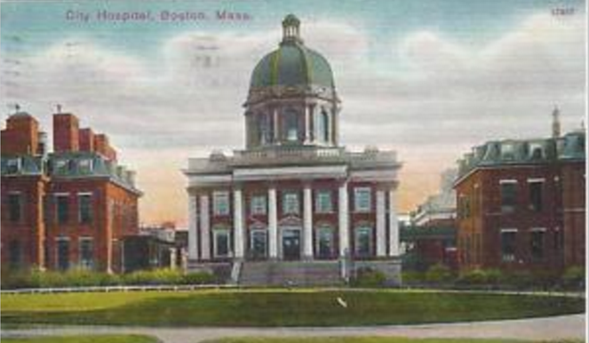

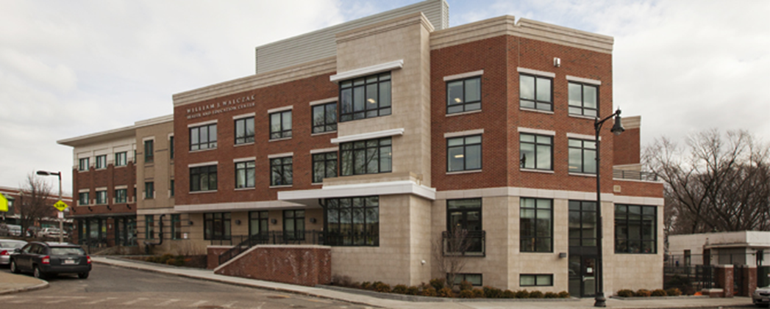
Background
FM Department at BU/BMC- est. 1997
1998 Residency training program
  36 FM and 10 FM/psych
~ 95 faculty
  > 90% provide prenatal care
  L&D faculty= 19 (11 surgical)
  Postpartum dyad service faculty= 18
Boston Medical Center (BMC)
    Private, non-profit, formed in 1996 by a merger of Boston City Hospital (1864) and Boston University Hospital (1855)
    Mission “Exceptional care without exception”.
    New England’s largest safety net hospital where
      70% people of color
      50% live at or below the federal poverty level
      30% primary language not English,
      50% of our Health Plan members have a mental health or substance use disorder.
FM Practices
Boston HealthNet (1994)
9 sites - 6 at FQHCs
5 sites with residents (1 FM/psych)
Total FM Panel ~ 85,000
A health center-controlled network of 12 CHCs, BU and BMC (patient pop 342,275)
Goal: Improve the health and care of our patients and communities
Notes:
Pop 342,275 268, 869 (CHCs) + 73,416 (BMC)
panels 2024
NH 21476 (Dec 2023)
SB 5298
Dot 9590
Cod 9793
Manet 4829
Roslindale 7315
FMMC 9571
BUCR 4727
Total = 82170 + Mattapan
----
Mattapan ? 3500-5000
The Boston University Chobanian & Avedisian School of Medicine was established in 1873 when the University assumed responsibility for the New England Female Medical College. Among its historic distinctions are its commitment to equal education for women and men and the development of the nation’s first academically affiliated Home Medical Service. In more recent decades, the School developed an extensive program of biomedical research based in several major research facilities. Department of Medicine faculty are important contributors to the research programs of the School and are able to take full advantage of the research facilities and core research support centers of the School.
Boston University Medical Center Hospital (BUMCH) was founded in 1855 as the Massachusetts Homeopathic Hospital. In 1910 the Evans Memorial Department of Clinical Research was established by a series of gifts by Mrs. Maria Antoinette Evans to endow a research department of medicine at the Hospital. The Evans Department was one of the few research institutions of its kind when its activities began in 1912. Although technically a separate research institute, the Evans Department has always functioned as an integral part of the clinical care and training programs of Boston Medical Center and of the Department of Medicine at BUSM. This is in accordance with Mrs. Evans’ stipulation that research, clinical care, and teaching should be intimately interrelated in the Department that she endowed.
Boston City Hospital (BCH) opened in 1864 and was the first municipal hospital established in the United States. In 1923 the Thorndike Memorial Laboratory was established with support provided by Dr. George L. Thorndike in memory of his brother, William, a long-time BCH staff member. The Thorndike became one of the nation’s most distinguished research facilities under the aegis of the BCH Harvard Medical Services. In 1968, the Finland Laboratory for Infectious Diseases was established at BCH in honor of Dr. Maxwell Finland, a leading clinical investigator in infectious diseases. When academic and clinical responsibility for BCH passed to Boston University in 1973, these laboratories were incorporated into the research programs of the Department of Medicine faculty.
In July, 1996, BUMCH and BCH were merged into the Boston Medical Center, a not-for-profit institution that fully retains the missions and commitments of its predecessor institutions.
The Boston Veterans Administration Medical Center was the first Dean’s Committee VA hospital, i.e., the first specifically designated as a teaching hospital. It is a major training site for students and residents. In addition, its faculty conduct a varied research program, including active, basic, clinical, and health services research efforts.

Slide 4
Birth of the L&D Collaborative Model (est. 2005)
What were the challenges?
Influx of new OB volume
Concerns due to professional “silos”
  OB: perceived lack of communication
  Midwifery: perceived disrespect and conflict
  FM: insufficient volume of deliveries/procedures to maintain skills
Ineffective communication structures and lack of transparency
Lack of risk stratification:
  Low-risk pregnancies cared for by surgical specialists
  High-risk pregnancy care not always transferred
Principles of Collaborative L&D Team
Team-focused: teams, not individuals
Clarity of Responsibility: clear attending responsible
Citizenship: interactions respectful, focus is on patient
Acceptable case load: no provider overload
Maximizing continuity of care: provider and caregiver team
Frequent communication: all providers and nurses
Good Documentation: clear and consistent
High Efficiency: work to the top of your license
Evidence-Based Care: standardized current best practices
Excellence in Education: all service lines teach all learners (mixed resident team- FM/OB/ED)
Notes:
FM began OB before 1997 and in Oct 1997 DFM started inpatient L&D (24 hr staffing, 365 days/yr)

Slide 5
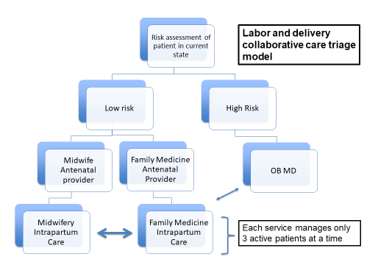
The L&D Collaborative Model
Labor and Delivery staffing
  3 L&D attendings (FM, OBGYN, Certified Nurse Midwife) in-house 24/365
  Interdisciplinary resident team = FM, OBGYN, ED
  9 labor rooms, 5 triage rooms, 2 ORs
Key elements of the model
  Interdisciplinary:
    Teams Training
    Huddles
    Safety Rounds
  Culture of curiosity/inquiry
  Merged billing
Notes:
Text J Pfau
Graphic R Iverson

Slide 6
Collaborative Evolution - Accomplishments
Collaborative practice – principles (2005)
Teams Training (2006)
Simulations
Safety team (reviews safety events and gives updates)
Care bundles – safety best practices
Data driven initiatives (PDSA – variances addressed & update standards)
AY24 Deliveries | Totals | % of Total
Total deliveries | 2963
Spontaneous vaginal | 1790 | 60.41%
Caesarean | 1173 | 39.59%
Pre-term births | 343 | 11.6%
TOLAC | 941 | 31.8%
VBAC Rate | 534 | 18.0%
Notes:
Based on Iverson slide
2006 Based on Crew Resource Management
Ask for information
Offer information
Communicate and confirm proposed actions
Advocacy for the patient and team
Conflict resolution
Simulations
2009 Maternal hemorrhage
2010 Shoulder dystocia
2011 Emergency cesarean
2012 Maternal seizure
2013 Pulmonary embolus
2014 Emergency cesarean
2015 Maternal hemorrhage
2016 Maternal code
2017 Shoulder dystocia
2018 Emergency cesarean
2019 Urgent cesarean
2020 Maternal code
2021 Maternal hemorrhage and hypertension
2022 Dual sims in ED (OB emergency w delivery)
2023 Cesarean timeliness (onboarding)
Safety Team reviews:
Delivery complications: shoulder dystocia, APGAR <7, hemorrhage
Unexpected Neonatal ICU admissions ≥ 36wks for ≥ 24 hours
Review for all complications – on high risk postpartum service
Alliance for Innovation in Maternal Health (AIM, ACOG) bundles
Reduction of Peri-partum Racial and Ethnic Disparities
Hemorrhage
Venous Thromboembolism
Hypertension
Substance Use Disorder
Enhanced Recovery After Surgery
Safe Reduction of Primary Cesarean Birth

Slide 7
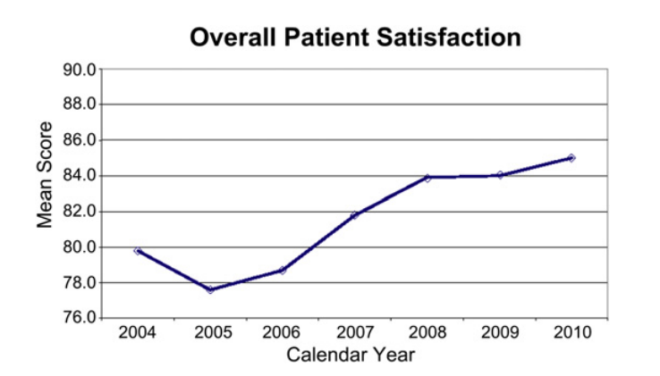
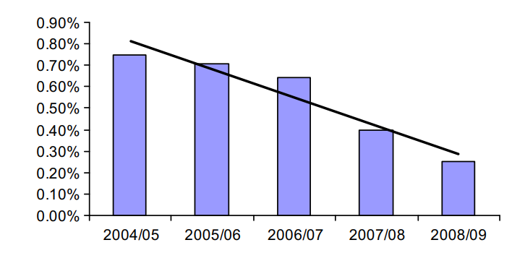
Triple Aim: Improving Care & Reducing Cost
Outcomes
  Decrease in claims data in first years of model implementation
  Low risk births have optimal outcomes
Outcomes
  Improved patient satisfaction scores (Press-Ganey) on L&D during first years after model implementation
Rate of reserved claims per policy year deliveries
Pecci CC, Mottl-Santiago J, Culpepper L, Heffner L, McMahan T, Lee-Parritz A. The birth of a collaborative model: obstetricians, midwives, and family physicians. Obstetrics and Gynecology Clinics. 2012 Sep 1;39(3):323-34.

Slide 8
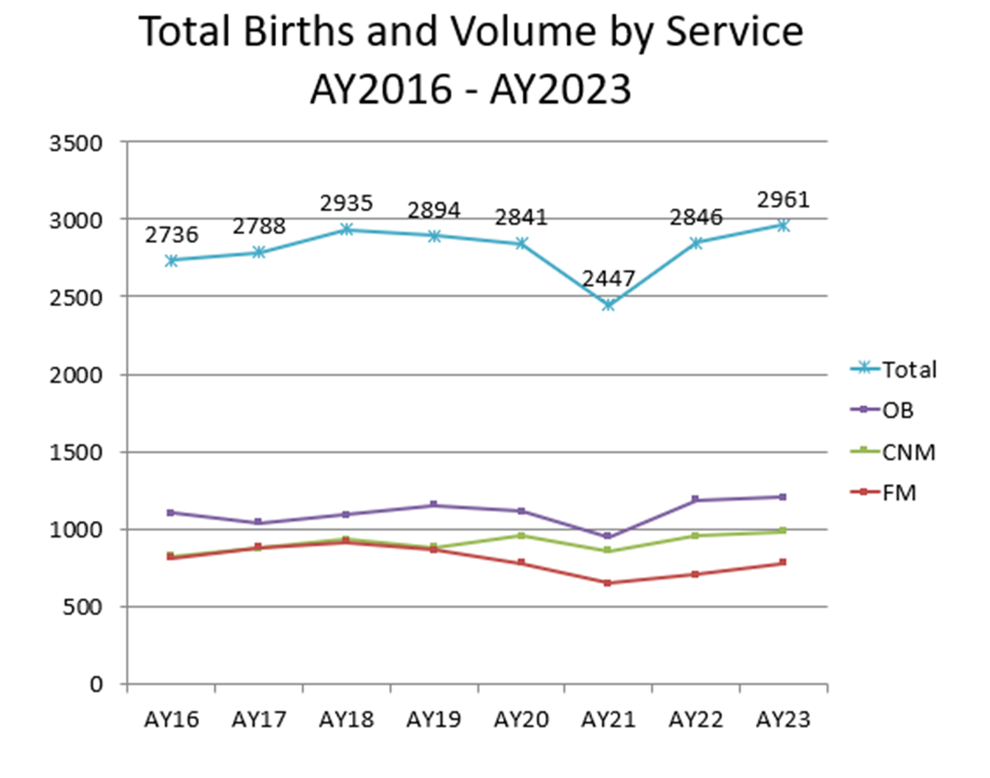
Safety Goals: Balanced Workload
Acceptable case load: Safe care is possible only if providers are responsible for a reasonable number of patients (Principle 4)
Results:
Each service attends approximately 1/3 of the births
Slight challenge in last 2 years with flux of surgical providers in FM and OB
Notes:
avia

Slide 9
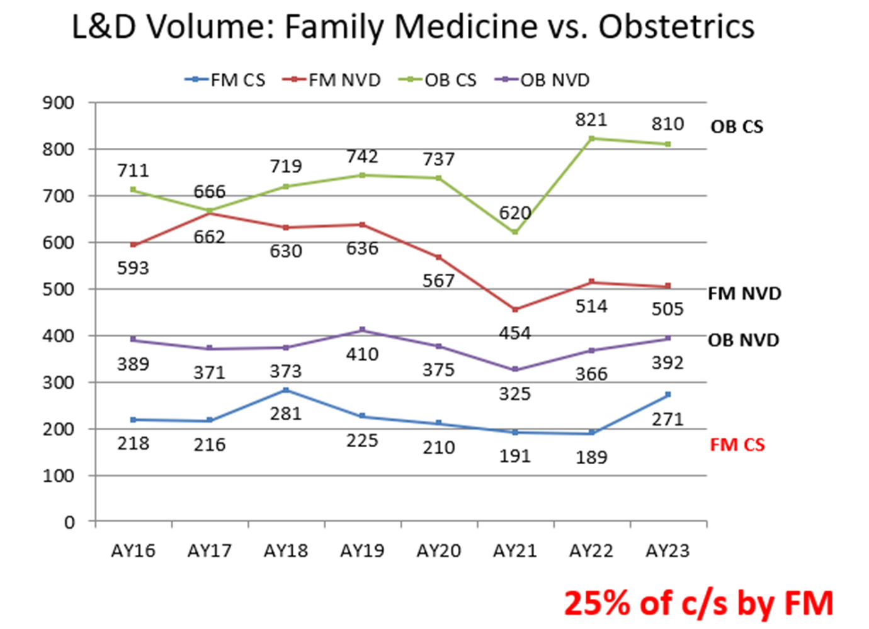
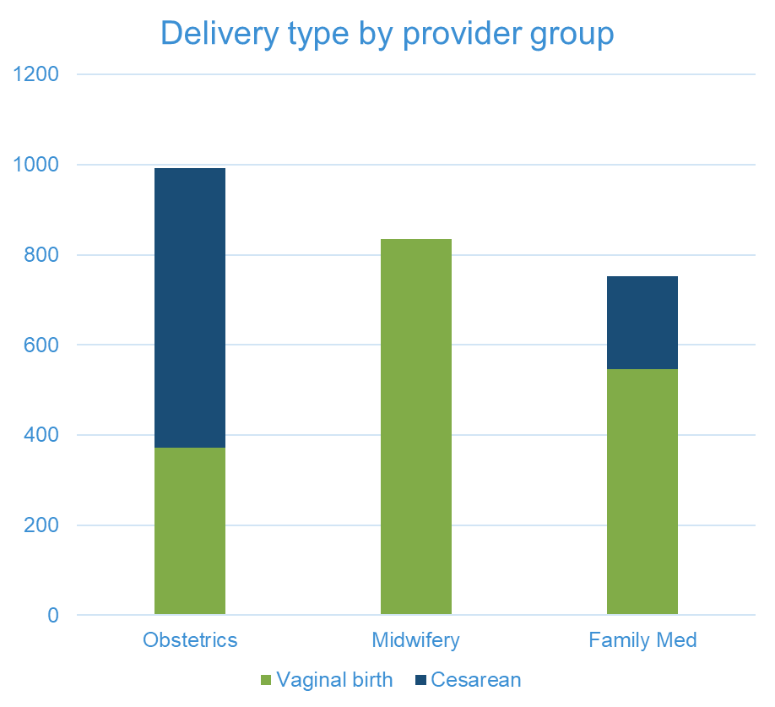
Safety Goals: Efficiency
High Efficiency: All providers should work to the ‘top of their license’ (Principle 8)
Results:
25% of C-sections by FM
~30% of vaginal deliveries by FM
Maintains skills
BUMC Dept OB/GYN delivery data, 2015
Notes:
avia

Slide 10
Outpatient: Systems and Guidelines
System wide: 50% prenatal care at BMC, 50% at one of 11 CHCs
Guidelines: Co-developed by FM with OB/CNM, updated regularly
Trainings: Local practice trainings, Grand Rounds, FM Quality Equity and Safety Rounds (revamped M&M)
Shared care
  FM with OB consulting as needed in outpatient, or MFM consultation/co-management
  FM with APP co-managing prenatal care in primary care practice
  2 FM embedded in some OB clinics including postpartum Bridge Clinic
Care management and oversight
Notes:
Numerous programs to address holistic health needs of low-income patients
Centering group prenatal care
Mobile Unit neighborhood care
Birth Sisters doula program

Slide 11
Maternal Child Health Outcomes
Health Of Boston Reports 1993 - 2021
Metric | Race/ethnicity | 1993 | 2021
Premature Birth | All | 8.8 | 9.2
 | Black/AA | 12.1 | 13.8
Low birth weight | All | 8.9 | 8.4
 | Black/AA | 12.6 | 13.4
Infant mortality | All | 9.3 | 4.6
 | Black/AA | 15.0 | 9.7*
* Statistically significant change began in 2008 to 2009, has been sustained
Notes:
The cause of the decrease is unclear, and we are looking for other factors

Slide 12
Collaborative Onboarding (2022)
Interdisciplinary Onboarding Support Committee (IOSC)
Goals:
1. Early identification of challenges/support opportunities for new providers
2. Decrease variation with introduction of new staff
Methods
Intentional onboarding
  Check list of tasks, assigned mentors, policy review and procedure proctoring
Structured team review
  Interdisciplinary reviews at 1-3-6 months
  Clinical data and anonymous peer surveys reviewed
IOSC Meetings:
Assess:
  clinical skills
  teamwork and citizenship (including respect across disciplines)
  working knowledge of and adherence to policies and procedures
Provide:
  Formative and summative assessment
  Approach which is supportive with a growth mindset
Results
New hire reviews (9/2022 - present)
  FM – 10 (8 operative, 2 non-operative)
  CNM – 7
  OB – 5
~150 peer feedback surveys
Notes:
From J Pfau
Post-pandemic
Recognized need for enhanced onboarding process
Shared goals
Standardization of onboarding experience across disciplines
Increase diversity within our team
Retention of providers
Summer 2022- planning meetings
October 2022- first formal IOSC meeting
Peer Survey 8 items
Clinical management skills
Procedural skills
Respectful communication with patients
Respectful communication with team members across disciplines
Communication reflects awareness of broader systems issues, including obstetric racism and disparities
Teamwork and citizenship skills
Working knowledge of and adherence to policies and procedures
Additional comments (free form)
Number of new L&D hires reviewed by IOSC across disciplines (9/2022 – present)
FM- 9 (7 operative, 2 non-operative)
OB- 5
CNM- 6
130 total peer feedback survey responses
1 more FM- Watler (operative)- 10
1 more CNM- 7
And we are up to around 150 total feedback surveys
We have not yet incorporated new MFM hires- I've been pushing for this, Ron wanted to leave it up to Kate White to decide

Slide 13
Lessons Learned
Be at the table
Get Leadership on board – FM, OB & CNM (NICU and Anesthesia)
Focus on shared goals: patients, safety, improving quality and equity
Take a systems approach and look both upstream (prenatal and preconception) as well as hospital care
Demand quality with a growth mindset
FM key contributions: broader medicine/psych skills, interdisciplinary experience throughout hospital, training for OB residents
Research can grow out of long-term collaboration

Slide 14
Implications – Elements that support FM-OB
Robust flexibility
  Make full scope as available and as possible as possible
  Broader new hires start the better.; very few expand scope of practice later
  Our docs can choose to do 1, 2, or 3 of the big buckets – inpt, outpt, OB (with and without C-section)
  Allow percentage distribution to changes overtime (life, new roles)
Set standards and expectations
Measure outcomes
Intentionality → Collaborative, supportive, structured environment
  Collaborate and develop a structure that is patient-centered and supports physicians
Be reliable and dependable partners → “indispensable”
Location and opportunity → Fuller scope is more likely to occur where resources and reimbursement are lower
Potential wellness implication
  Our FM-OB physicians had some of the best scores on the Stanford wellness survey
Notes:
#1
Partly about robust flexibility. This is key. We try to make full scope as available and as possible as possible.. The broader they start the better. Very few people expand scope of practice.
Our docs can choose to do 1, 2, or 3 of the big buckets – inpt, outpt, OB (with and without C-section).
Often their percentage distribution changes as they (and their families age) and as their career changes Those who get more admin/leadership roles tend to squeeze one of the lines of comprehensiveness since it is hard to keep skills sharp, unless it a clinical leadership role in one of the scopes they practice. Cannot be a tourist in a quaternary care hospital
#2
Supportive, structured environment that intentionally collaborates with: 1) OB and midwifery, and 2) IM
We are not competing with or trying to prove ourselves to MFM.
#3
We are reliable and dependable: we commit to a certain amount of work and do it. This makes us more interwoven into the life, workflow, and needs fulfillment of the institution
#4
Location and opportunity are big drivers
Fuller scope is more likely to occur where resources and reimbursement are lower
Full scope will become a challenge as the a larger percent of physicians see work-life balance as the number one issue to navigate.
Number of work hours are often the key part of the calculus to WLB.
Full scope FM physicians tend to work less hours than narrow scope.

Slide 15
Implications for the discipline of Family Medicine
Obstetrical care is an integral of FM
  Promotes patient continuity and provider satisfaction
  FM doing OB allows for quantitative expansion to meet need (e.g. CHCs or rural)
  Breadth adds value to our voice/perspective.
Collaborative Model benefits patients and providers
  Improved care and ability to sustain skills
  Adaptable from inner city safety net practices like ours to rural practice, even in conjunction with a skilled general surgeon
  Could be pushed as an interdisciplinary approach nationally
  What other collaborations might reinvigorate for our discipline?
Data-driven rigor is critical
  Take the lead in driving local & national guidelines of practice for outpatient systems
  Need for FM-specific care outcomes data
  Privileging: Consider follow up after FMOB fellowships to assess outcomes & quality

Slide 16
Acknowledgments
Ronald Iverson, MD (Ob/Gyn), Jennifer Pfau, MD (FM) & Julie Mottl-Santiago, CNM, MPH, DrPH(c)
Stephen Wilson, MD, MPH – Chair of FM at Boston University
Ongoing collaboration with colleagues in Anesthesia, Nursing, Pediatrics, and CHCs
Those who laid the groundwork: Drs. Larry Culpepper, Brian Jack, Rick Long, Christine Pecci (FM); Phil Subblefield, Linda Hefner, Aviva Lee-Paritz (Ob/Gyn) and the many others who have cultivated the collaborative along the way.

Slide 17






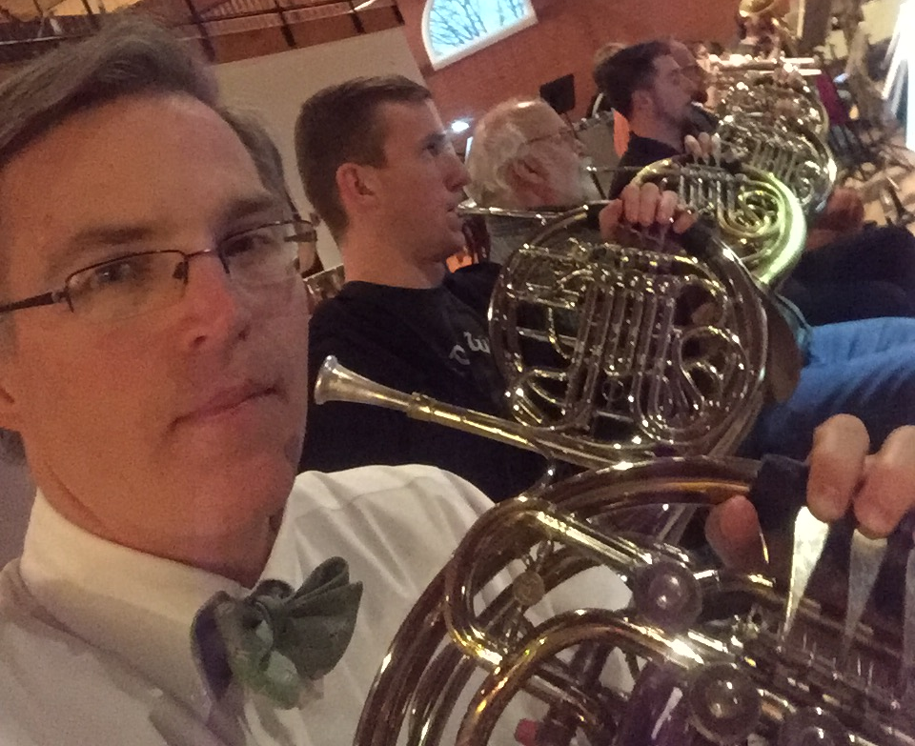
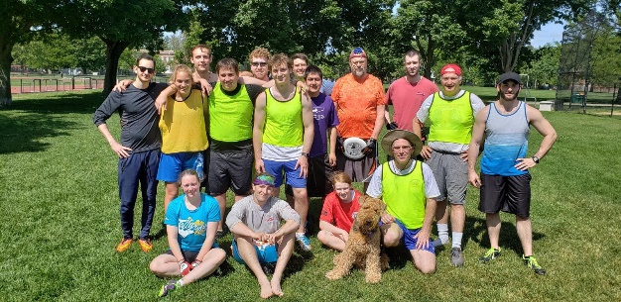

Slide 18
References
Pecci C, et al. The birth of a collaborative model: obstetricians, midwives, and family physicians. Obstet Gynecol Clin North Am. 2012 Sep;39(3):323-34. doi: 10.1016/j.ogc.2012.05.001. Epub 2012 Aug 15. PMID: 22963692.
Pecci C, et al. How we built our team: collaborating with partners to strengthen skills in pregnancy, delivery, and newborn care. J Am Board Fam Med. 2012 Jul-Aug;25(4):511-21. doi: 10.3122/jabfm.2012.04.110160. PMID: 22773719.
Wu M, et al. Interventions for improving teamwork in intrapartem care: a systematic review of randomised controlled trials. BMJ Qual Saf. 2020 Jan;29(1):77-85. doi: 10.1136/bmjqs-2019-009689. Epub 2019 Oct 10. PMID: 31601734.
Fransen AF, et al. Multi-professional simulation-based team training in obstetric emergencies for improving patient outcomes and trainees' performance. Cochrane Database Syst Rev. 2020 Dec 16;12(12):CD011545. doi: 10.1002/14651858.CD011545.pub2. PMID: 33325570; PMCID: PMC8094450.
Etheridge JC, Goldstone RN, Harrington B, Calcaterra MJ, Tomczyk EG, Parangi S, Haas S. Implementation of a New Surgeon Onboarding Program in an Academic-affiliated Community Hospital. Ann Surg. 2023 Dec 1;278(6):e1156-e1158. doi: 10.1097/SLA.0000000000006034. Epub 2023 Jul 24. PMID: 37485995.

