Slide 1
CMS Innovation Center Strategy and Primary Care Portfolio Overview
CMS Innovation Center
Dr. Purva Rawal, Chief Strategy Officer
August 15, 2024

Slide 2
Agenda
1
CMS Innovation Center Background & Strategy
2
CMS Primary Care Strategy and Model Portfolio
3
Innovation Center Primary Care Models
4
Advanced Primary Care Management Codes (APCMs)

Slide 3
CMS Innovation Center Statute
“The purpose of the [Center] is to test innovative payment and service delivery models to reduce program expenditures…while preserving or enhancing the quality of care furnished to individuals under such titles”
Three scenarios for success from Statute:
Quality improves; cost neutral
Quality neutral; cost reduced
Quality improves; cost reduced (best case)
If a model meets one of these three criteria and other statutory prerequisites, the statute allows the Secretary to expand the duration and scope of a model through rulemaking

Slide 4
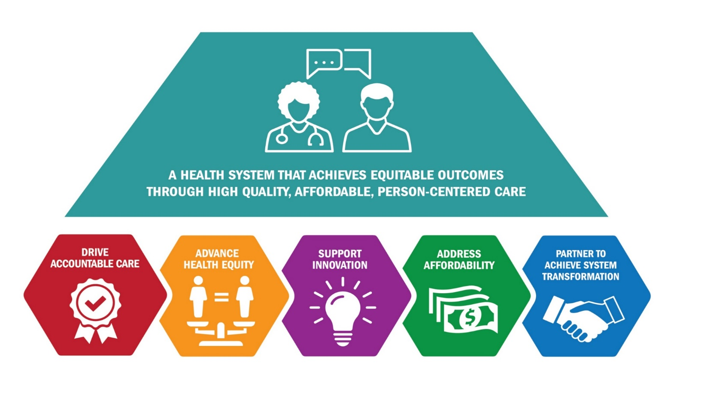
CMS Innovation Center’s 2021 Strategic Refresh: A Vision for the Next Decade

Slide 5
Role of Advanced Primary Care in the Innovation Center’s Strategy
Given the foundational role of primary care in transforming the health system, the CMS Innovation Center has devoted significant time and resources to develop and test primary care models. Models have tested advanced primary care across the country to improve and enhance how practices deliver care.
…The CMS Innovation Center can make improvements to broaden participation among practices, to include a broader population of beneficiaries, and to consider primary care’s role in generating savings.”
- CMS Innovation Center White Paper, October 2021

Slide 6
The CMS Innovation Center’s Approach to Rebuilding Primary Care: Financing, Equity, Sustainability
The Innovation Center is taking a portfolio-wide approach to rebuilding primary care focused on the following three dimensions:
Improving primary care financing through increased, stable revenue that moves practices away from fee-for-service payments that pay for the volume of services delivered and toward support for team-based care, coordination with specialty providers, and community-based supports.
Advancing health equity by increasing safety net provider participation, increasing payments to underserved areas, and requiring health equity plans from model participants; and
Supporting the sustainability of value-based payment models through multi-payer alignment, starting with Medicaid, and scaling successful models and features.
1
2
3

Slide 7
How the CMS Innovation Center Models Support Primary Care
The CMS Innovation Center is investing significantly in testing models with multiple pathways to strengthen primary care, improve care coordination, and address social determinants of health.⁹
Encourages health care providers to come together to form an ACO
Breaks down silos and delivers high-quality, coordinated care
Addresses health disparities
Supports primary care practices in managing their patients’ health
Enables primary care providers to offer a broader range of health care services that meet the needs of their patients
Improves care management, community connections, and care integration
Increases access to care and creates sustainable change in underserved communities
Creates a new pathway to invest in primary care
Provides Enhanced Primary Care Payments
Uses a flexible framework of care transformation activities
Focuses on improving primary care funding within ACOs
Flexible, prospective payment within the Shared Savings Program
Incentivizes the development of new, low revenue ACOs
ACO Realizing Equity, Access, and Community Health
(ACO REACH)
States Advancing All-Payer Health Equity Approaches and Development
(AHEAD)
Primary Care First
(PCF)
Making Care Primary
(MCP)
ACO Primary Care Flex
(ACO PC Flex)
2021 - 2026
2021 - 2026
2024 - 2034
2024 - 2034
2025 - 2029
7

Slide 8
CMMI Portfolio | Making Care Primary (MCP)
MCP provides a pathway from FFS payment to prospective, population-based payment. The model is designed to support comprehensive primary care while aiming to improve quality, patient experience, and population health outcomes.
Comprehensive
Primary Care
New Payment Pathway for Value-Based Care
Improved Quality and Outcomes
Comprehensive Primary Care
New Payment Pathway for VBC
Improved Quality and Outcomes
Ensure patients receive primary care that is integrated, coordinated, person-centered and accountable
Create a pathway for primary care organizations and practices – especially small, independent, rural, and safety net organizations – to enter into value-based care arrangements
Improve the quality of care and health outcomes of patients

Slide 9
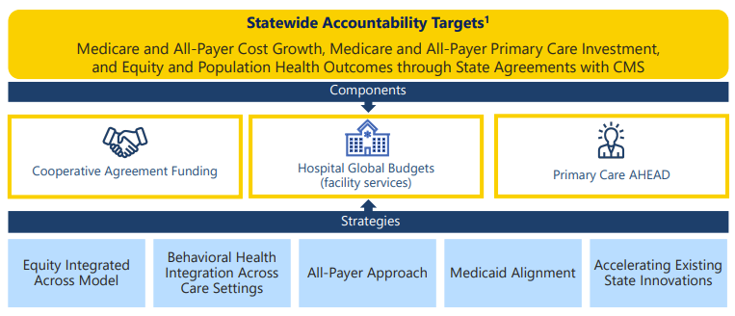
CMMI Portfolio | States Advancing All-Payer Health Equity Approaches and Development (AHEAD)
CMS’s goal in the AHEAD Model is to collaborate with states to curb health care cost growth; improve population health; and advance health equity by reducing disparities in health outcomes. The model is designed to be a flexible framework that can be adapted across multiple states.

Slide 10
CMMI Portfolio| ACO Primary Care Flex (ACO PC Flex)
Advanced Shared Savings
Upfront funding to cover the costs of forming an ACO and / or administrative costs for required model activities
Guaranteed Primary Care Revenue
Enhanced amounts of Prospective Primary Care Payments (PPCPs) are not recouped by CMS to the extent they exceed positive regional adjustment and prior savings adjustments as part of performance-based risk arrangements
Prospective, Population-Based Payments
Prospective, population-based payments for primary care combined with total-cost-of-care accountability within the Medicare Shared Savings Program
Guardrails
Specific policies and monitoring to ensure PPCP funds are used to support primary care
Regionally Consistent Rate for Primary Care
The PPCP County Base Rate will not be based on the historical experience of the ACO, but on average county primary care spending
Health Equity
Multiple model design features to promote health equity

Slide 11
FY25 PFS Proposed Advanced Primary Care Management Codes (APCM)
For CY 2025, we propose to establish coding and make payment under the Physician Fee Schedule (PFS) for a set of APCM services described by three HCPCS G-codes.
Physicians and non-physician practitioners who use an advanced primary care model of care delivery could bill for APCM services for a beneficiary when they are the continuing focal point for all needed health care services.
The proposed APCM services would:
  Incorporate elements of several existing care management and communication technology-based codes into a bundle that reflects the essential elements of advanced primary care delivery;
  Remove some of the more burdensome elements of billing and coding the individual service elements:
  Not be time-based, but rather based on a set of service elements and practice-level requirements indicative of advanced primary care delivery
  Be stratified into three levels based on the number of chronic conditions and enrollment as a Qualified Medicare Beneficiary, reflecting both patient medical and social complexity.
  Be able to be billed on a monthly basis

Slide 12
FY25 PFS Request for Information on APCMs
CMS released an accompanying Request for Information (RFI) in hopes of gaining insights into hybrid payment and coding for advanced primary care services.
  In the future, APCM services could be revised to include additional elements, including traditional E/M services, to advance the scope of hybrid payments.
  CMS is soliciting feedback on how we can:
    Further the goal of reducing administrative burden to refocus time on patient care;
    Better recognize the relative resources involved in furnishing care;
    Recognize interdisciplinary, team-based primary care;
    Support primary care sustainability and stability, especially for underserved communities.
The RFI asks questions related to the following categories:
  Value-Based Care Opportunities
  Billing Requirements
  Person-Centered Care
  Health Equity
  Quality Improvement and Accountability

Slide 13
Where can innovators go for more information?
Sign up to receive regular email updates about the CMS Innovation Center, including opportunities to engage with, provide input on and potentially participate in model tests.
Visit the CMS Innovation Center website and CMS Innovation Center Models webpage to see current participant information* and which models are currently enrolling.
To learn more about ACOs, visit the Medicare Shared Savings Program site.
Follow us @CMSinnovates on Twitter.

