Slide 1
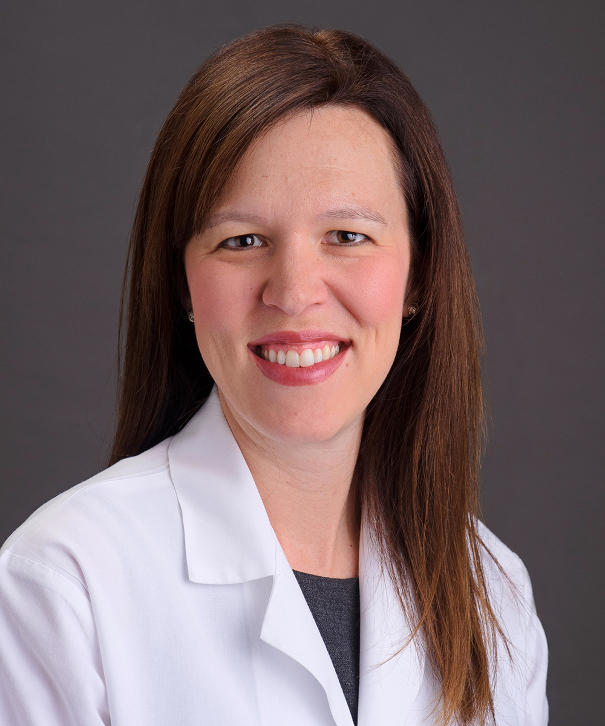
Owning and Integrating Telehealth Care to Enhance Continuity and Access
Richelle J. Koopman, MD, MS
Chair, Department of Family and Community Medicine
Sarah Swofford, MD, MSPH
Director of Telehealth, MU Healthcare; Professor of Family and Community Medicine

Slide 2
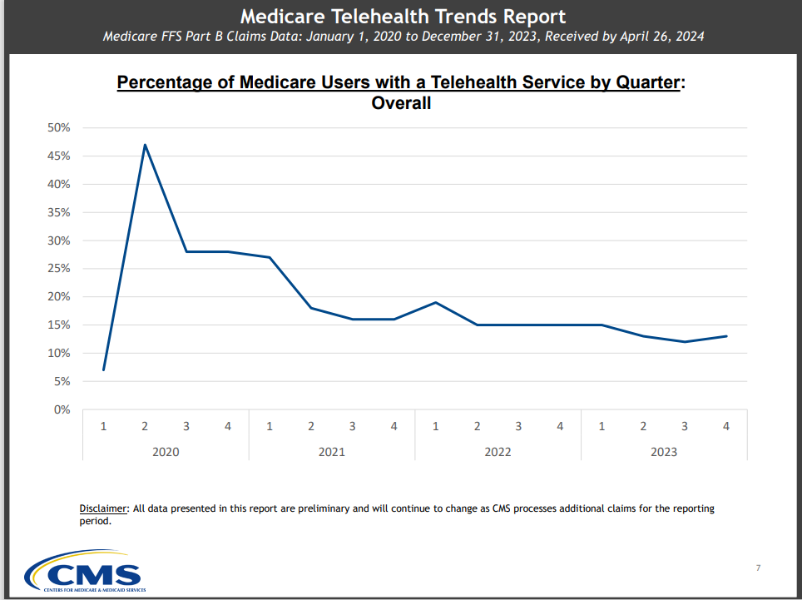

Slide 3
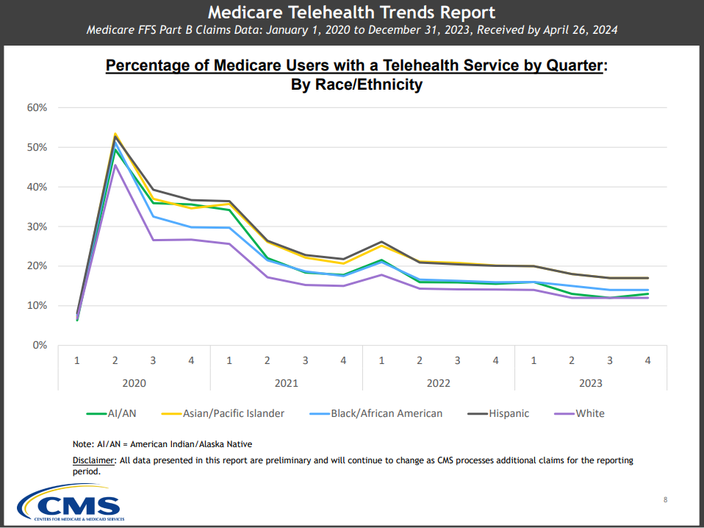

Slide 4
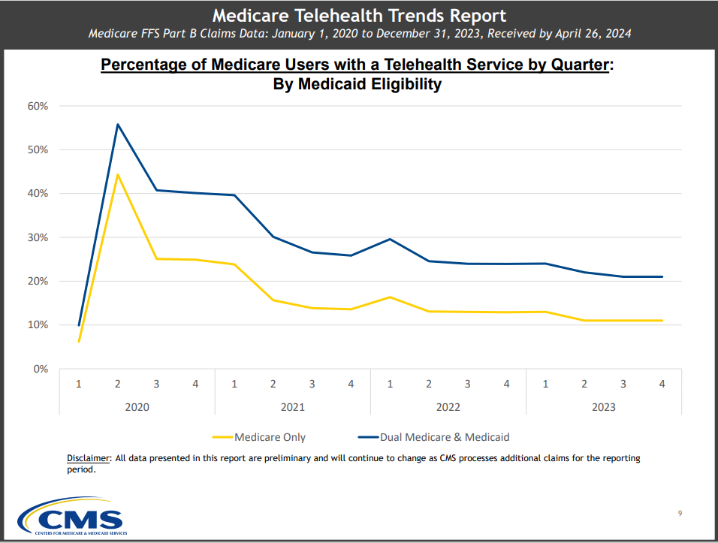

Slide 5
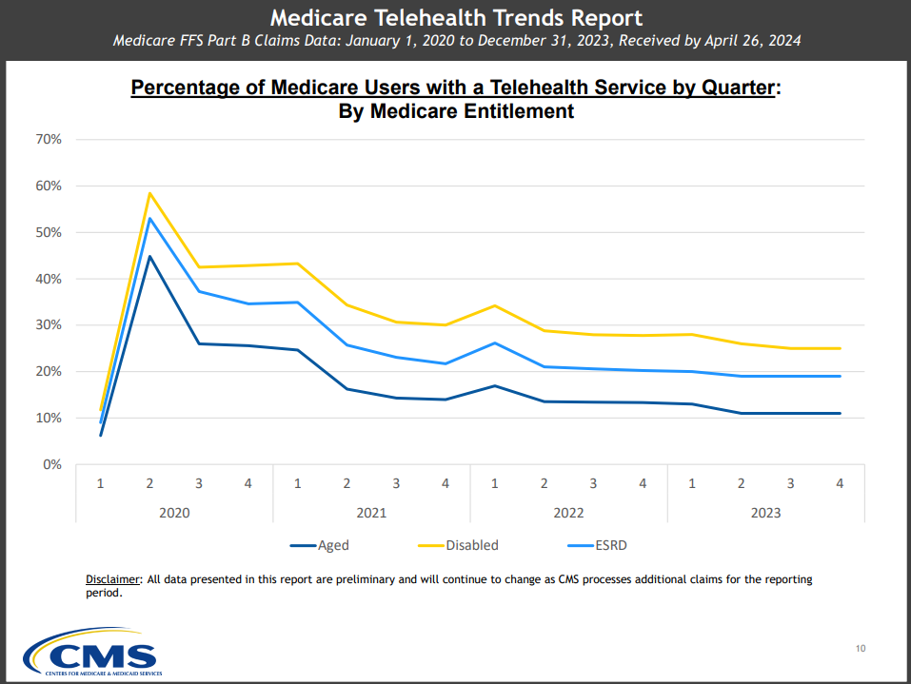

Slide 6
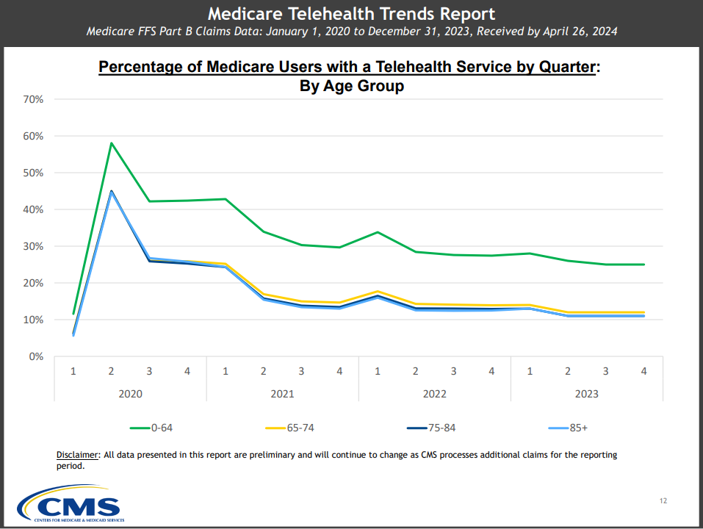

Slide 7
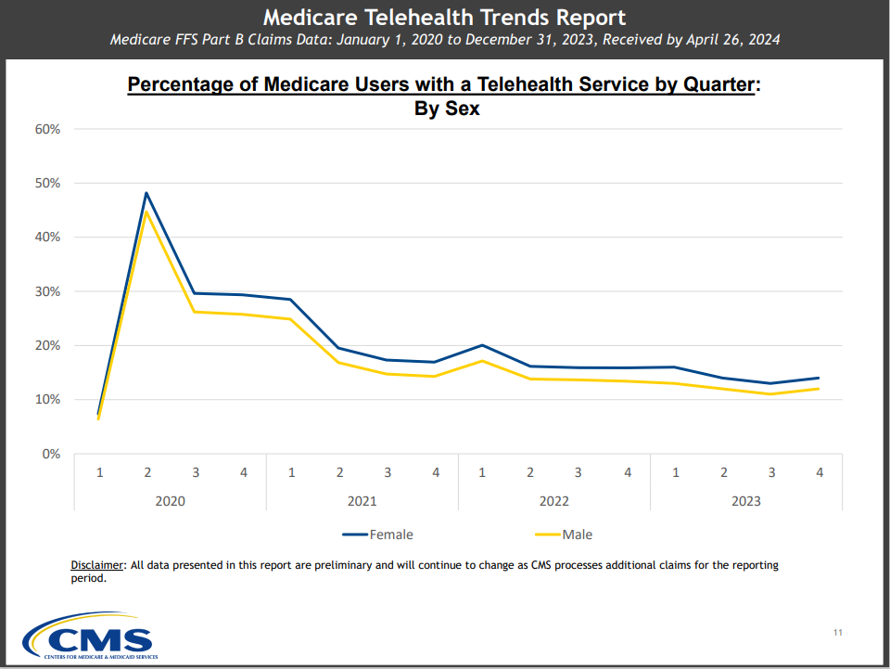

Slide 8
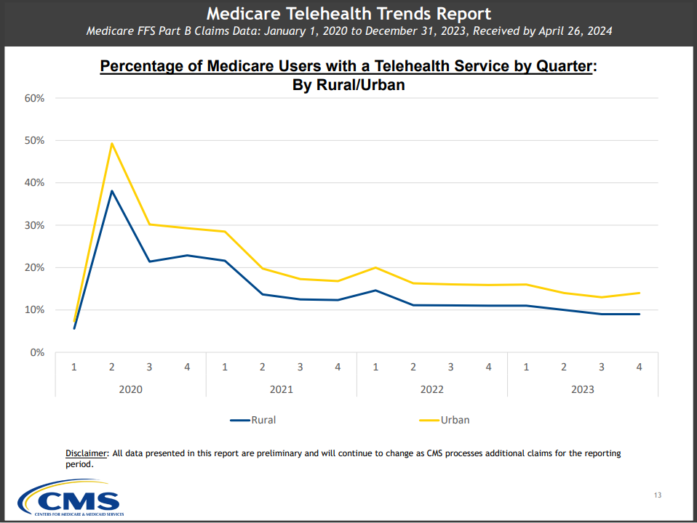

Slide 9
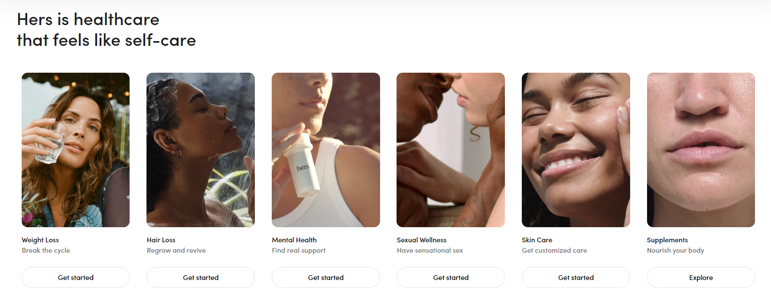

Slide 10
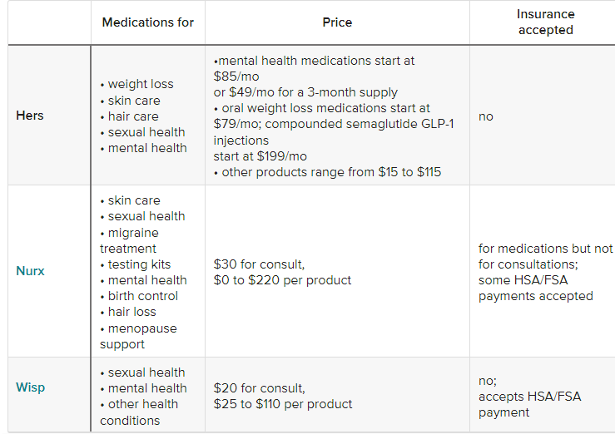

Slide 11
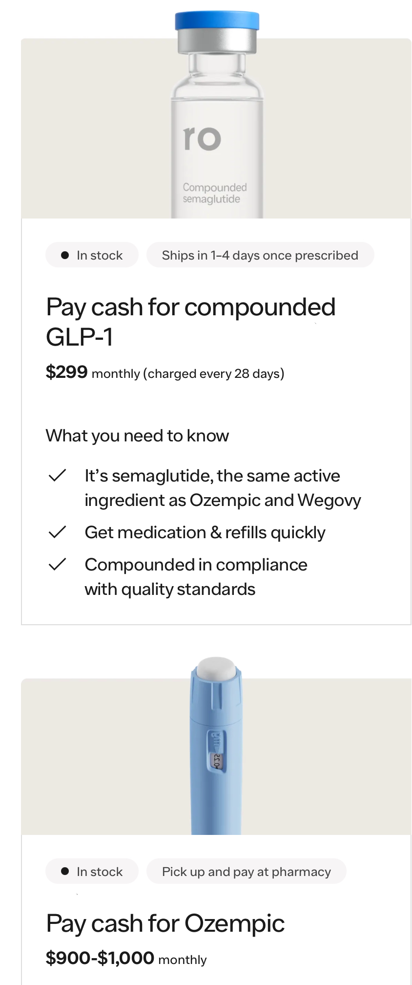
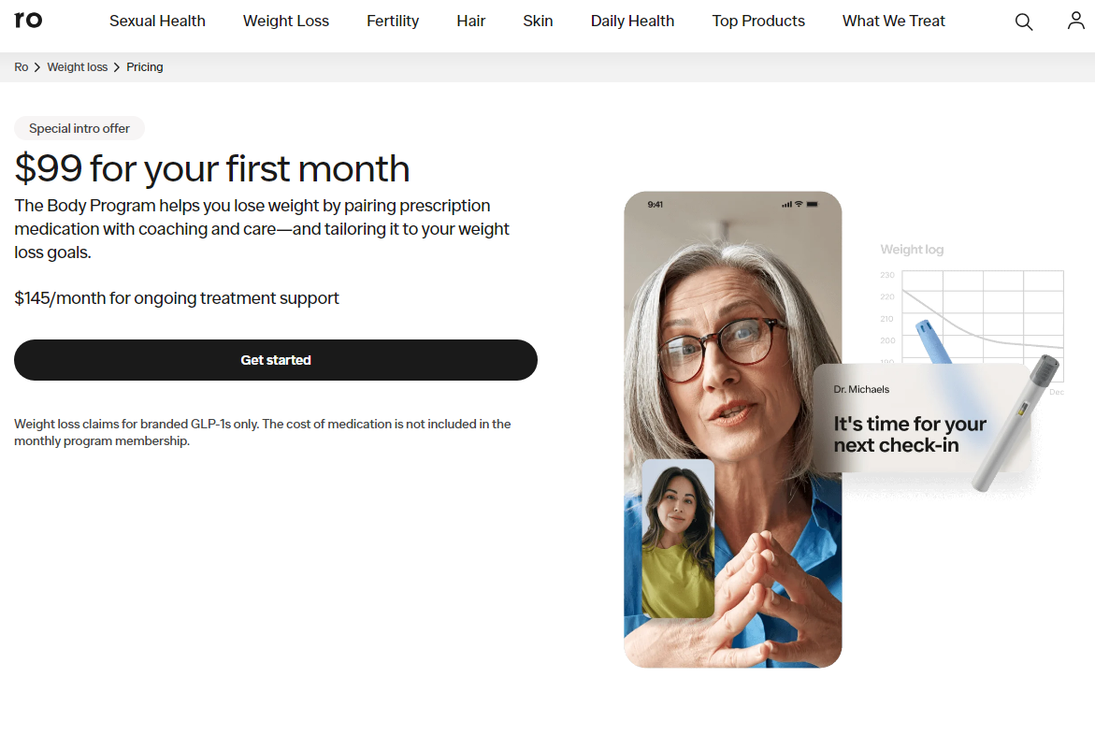

Slide 12



Mizzou Quick Care
3 locations at HyVee grocery stores
Virtually eliminated all other urgent care and minute clinics in Columbia Missouri
population 125,000
2 principal health systems
A collaboration with Columbia HyVee grocery stores for almost 10 years
Integrated EHR with MU Healthcare
Same copay as primary care visit

Slide 13
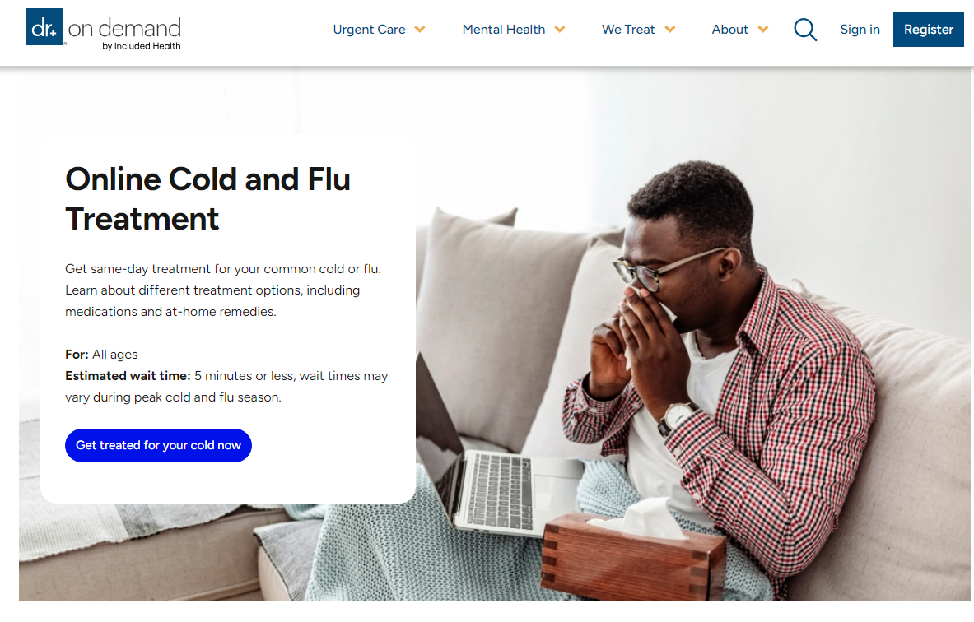

Slide 14

Searching for the Family Doctor
Top 10 List for Saving the Family Doctor
#10 Embrace Virtual Care check
#9 Remain the Patient’s Chief Data Sentinel where they trust
#8 Make patients your partners engage with them
#7 Organize locally and create advocacy armies state advocacy
#6 Create strategic alliances like the grocery store
#5 Expand the work of family medicine creatively and relationally
#4 Change how family doctors are trained
…
#1 Something else radical the specialty can think up

Slide 15
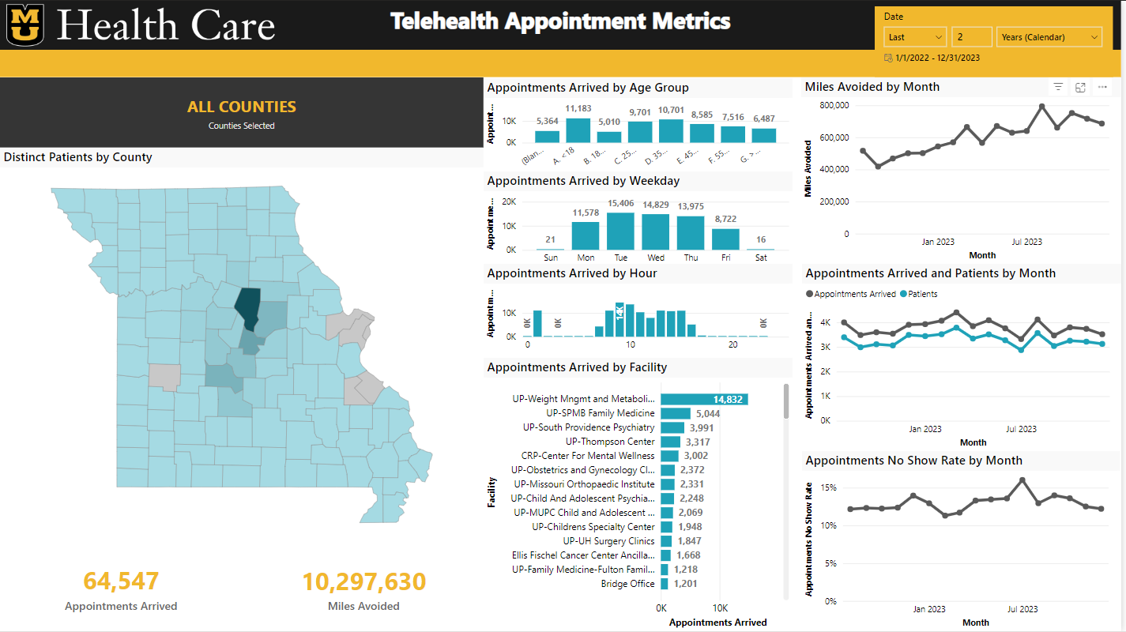

Slide 16
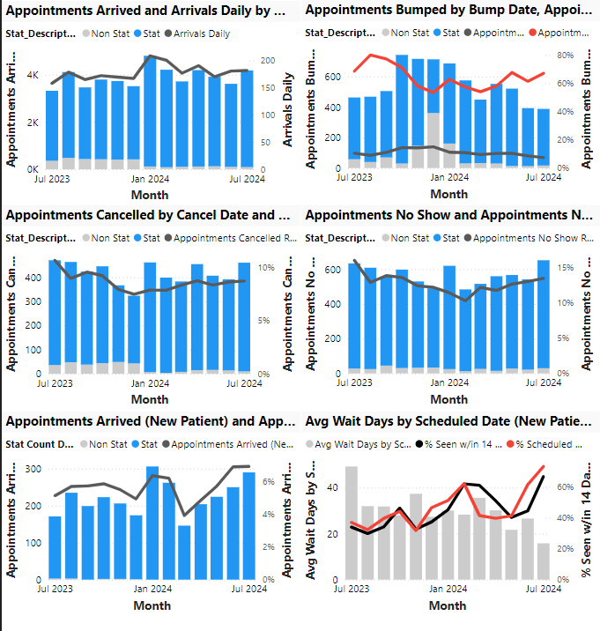
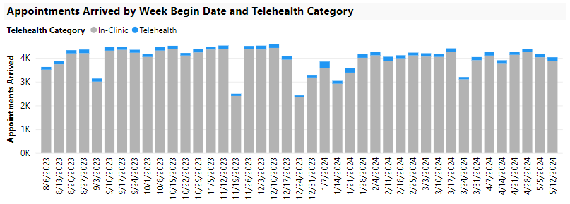
Family Medicine Telehealth Data FY24
4.5% : total visits were telehealth
6% : new patient telehealth visits

Slide 17
Scheduled Care – Ambulatory Visits
Accomplishments
Goals
Implemented telehealth platform that integrates with the EMR
Created an “on the fly” telehealth option
Introduced ability to join telehealth visits via the patient portal
Implement internal e-consults
Improve scheduling and check in process for virtual visits
Expand online scheduling capabilities
Utilize telehealth to aid in space utilization

Slide 18

How do we compete in the virtual space?
We own and trade on relationships
What do patients want from telehealth?
Convenience, convenience, convenience
  Easy access
  On demand
Circumscribed
Connect if they don’t have a doctor
Connect if they do have a doctor
Transparent pricing

Slide 19
How do we compete in the virtual space?
We own and trade on relationships
What do we offer?
Trusted relationship
On demand care
Continuity of data and care
Whole person care congruent with their other health conditions

Slide 20
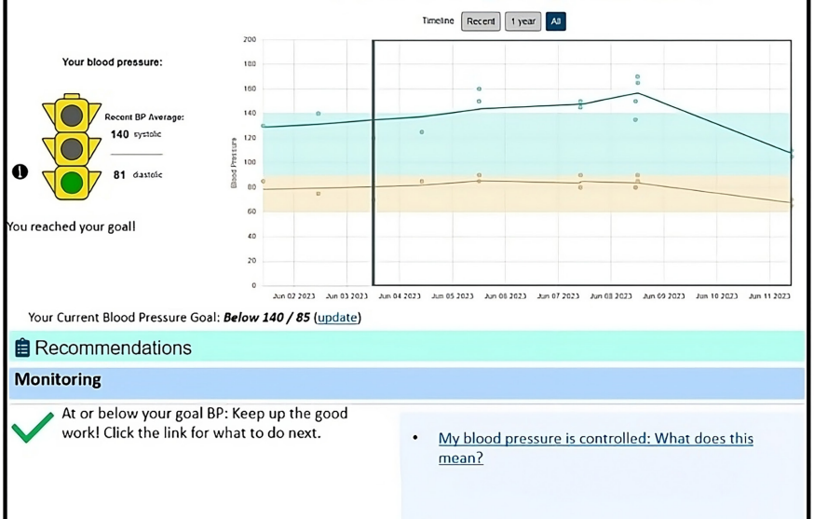
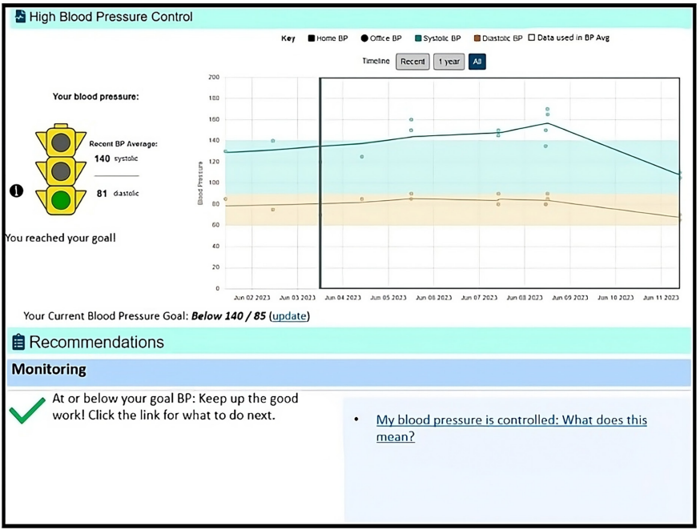
Design Care for virtual connections
Hypertension management support
COACH tool to co-manage blood pressure with patients using home blood pressure and the patient portal
Dorr DA, Montgomery E, Ghumman AJ, Michaels L, Rolbiecki A, Canfield S, Shaffer V, Johnson B, Lockwood M, Ghosh P, Martinez W, Koopman R; COACH Consortium. Study protocol: Collaboration Oriented Approach to Controlling High blood pressure (COACH) in adults - a randomised controlled trial. BMJ Open. 2024 Jul 8;14(7):e085898. doi: 10.1136/bmjopen-2024-085898. PMID: 38977368; PMCID: PMC11256044.

Slide 21
Advocacy
State level
Educate representatives:
--economic drain of out of state telehealth
--lack of contribution to enduring healthcare infrastructure
Questions?

