Slide 1
An Update: The Primary Care Workforce and the US Usual Sources of Care (in 9 figures or fewer!)
Alison Huffstetler
August 2024

Slide 2


Slide 3


Data Sources
Notes:
briefly note limitations
1) no USC; 2) a person as their USC; 3) a facility as their USC; or 4) a person within a facility as their USC.

Slide 4
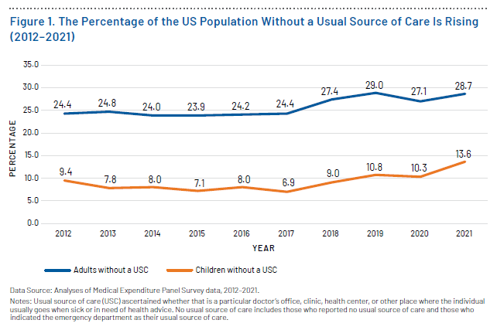
Notes:
Left 2023 Scorecard, Right 2024 Scorecard

Slide 5
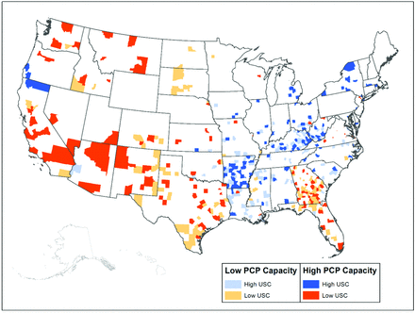
 |  | Usual Source of Care
 |  | Low | High
PCP Capacity | Low | ↓↓ | ↓↑
 | High | ↑↓ | ↑↑

Slide 6
The Primary Care Workforce: Small & Inadequate
(but mighty!)

Slide 7
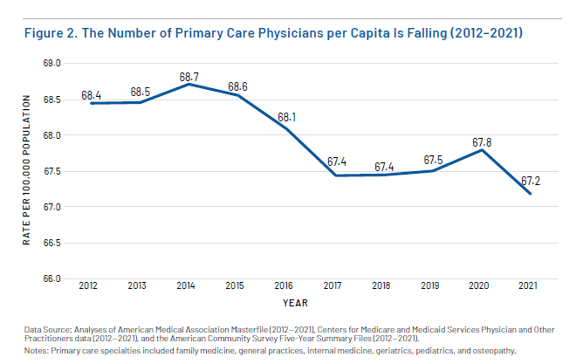
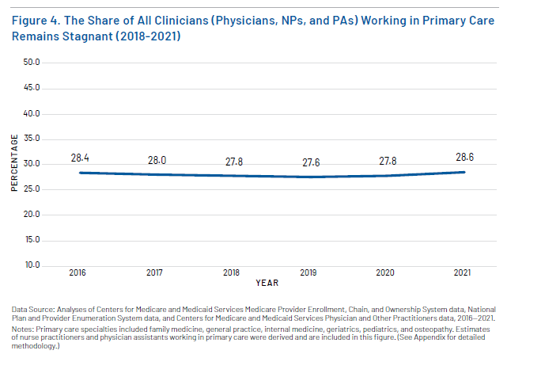
Notes:
2024 scorecard

Slide 8
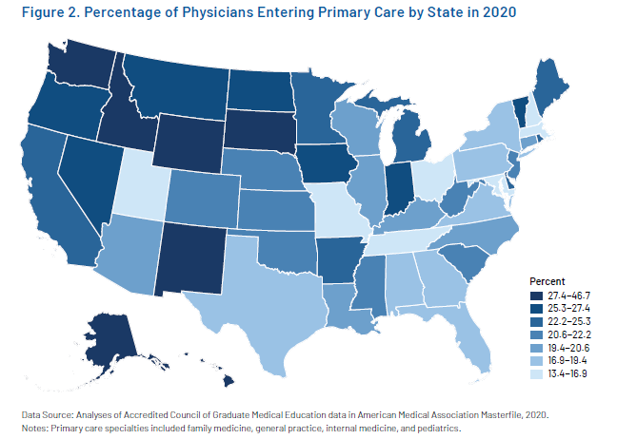
Notes:
2023 scorecard

Slide 9
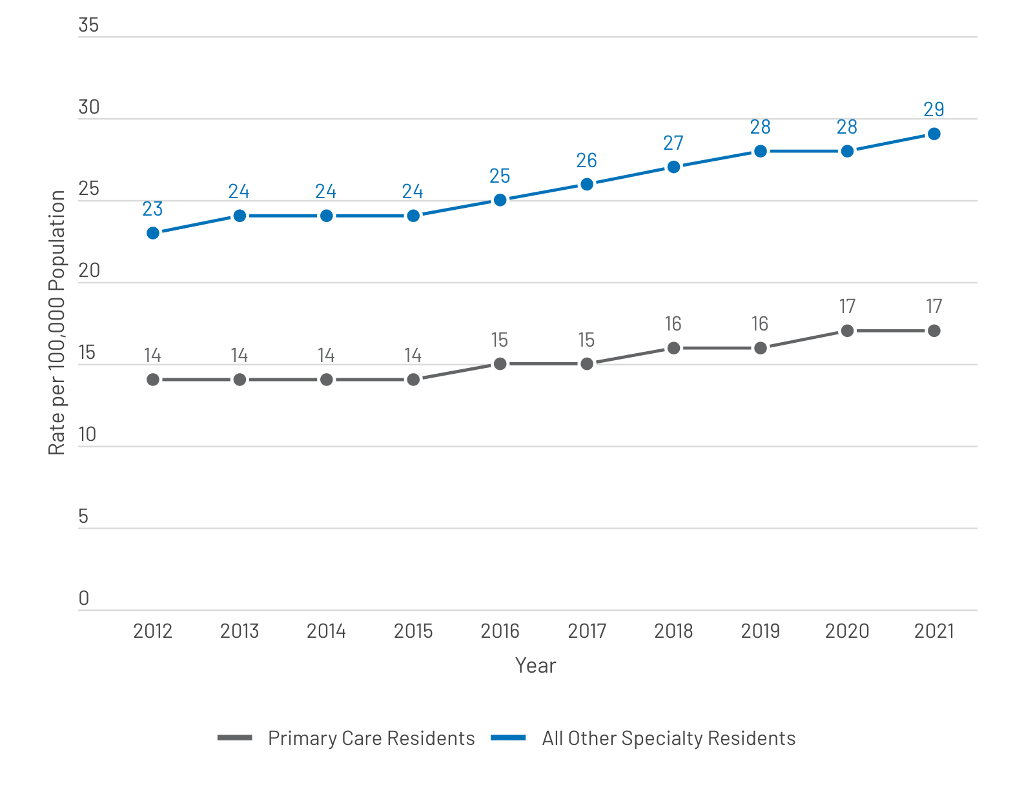
Notes:
Scorecard 2024

Slide 10
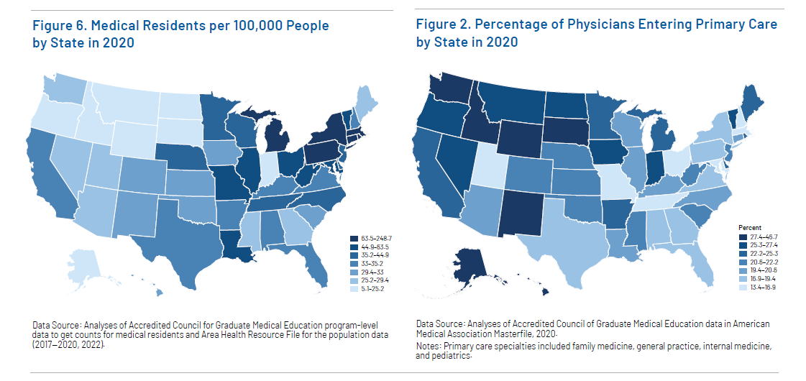
Notes:
2023 scorecard

Slide 11
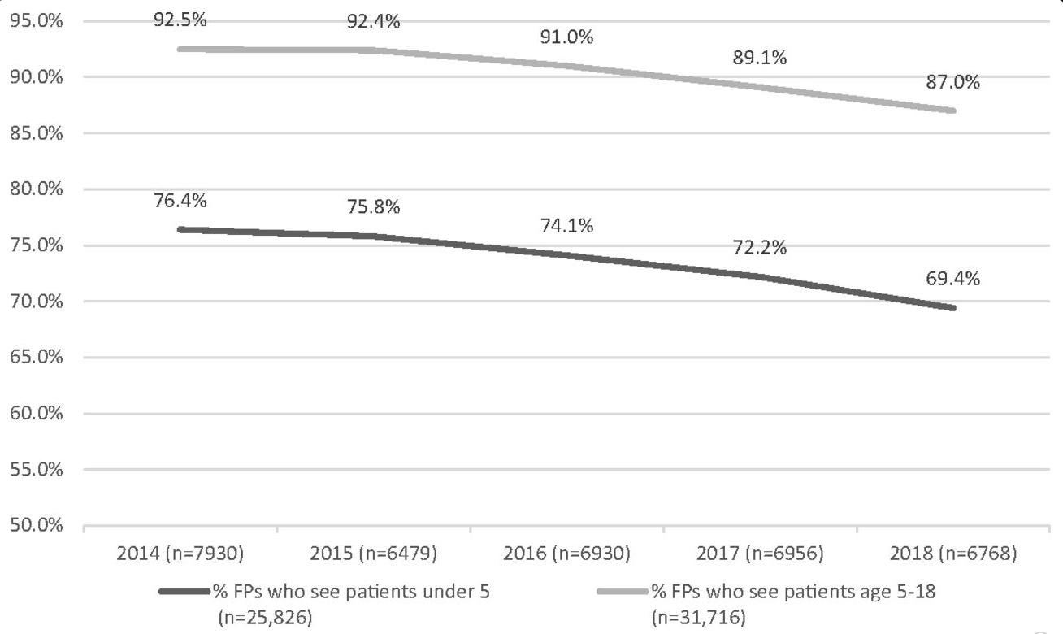
Notes:
Eden AR, Morgan ZJ, Jetty A, Peterson LE. Proportion of Family Physicians Caring for Children is Declining. J Am Board Fam Med. 2020 Nov-Dec;33(6):830-831. doi: 10.3122/jabfm.2020.06.200089. PMID: 33219061.

Slide 12
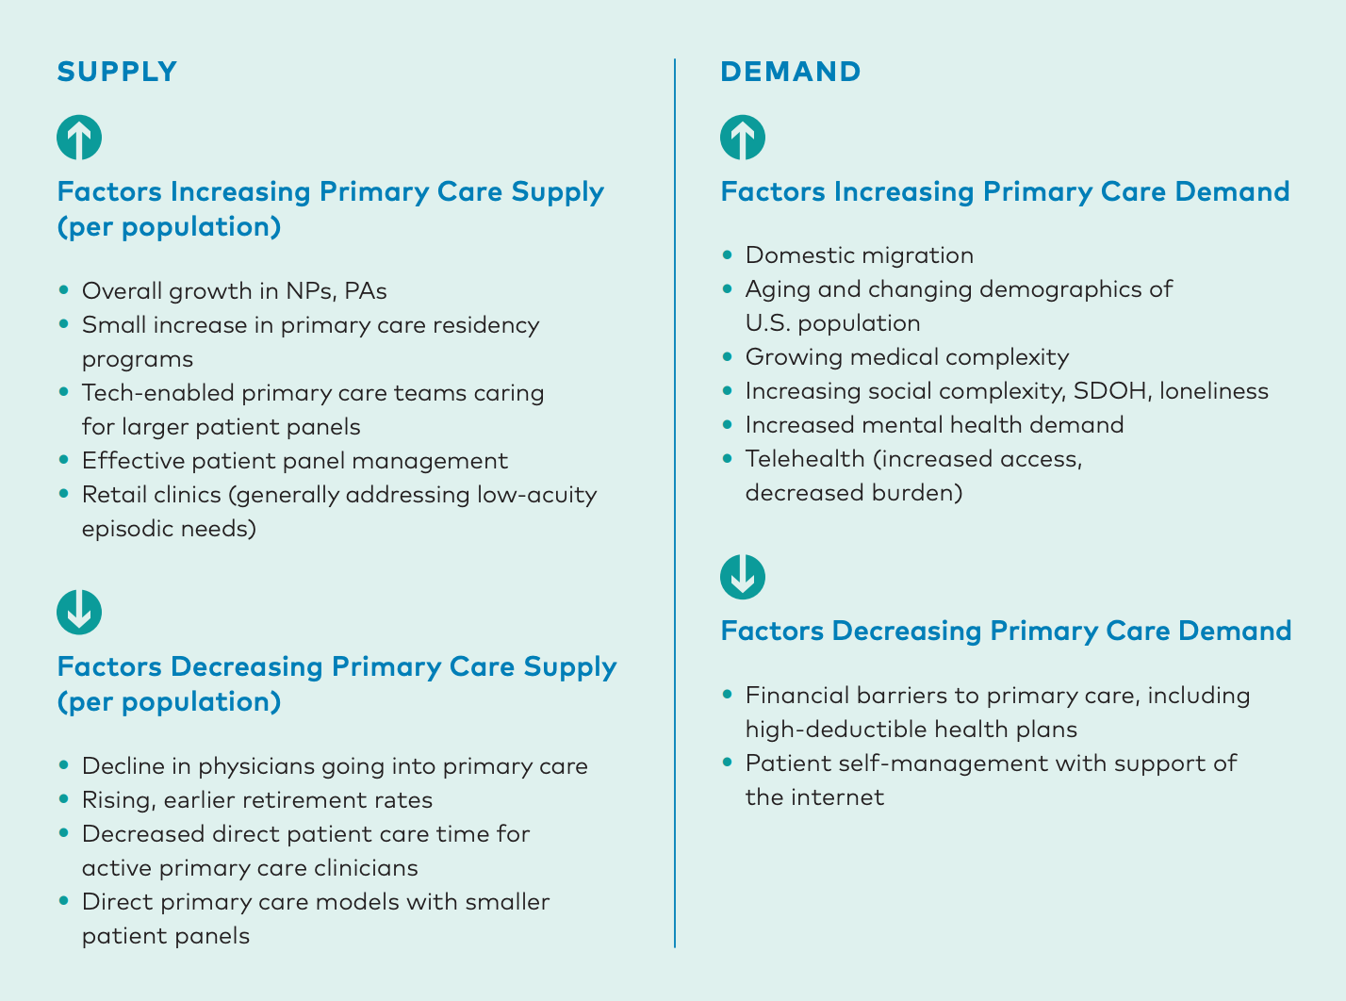

Slide 13


Slide 15
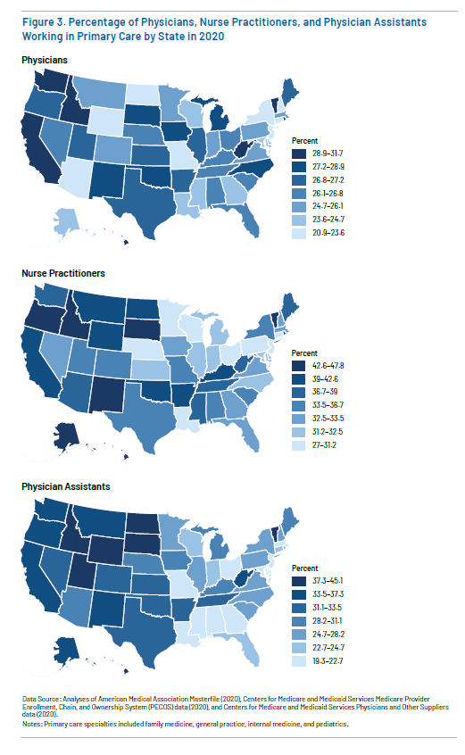
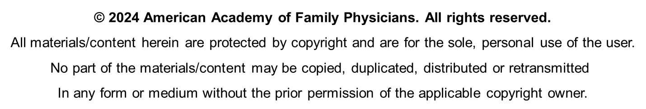

Slide 16
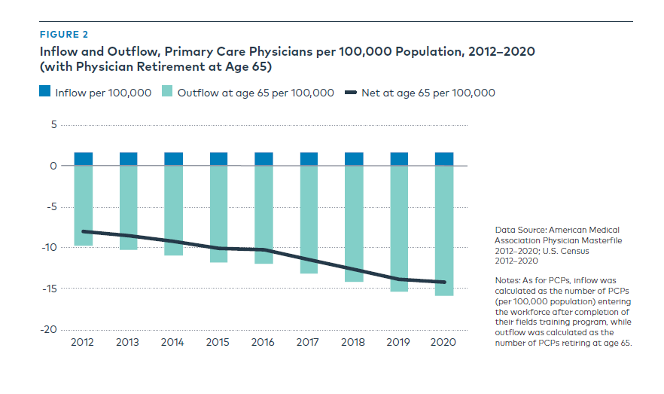
Notes:
2023 PCC ER

Slide 17
