Slide 1

Inpatient Medical Care for a Whole Community:
UNC Family Medicine Inpatient Service
Karen Halpert, MD
Associate Professor
Vice Chair of Clinical Excellence
8/16/2024

Slide 2
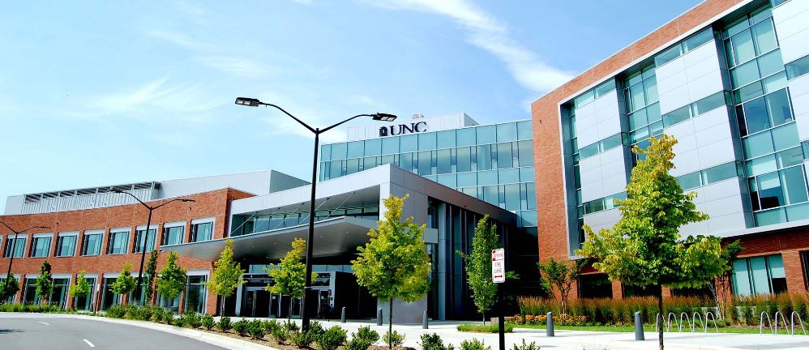
Background
Prior 2020, located on main campus in quaternary care hospital
Spring 2020 moved to Hillsborough hospital to cohort non-COVID care
Winter 2022 moved into new tower, expanded coverage for neurosurgical patients and co-management for Acute Inpatient Rehab
Spring 2022: Expanded service to three teams, added nighttime coverage

Slide 3
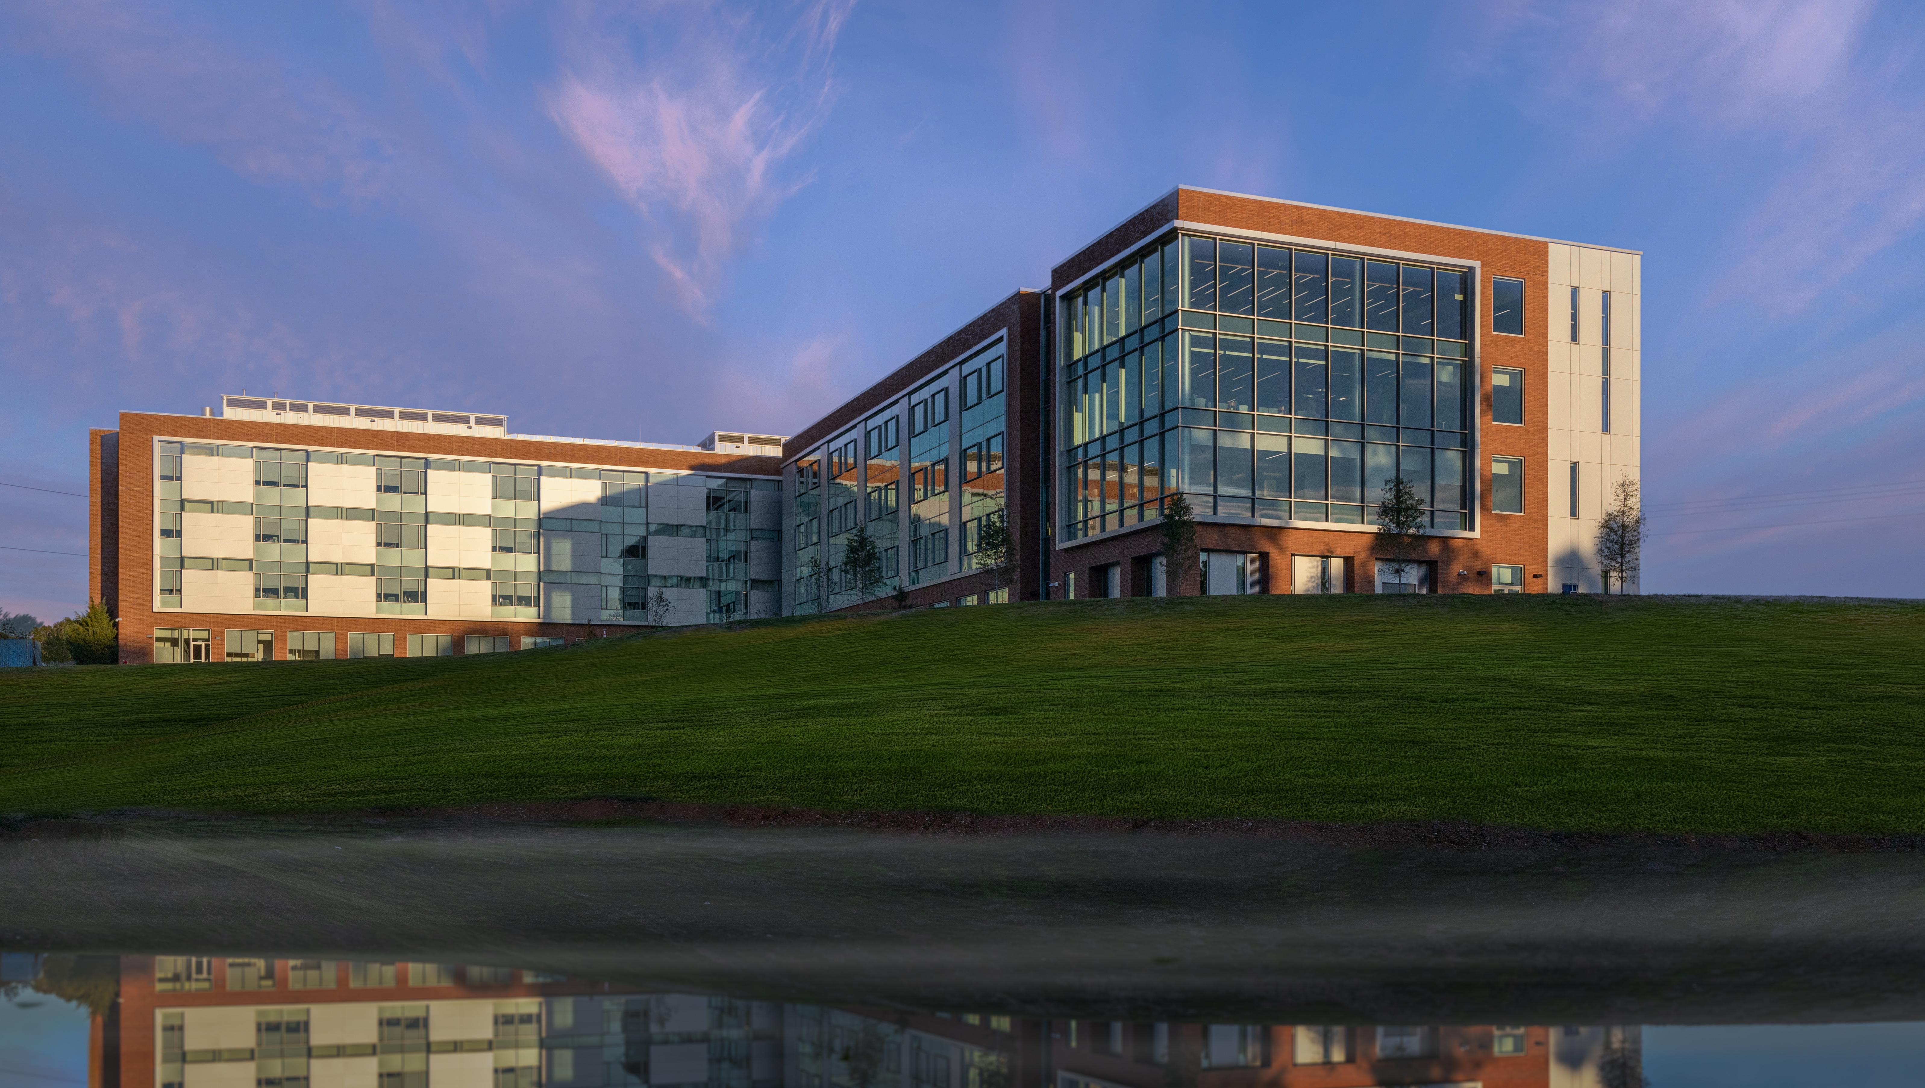
Structure
Three services with 40 patient cap
8 patients/resident
2 ICU/stepdown level patients per resident
10 overnight admissions
Procedures: inpatient, critical care, intubation

Slide 4
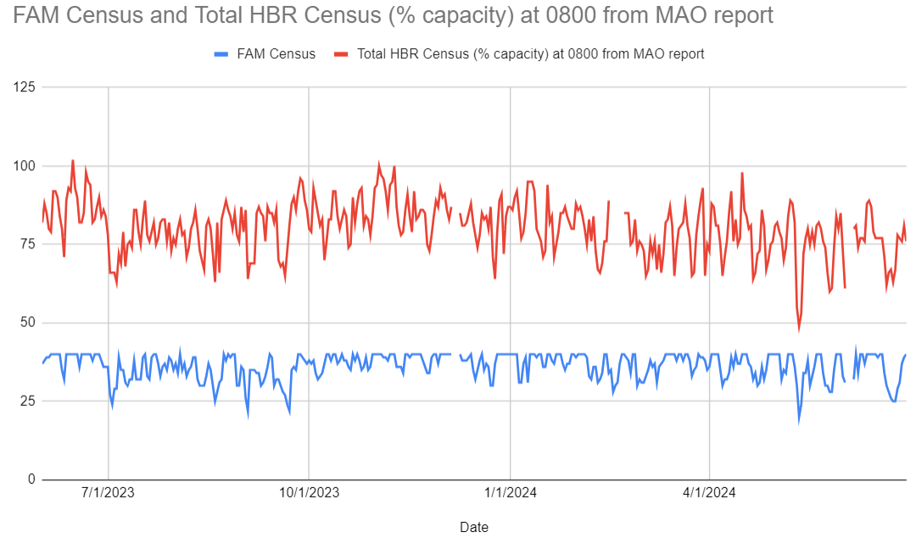
Inpatient Volume: Daily Census
Average Daily Census:
36

Slide 5
Outcomes

Slide 6
Admissions Data
Total Admissions: 2,568
Admissions by Hospital by Department for FY24
Row Labels | Sum of Admissions (Inpatient)
HBR | 1,729
1 BT2 HBRH | 392
2 BT1 HBR | 183
2 BT2 HBRH | 264
3 BT1 HBR | 30
4 BT1 HBR | 21
EMERG DEPT HBR | 830
PERIOP HBR | 9
ICU Level Care
Admissions no Level of Care Designated
Department Level of Care Grouper Name | (blank)
Row Labels | Sum of Admissions (Inpatient)
HBR | 839
EMERG DEPT HBR | 830
PERIOP HBR | 9
Observation

Slide 7
Readmission Rate

Slide 8
Length of Stay

Slide 9
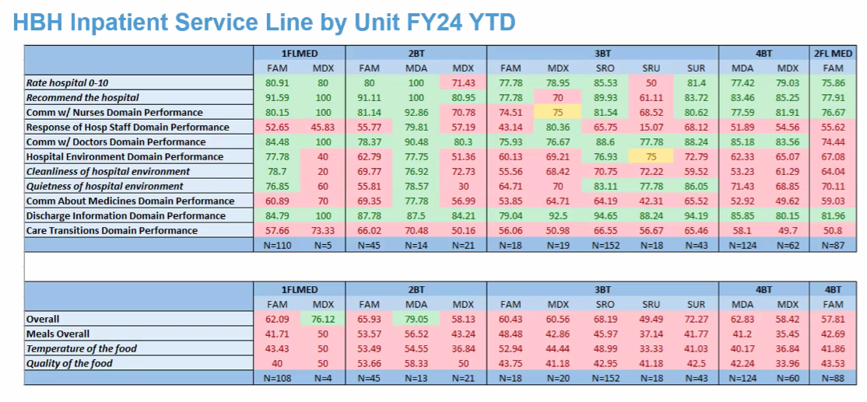
Patient Satisfaction

Slide 10
Residency Training
Graduates practicing inpatient medicine after residency
  2015-2020: ~40% of graduates
  Class of 2022: currently 7/11
  Class of 2023: currently 5/14
  Increase in procedural numbers and comfort managing critically ill patients
  2022 Resident survey:
  31% of residents strongly agree and 44% of residents agree that they are more comfortable performing critical care/inpatient procedures as a result of working at Hillsborough

Slide 11
Challenges
Increase in acuity with open ICU
Faculty upskilling (critical care workshops)
Hospital resources and available consults
  Added dialysis unit, cath lab
  Transportation between campuses

Slide 12
Leaning in
Using addition of acute inpatient rehabilitation to negotiate for nocturnist coverage
Building volume and skill allows us stronger voice at HBH
Being seen as core service at HBH

Slide 13
Where do we go
Strong inpatient service allows us to recruit strong residents who can leave and obtain hospitalist positions
Ensure access for hospitalist work on graduation
Example for medical students of inpatient care outside IM
Maintaining faculty comfort in complexity of patient care
Committing to services to ensure able to provide broad scope of care needed

Slide 14
Questions

