Slide 1
Family Medicine Leadership Council Summer Retreat
Revisiting the Clinical Model of Family Medicine
August 15-16, 2024
We seek breadth of perspective at each table. Please sit at tables with people outside of your organization or in different roles (eg learner, public member, editor, career stage)

Slide 2
Goals for the Retreat
Identify long term trends in scope of practice and key drivers
Learn others’ perspectives on role of family physicians in the health care system
Explore “brights spots” in clinical practice and catalysts for change: what are the learnings?
Ask “what next?” What should our specialty do together going forward?

Slide 3
FMLC Program Committee
Andrea Anderson
Stacy Brungardt
Renee Critchlow
Sarah Cole
Richelle Koopman
Shawn Martin
Bob Moore
Warren Newton
Lisa Ochs
Heather Palmer
David Park
Jehni Robinson
Kevin Rode
David Schneider
Tom Vansaghi
Amanda Weidner
Thanks to STFM for website, AAFP for venue and the ABFM Foundation for supporting this pilot summer retreat
Special Thanks : Shawn Martin, Courtney Brown, Janice Thomas and other ABFM staff
Special, Special Thanks to the 30 speakers who are giving us their wisdom…

Slide 4
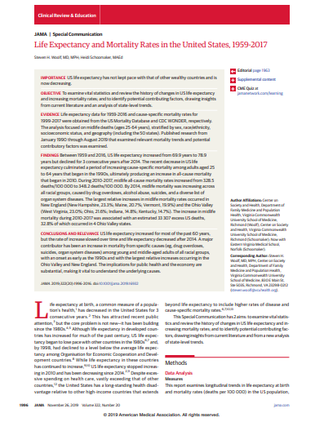
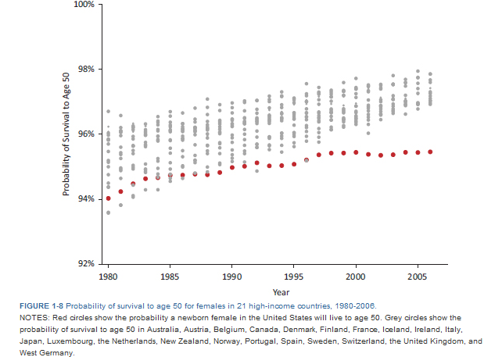
Why are we here?

Slide 5
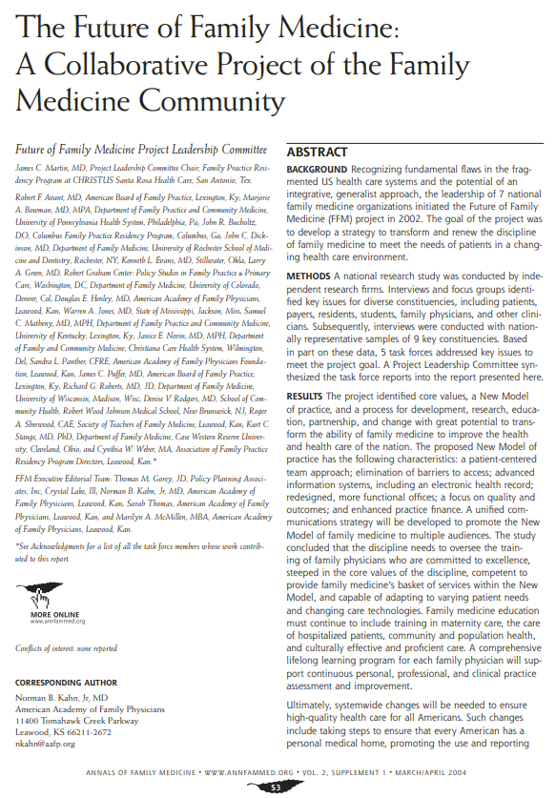
Where we came from,,,
1969: How we started…
Call for access to care
Broadly trained generalists, in small group practices, in communities
A new training model

Slide 6
Where are we going?
What will be
our promise to the public?
Commit to access, relationships and whole person care
Eliminate ACEs
Prevent, Manage and Reverse Chronic Disease
Delay onset of dementia
Increase health equity through delay of multimorbidity improving and social change
Empower patients and communities to make choices

