Slide 1
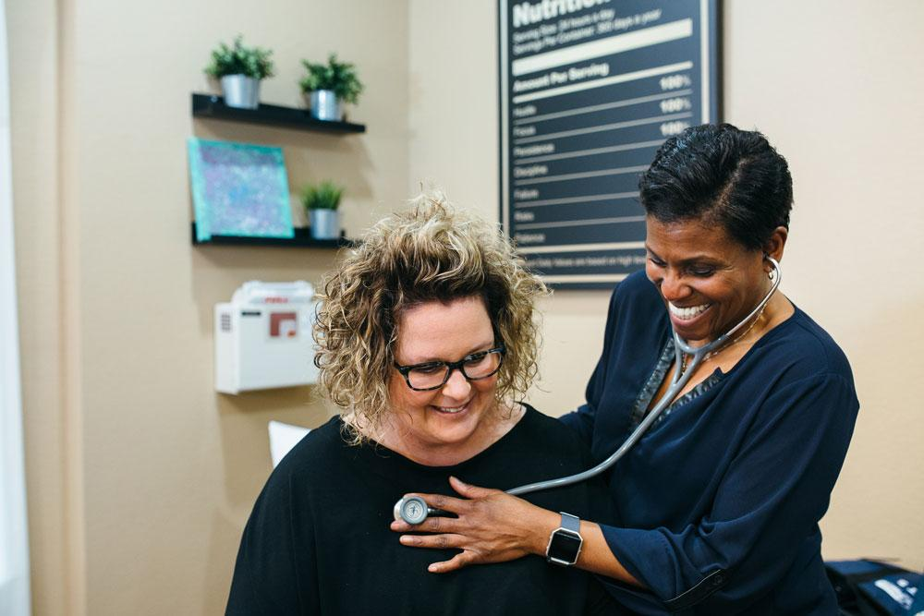

Sara J. Pastoor, MD, MHA, FAAFP
Head of Primary Care Advancement, Elation Health
Direct
Primary Care
The Brightest Spot in Family Medicine
August 16, 2024

Slide 2

August 16, 2024
Table of Contents
1
Why Direct Primary Care?
4
Common DPC Myths
2
What is Direct Primary Care?
5
Outcomes
3
How it’s Going
6
Recommendations

Slide 3
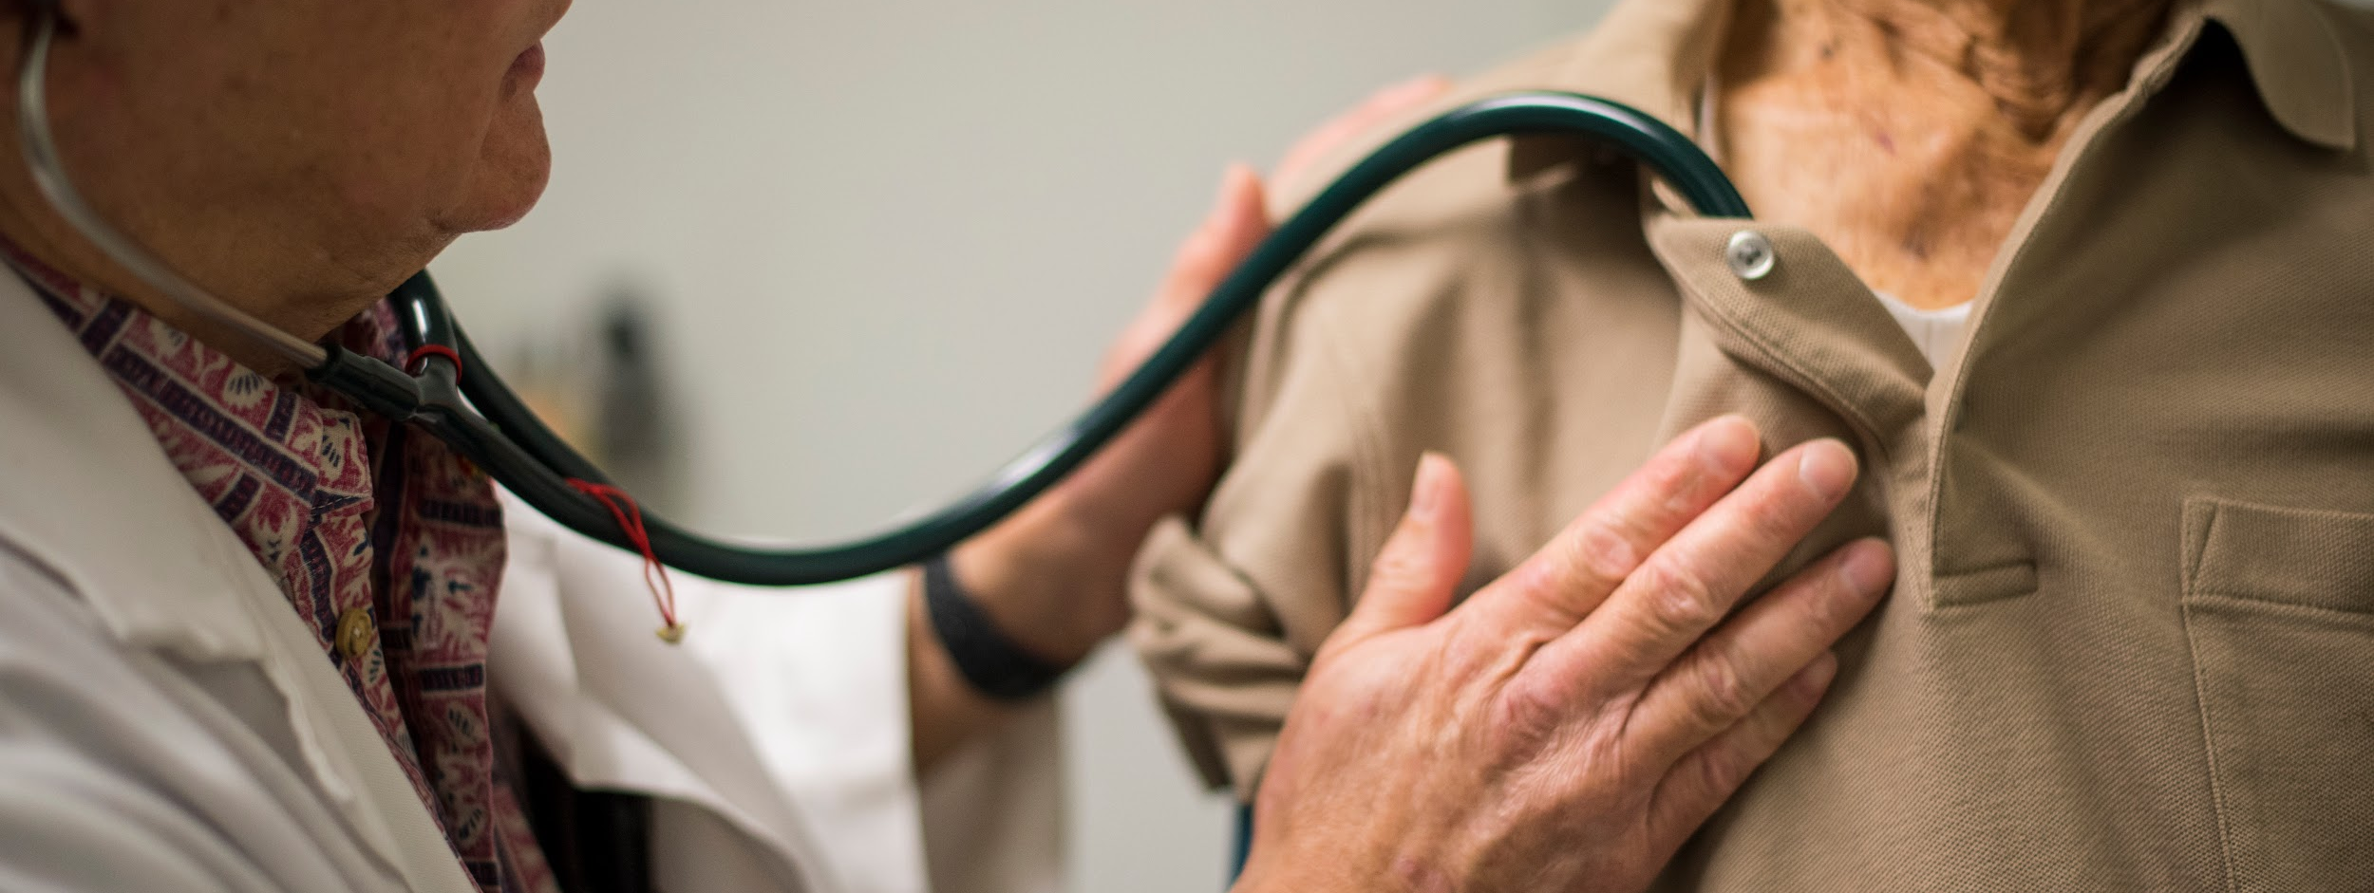

Why Direct Primary Care?
August 16, 2024

Slide 4
Why DPC?
DPC is as much a community of rebels as it is a practice and payment model
Physicians choose DPC to escape moral injury caused by America’s third party payment system which:
  Interferes with care.
  Buries them in paperwork and red tape.
  Misaligns the clinical and financial incentives.
  Shrinks their scope of practice.
  Robs them of professional autonomy.
DPC champions are deeply committed to a mission to change healthcare delivery in the U.S.
August 16, 2024
Notes:
Talk about how FFS is not the problem, our insurance industry is the problem.
Essentially our health insurance industry is a perfectly optimized business model for "Peripheraliz[ing] and commoditiz[ing] the patient, and add[ing] monumental layers of bureaucracy and overhead costs to the healthcare delivery process..[pause]..but as a healthcare model, especially for non catastrophic care, it has failed
In no other industry do we expect to use insurance for services which are routine, preventive, and necessary for everyone. We reserve insurance for catastrophes. It doesn’t make sense to pay for primary care that way.
DPC champions are revolutionaries on a mission to disrupt that system and create a better one, built on a strong foundation of high value primary care which centralizes the PCP-patient relationship.

Slide 5
What is Direct Primary Care?
August 16, 2024

Slide 6
Direct Primary Care is a Paradigm Shift
A PAYMENT MODEL
A PRACTICE MODEL
AN ECONOMIC MODEL
No insurance billing
Subscription-based - all-inclusive
Average = $75/mo
How paid > > Who pays (patient, employer, government, etc)
Accept all comers, regardless of insurance status
Higher per-patient revenue
Better financial stability
>>RELATIONSHIP<<
Unlimited access
Smaller panel sizes 400-700)
Longer appointments (~30-60 min)
Omnichannel access (face:face, virtual, secure message, text, phone)
Same day/next day/after hours access
Low overhead
Offsets OOP $$ for primary care + downstream services
  Discount wholesale prices on Rx/Lab/ Rad/Specialty
  Virtual specialty care options
Price transparency + purchasing power
More cost effective for pts
Notes:
What you see here are generalizations, and DPCs vary, but at the heart of it is a periodic, prospective “membership” fee and the sacred relationship between the physician and the patient.
No copays or other hidden fees for the patient
Membership covers most services and procedures
The average DPC membership costs less than car insurance, and you’re much more likely to use it. DPC accepts patient regardless of insurance status, and how it’s paid for is more important than who pays, although we need to follow who profits and make sure the incentives all align.

Slide 7

Direct Primary Care is about Freedom
Freedom to get outside the box - customize and innovate.
Freedom from burden related to insurance/billing/hyperproductivity:
High overhead costs
Coding and documentation requirements
Reductive quality metrics and reporting
Complex contracting
Poor reimbursement/denials
Low value busywork
Freedom from brick and mortar - care happens wherever/however you and the patient want.
Freedom from technology you didn’t choose and don’t want.
Freedom from anything that prevents or distracts you from doing what’s in the patient’s best interest.
Income varies. Quality of life is exceptional.
August 16, 2024
Notes:
How does it work? However you want!

Slide 8
How it’s Going
Direct Primary Care
August 16, 2024

Slide 9
1
Growth in Clinicians
August 16, 2024
How it’s Going
DPC clinicians per 100,000 grew 159% from 2017-2021 (vs 6% for total PCPs)
AAFP members in a DPC grew from 3% in 2022 to 9% in 2023
21% YoY logo growth, over 3300 today
4
Growth in DPC Networks
From 2019 - 2021 networks expanded from 20 states to 40
Practices in a network saw 548% 3 year growth compared to 255% when not in a network
2
Growth in Employer Sponsorship
800% increase in employer sponsors offering DPC from 2017 - 2022
5
Legislation
3
Growth in Patients
S.628 the Primary Care Enhancement Act
HR 3836 the Medicaid Primary Care Enhancement Act
Cash payments towards deductibles
377% growth in DPC patient memberships from 2017-2022
Data from Hint Health and AAFP
Notes:
DPC Networks assume the administrative burden of selling to employers and managing the relationship
Practices may be owned or affiliated
S.628 the Primary Care Enhancement Act provides that DPC fees can be paid out of HSA funds - crucial to the employer movement
HR 3836 the Medicaid Primary Care Enhancement Act allows states to work with CMS to pay DPC membership fees for Medicaid beneficiaries
Texas and Tennessee have passed legislation allowing cash payments for qualifying services to apply towards a patient’s deductible. Will more states follow?

Slide 10
Common Myths
Direct Primary Care
August 16, 2024

Slide 11


Myth #1: DPC is only for the privileged few
Myth #2: DPC panel sizes will make the primary care shortage worse
Rural, deep urban, and marginalized communities
Employers: low income, blue collar workers + families
2022 AAFP survey data:
  ~20% of DPC members are in government insurance programs
  ~25% of DPC members are uninsured & lack affordable access to traditional primary care
A $1200/year membership fee that prevents a single ER visit pays for itself!
Consider what is making the shortage worse right now?
Very little burnout
Oak Street Health, ChenMed, and VillageMD all have similar panel sizes to DPC - are we concerned?
August 16, 2024
Notes:
Per a 2023 AAFP survey of its members:
94% of DPC physicians are satisfied with their practice (compared to 57% not in DPC)
49% reported zero burnout, vs 14% not in DPC

Slide 12

Outcomes
August 16, 2024

Slide 13
Net Promoter Score
DPC Outcomes
August 16, 2024
Patients: 79-96
Practice owners: 98
Anovia Health
Nexterra Healthcare
Society of Actuaries
Primary Health Partners
2023 case study of 157 DPC members on employer-sponsored plan
$315,750 saved in year 1
Savings breakdown:
  35% surgical
  20% lab/rad
  16% Rx
  20% primary care
2020 Case study of 2000+ Colorado School District employees in DPC vs PPO
Reduced patient OOP costs by ~$1K per year
50% reduction in total costs of care
72% reduction in hospital claims
62% reduction in surgical care
74% reduction in ER claims
2020 case study by Milliman comparing 900 DPC patients to 1100 PPO patients
40% fewer ER visits
53% lower ER spend
20% fewer hospitalizations
12.6% lower overall claims cost
Reduced patient OOP costs
2018 Case study of 1500+ DPC members compared to PPO patients
12% more hypertensives had BP control
32% more diabetics had BP control
39% more diabetics had A1C <9%
Data from Hint Health, Society of Actuaries, and Anovia Health

Slide 14
Recommendations
Direct Primary Care
August 16, 2024

Slide 15

Recommendations
POLICY INFLUENCERS
Help legislators understand why insurance is a poor way to pay for primary care.
Advocate for policies which support expansion of the DPC movement.
GME LEADERS
Work with DPC practices to ensure learners are exposed to the DPC experience during training.
THOUGHT LEADERS:
Boldly elevate the industry conversation about DPC.
EDUCATORS
Create literacy about primary care’s troubled relationship with insurance and the option to adopt the DPC model.
August 16, 2024
Notes:
I would like to recommend that we make an effort to raise literacy about DPC with lawmakers, learners, thought leaders, and educators.
To change the conversation about how we pay for primary care and help people understand why the concept of insurance is a poor fit for a service that should be accessed routninely for everyone, as much as you need it.
And to help family physicians know that DPC is an accessible and legitimate practice option for anyone who wants to shed professional disillusionment and restore joy to their practice.
No one is coming to save our specialty. Only we can save it, and DPC has given us a way.

Slide 16
Q&A
THANK YOU!
Direct Primary Care
The Brightest Spot in Family Medicine
Sara J. Pastoor, MD, MHA, FAAFP
Head of Primary Care Advancement, Elation Health
ELATIONHEALTH.COM

Slide 17
DPC Outcomes - Quality
August 16, 2024
Primary Care Vital Signs
DeSoto Memorial Hosp
2024: 12 DPC Physicians surveyed: FFS vs DPC
Burnout: 83% vs 0%
Practice Satisfaction:
0% vs 100%
Visit length: 15m vs >30m
After hrs work:
2.1 h vs 48 m
Panel size: 3000 vs 650
2020 case study of 157 rural hospital employees in a DPC+ health plan
54% reduction in total health plan spending
Reduced patient OOP costs by 30%
Reduced employee premiums by 20%

