Slide 1

ABFM Data Collection and Trends in Scope of Practice
Lars Peterson, MD, PhD

Slide 2
Where do the data come from?

Slide 3
Data Used for Business Purposes
Monitor scope of practice and alignment with exam blueprint
Feasibility / demand of new CAQs
Access to computers and internet
  Feasibility of move to online program in mid 2000s
Race / ethnicity collection for DIF analysis
Monitor trends in diplomates’ practices

Slide 4
Long History of Collecting Data
1999
1986

Slide 5
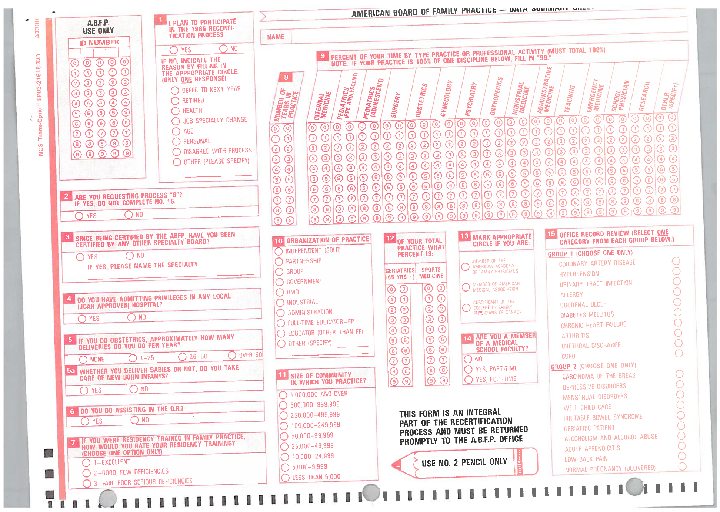
Notes:
1986

Slide 6
 | Continuing Certification Questionnaire (CCQ) | Initial Certification Questionnaire (ICQ) | National Graduate Survey (NGS) | Practice Demographic Survey (PDS) | National Resident Survey (NRS)
Timing | 3-4 months prior to examination date or beginning FMCLA | 3-4 months prior to examination date | Calendar Year | Calendar Year | With In-Training Examination
Cohorts | 10 years after residency; regularly returning cohorts | Residency graduates from that year | 3 years after residency graduation (2020 graduates in 2023) | End of each 3-year Continuous Certification Cycle | Residents
Business Requirement | Yes | Yes | No | No | No
Implemented | 1980s | 2014 | 2016 | 2019 | 2023

Slide 7
Contemporary ABFM Data Collection
~4,000, 100%
~1,700, 45%
~10,000 50%
~10,000, 100%
3rd Yr. Residents
New Diplomates
Recertifying
Diplomates
RTM
System
NRS
Initial Cert
Graduate
Survey
PDS
Contin Cert
Name, gender,
DOB, medical school, residency training
Introduced 2023
Introduced 2014
Introduced 2016
Introduced 2019
For 30+ years
2021
2023
2024
2027
3-year stage
2030
3-year stage
2034
3-year stage
2016
2026

Slide 8
Every exam candidate will be assigned a module.
Module 1 has 50/50 split within it
Modules will be assigned 1 through 5 in the order in which diplomates activate their application.
Additional ONC Questions (Core)
Module 1
ONC
Core Demographic Questions
50% of Module
100% of Module
50% of Module
Module 2 (PCMH)
Module 3 (Payment / Insurance)
Module 4 (Procedures)
Module 5 (Wellness)
2024 Continuing Certification Questionnaire Process

Slide 9
What ABFM data can and can’t do
Can
Provide valid estimates at a point in time
How has the percent of family physicians in solo practice changed over time?
How has involvement in inpatient care changed over time?
Can’t
Provide current information on all certified diplomates at a point in time
Identify all current diplomates in solo practice.
Provide a list of all current diplomates involved in inpatient care.

Slide 10
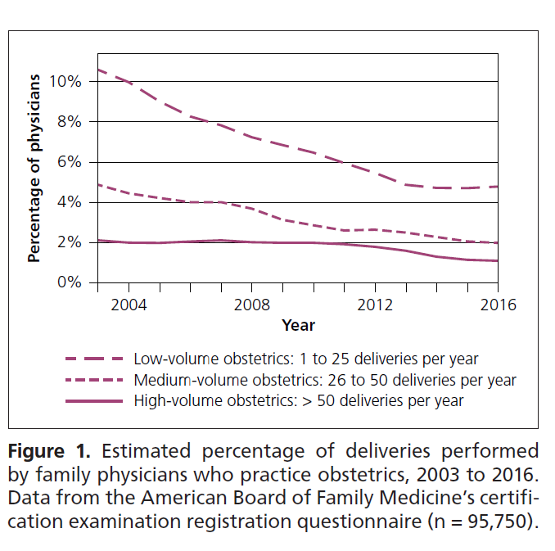
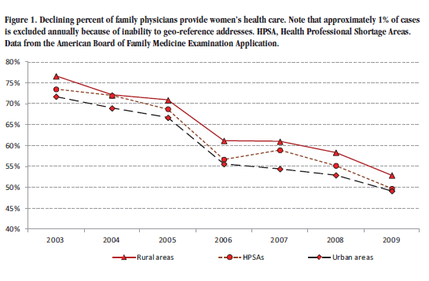
Declines in Scope – Women’s Health and OB (CCQ)
Xierali IM, Puffer JC, et al. The percentage of family physicians attending to women's gender-specific health needs is declining. JABFM 2012;25(4):406-407.
Barreto T, Peterson LE, et al. Family Physicians Practicing High Volume Obstetric Care Has Recently Dropped by Half. American Family Physician. 2017;95(12):762.

Slide 11
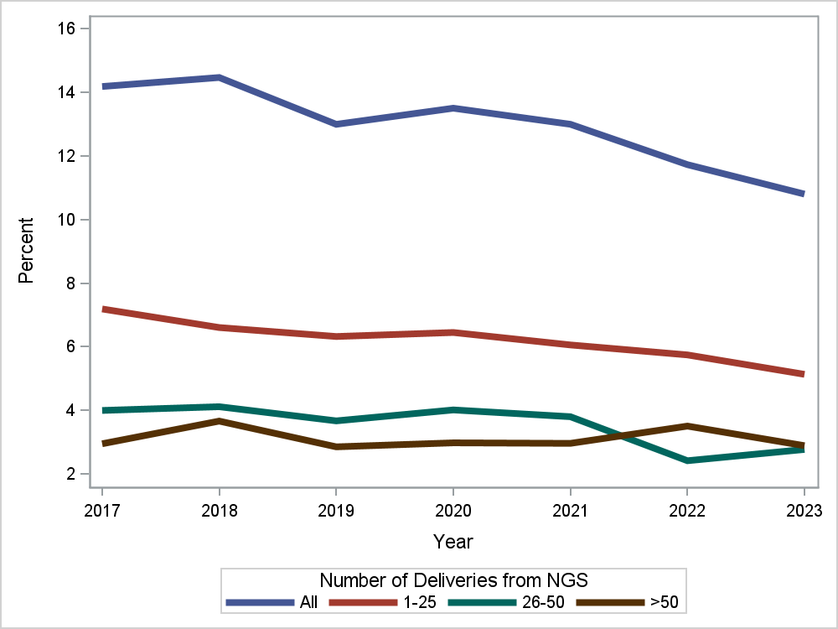
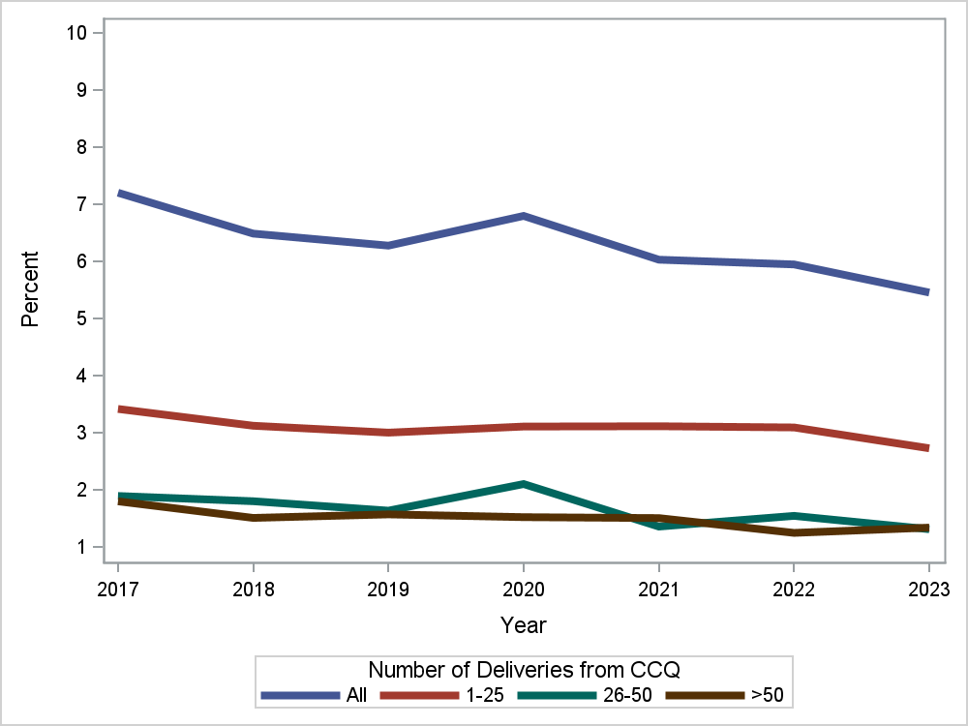
Declining Number Doing Deliveries
NGS
CCQ

Slide 12
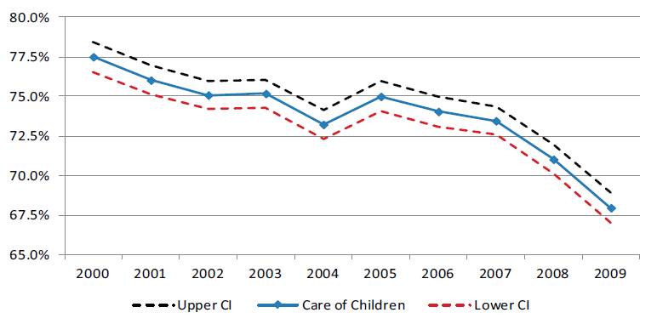
Declines in Scope – Care of Children (CCQ)
Bazemore AW, Makaroff LA, et al. Declining Numbers of Family Physicians Are Caring
for Children. JABFM 2012;25:139-140
Related Paper:
Eden AR, Morgan Z, Jetty A, Peterson LE. Proportion of Family Physicians Caring for Children is Declining. JABFM 2020;33:830-831

Slide 13
Declines in Scope – Adult Inpatient Care (CCQ)
Adapted from: Jetty A, Jabbarpour Y et al. The Declining Presence of Family Physicians in
Hospital-Based Care. JABFM 2019;32:771-772

Slide 14
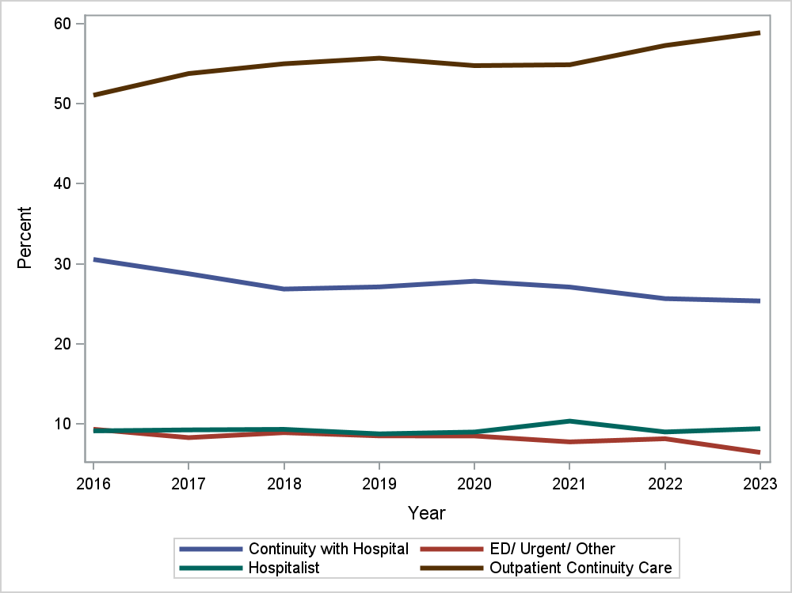
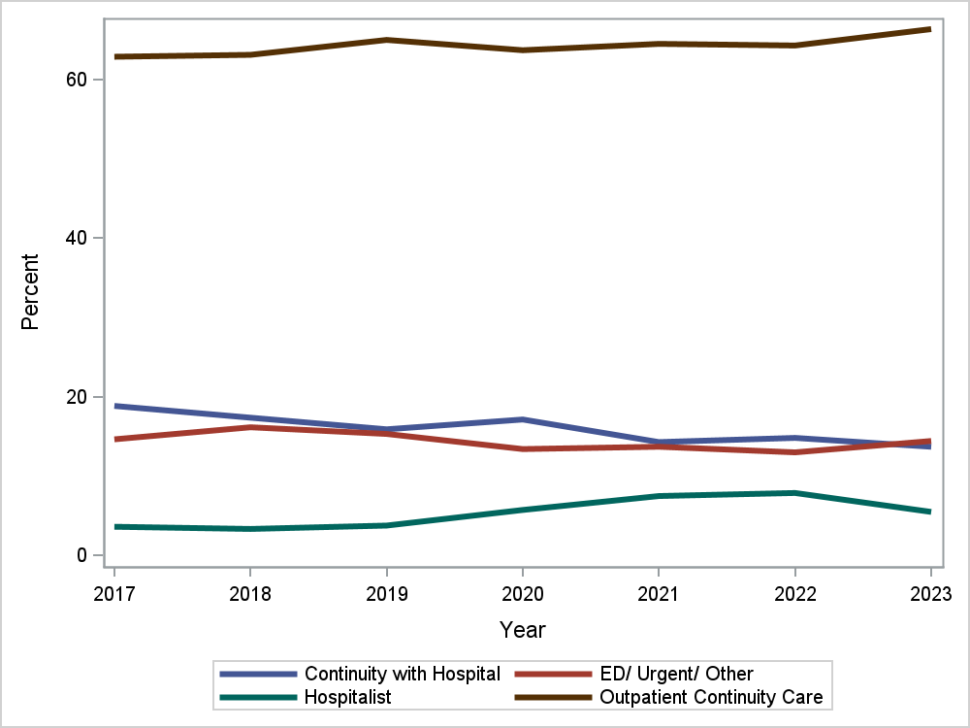
Practice Patterns of New Graduates (NGS) vs later Career Docs (CCQ)
NGS
CCQ
Related paper: Carek PJ, Cheng Y, et al. Variation in Practice Patterns of Early- and Later Career Family Physicians. JABFM 2024;37:35-42.

Slide 15
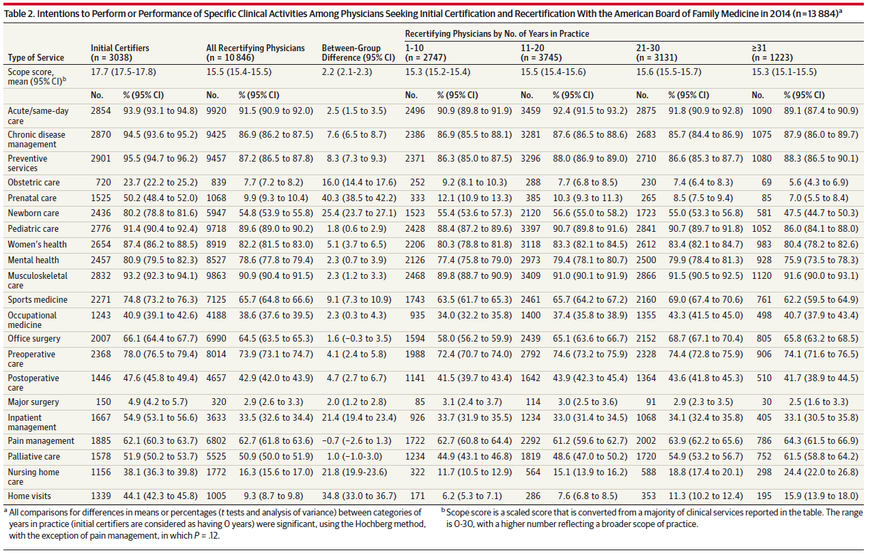
Gap in Intention of Residents to Practice of Later Career Family Physicians (ICQ vs. CCQ)
Coutinho AJ, Cochrane A, et al. Comparison of intended scope of practice for family medicine residents with actual scope of practice among practicing family physicians. JAMA 2015;314:2364-2372

Slide 16
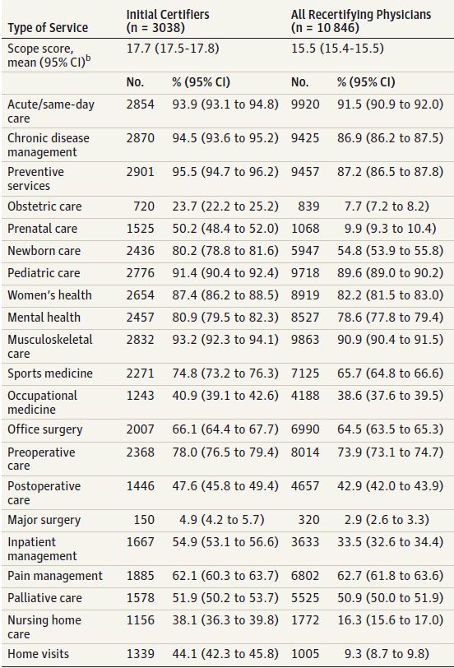
Largest gaps seen in..
  Prenatal care 40.3%
  Home visits 34.8%
  Newborn care 25.4%
  Nursing home care 21.8%
  Inpatient care 21.4%
  Obstetric care 16.0%

Slide 17
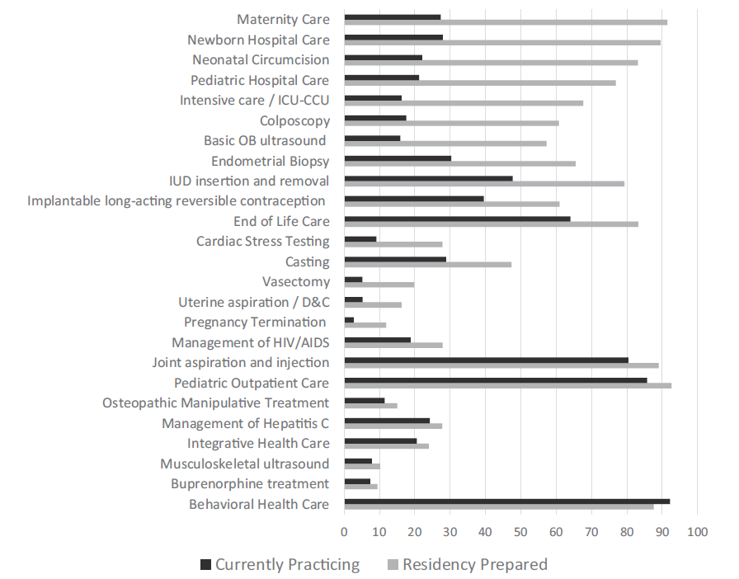
Gap Between Preparation and Practice (NGS)
Peterson LE, Fang B, et al. Wide Gap between Preparation and Practice of Early Career Family Physicians. JABFM 2018;31:174-177

Slide 18
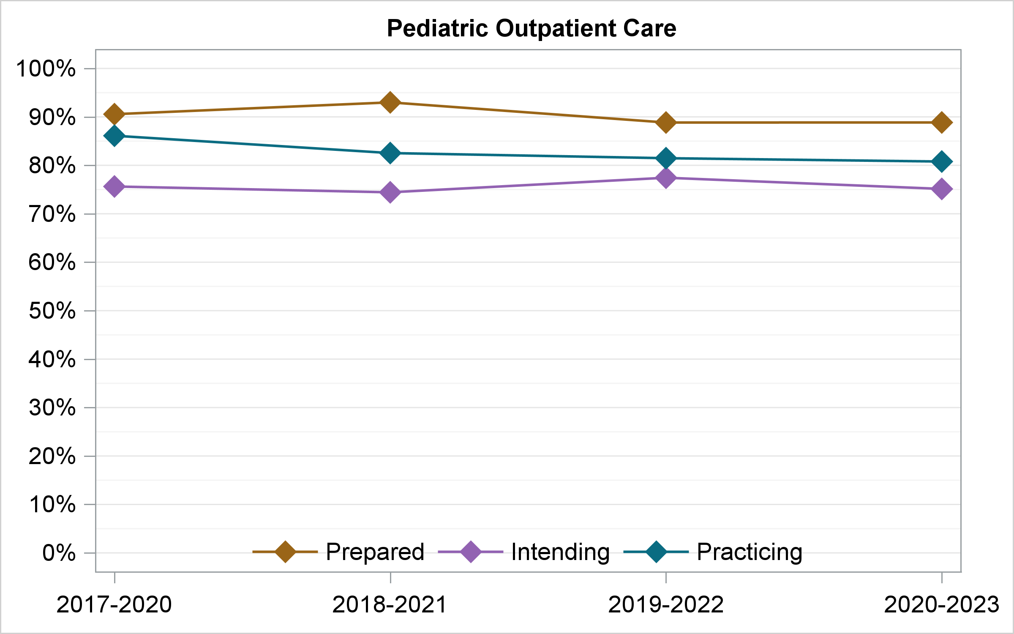

Slide 19
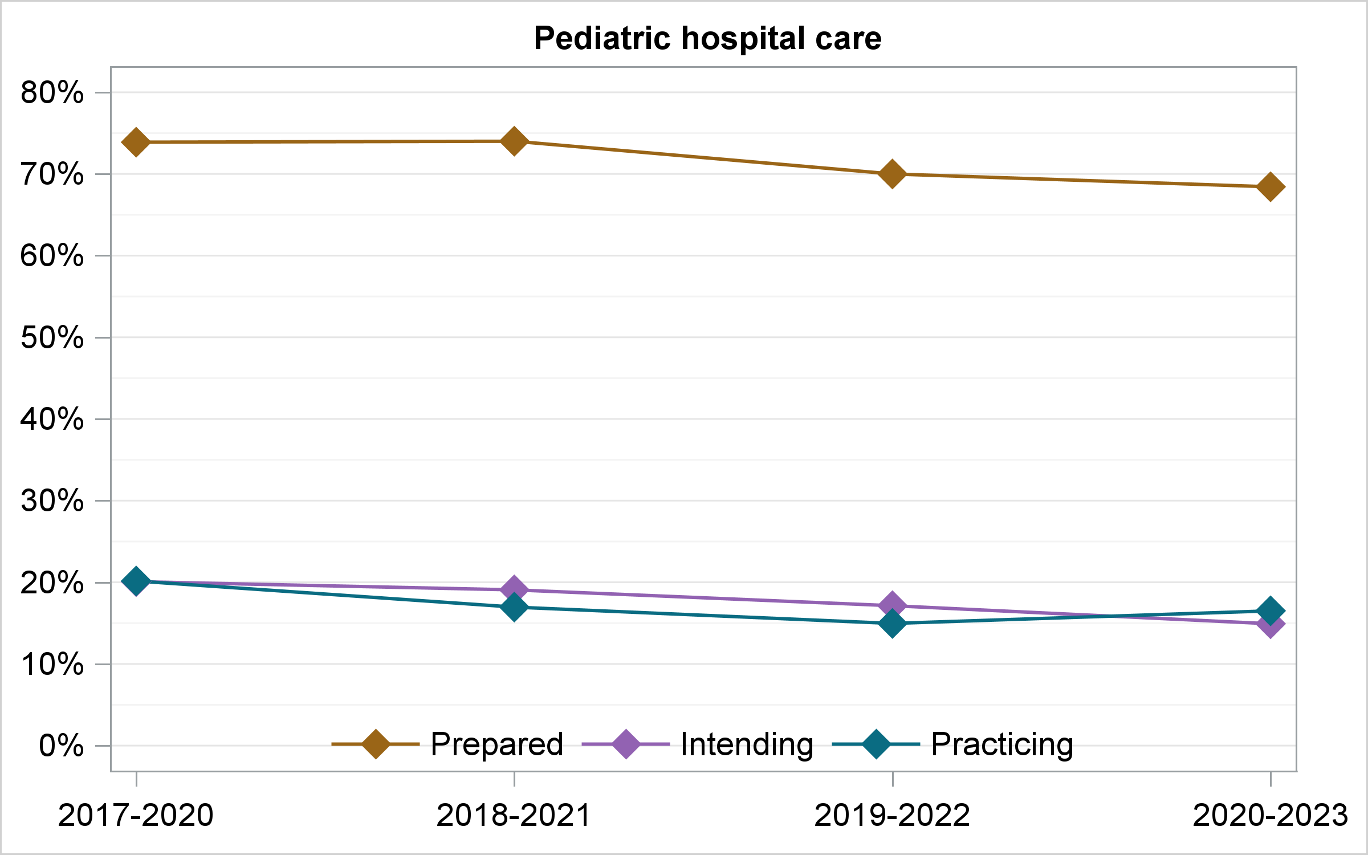

Slide 20
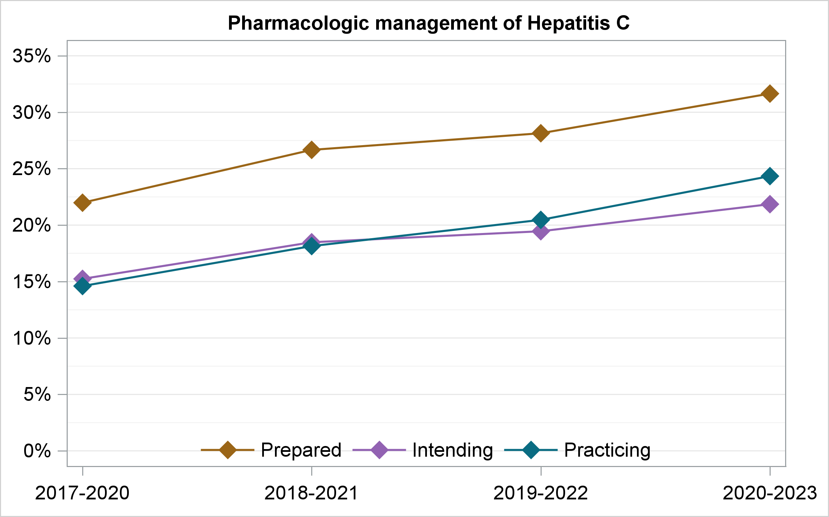

Slide 21
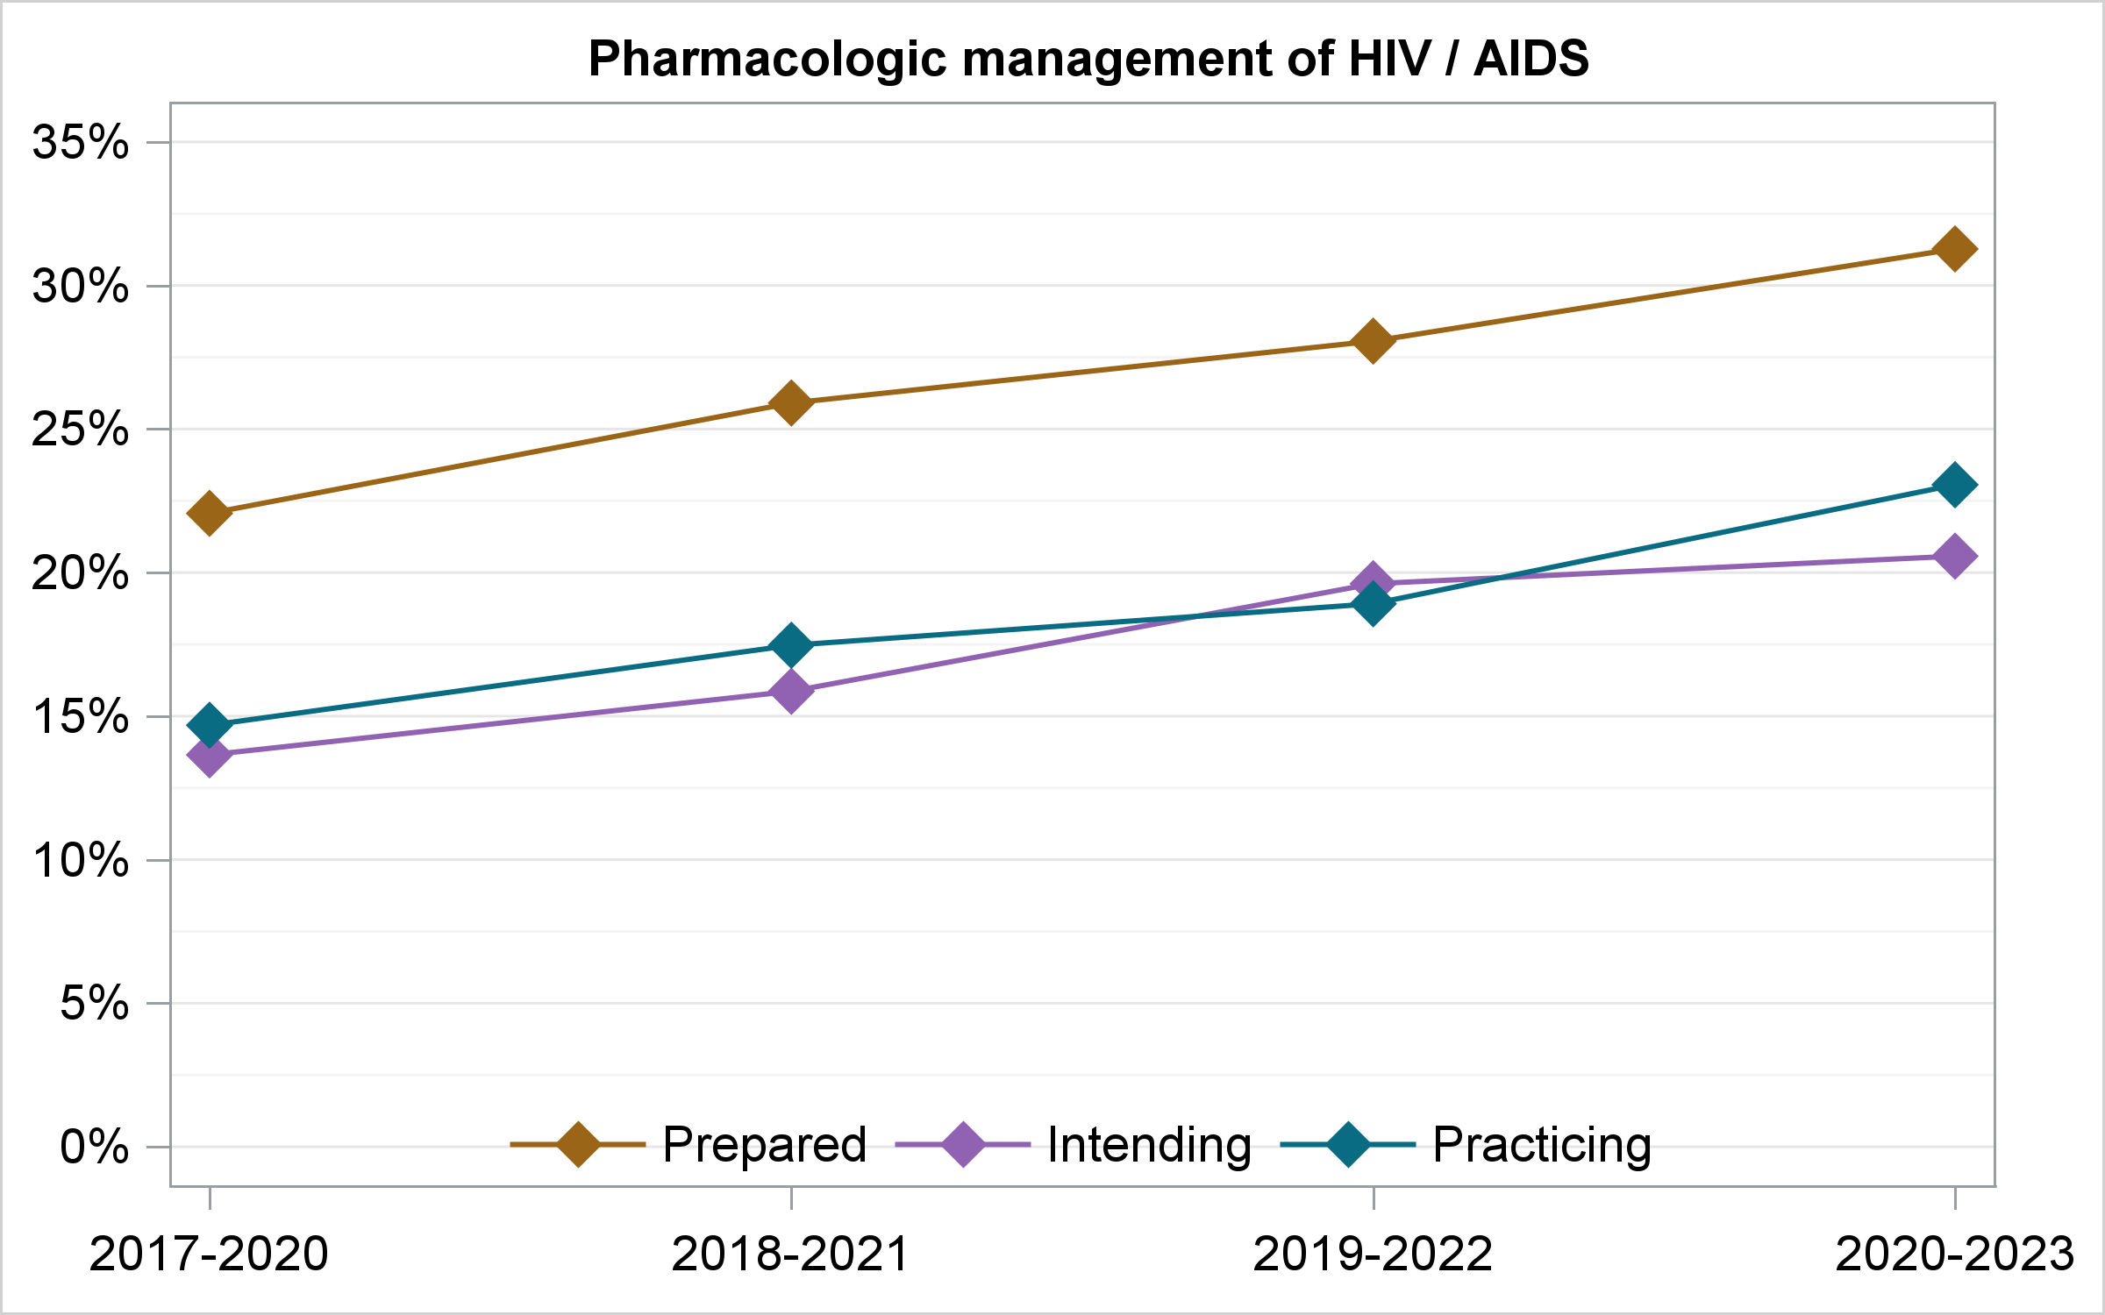

Slide 22
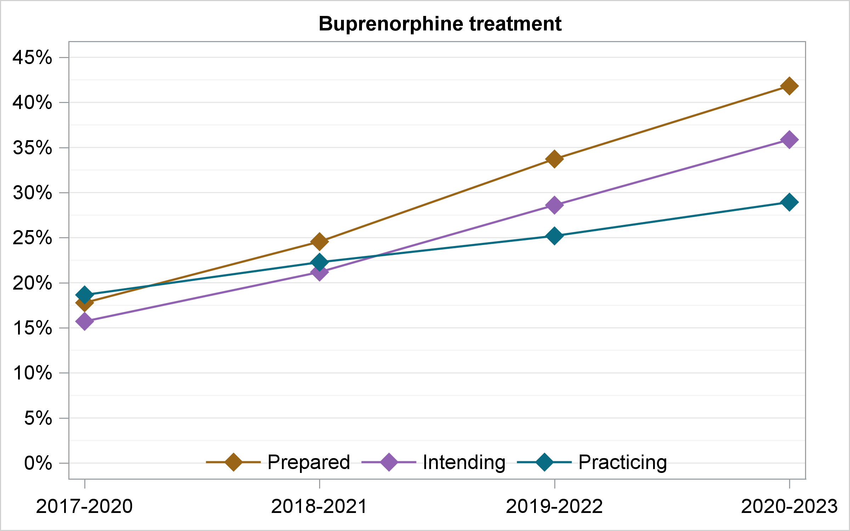

Slide 23
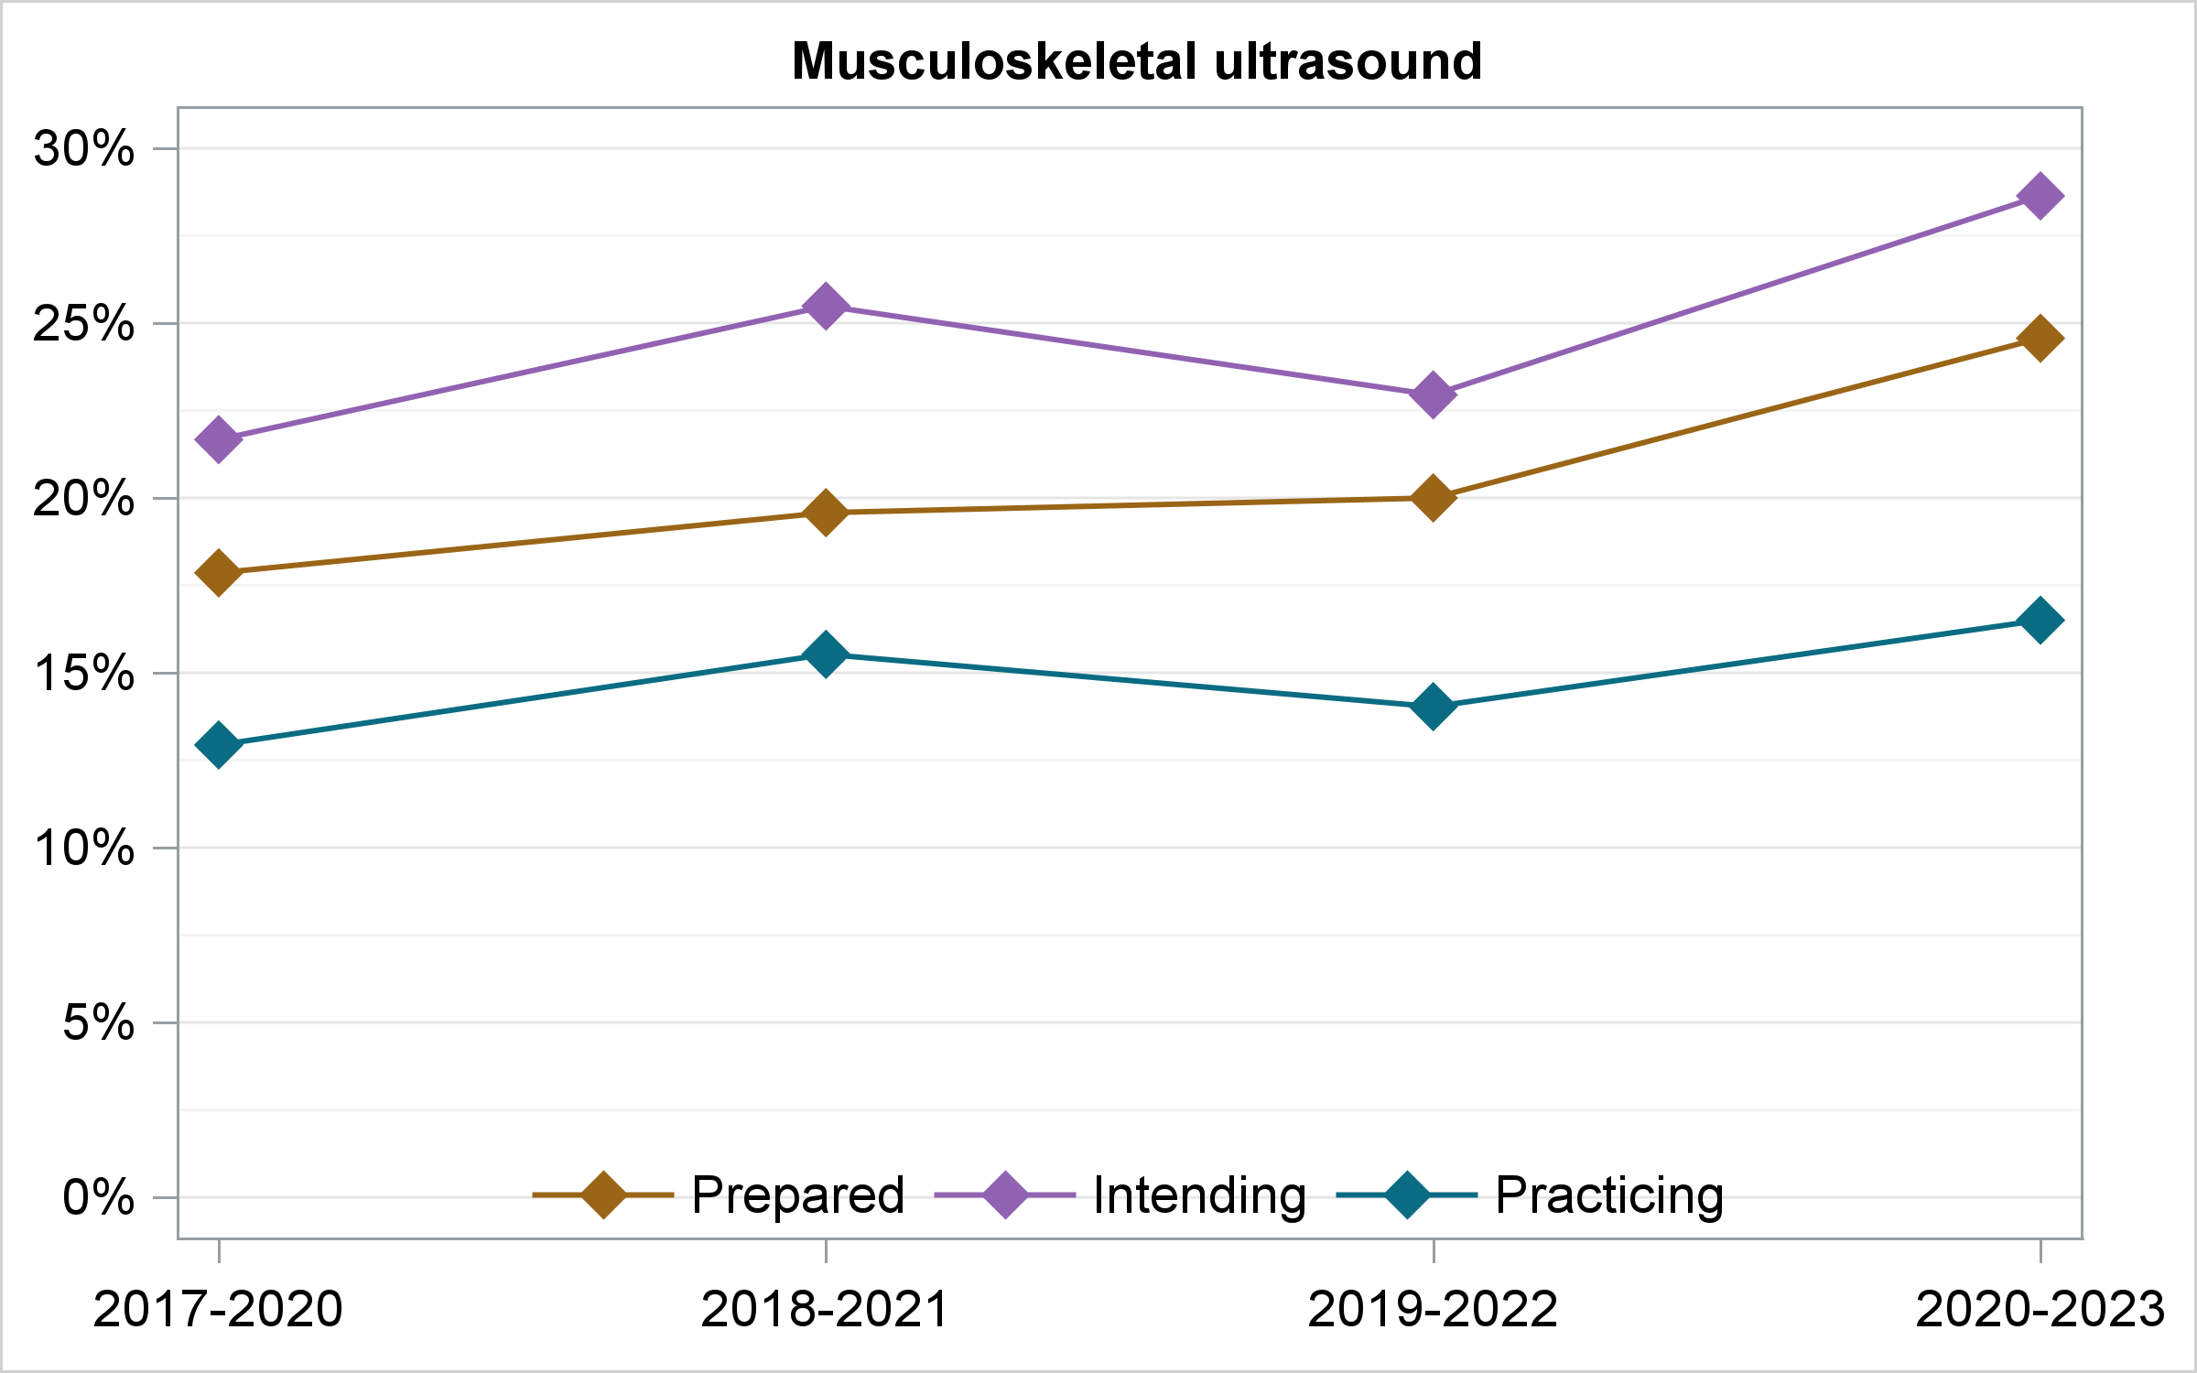

Slide 24
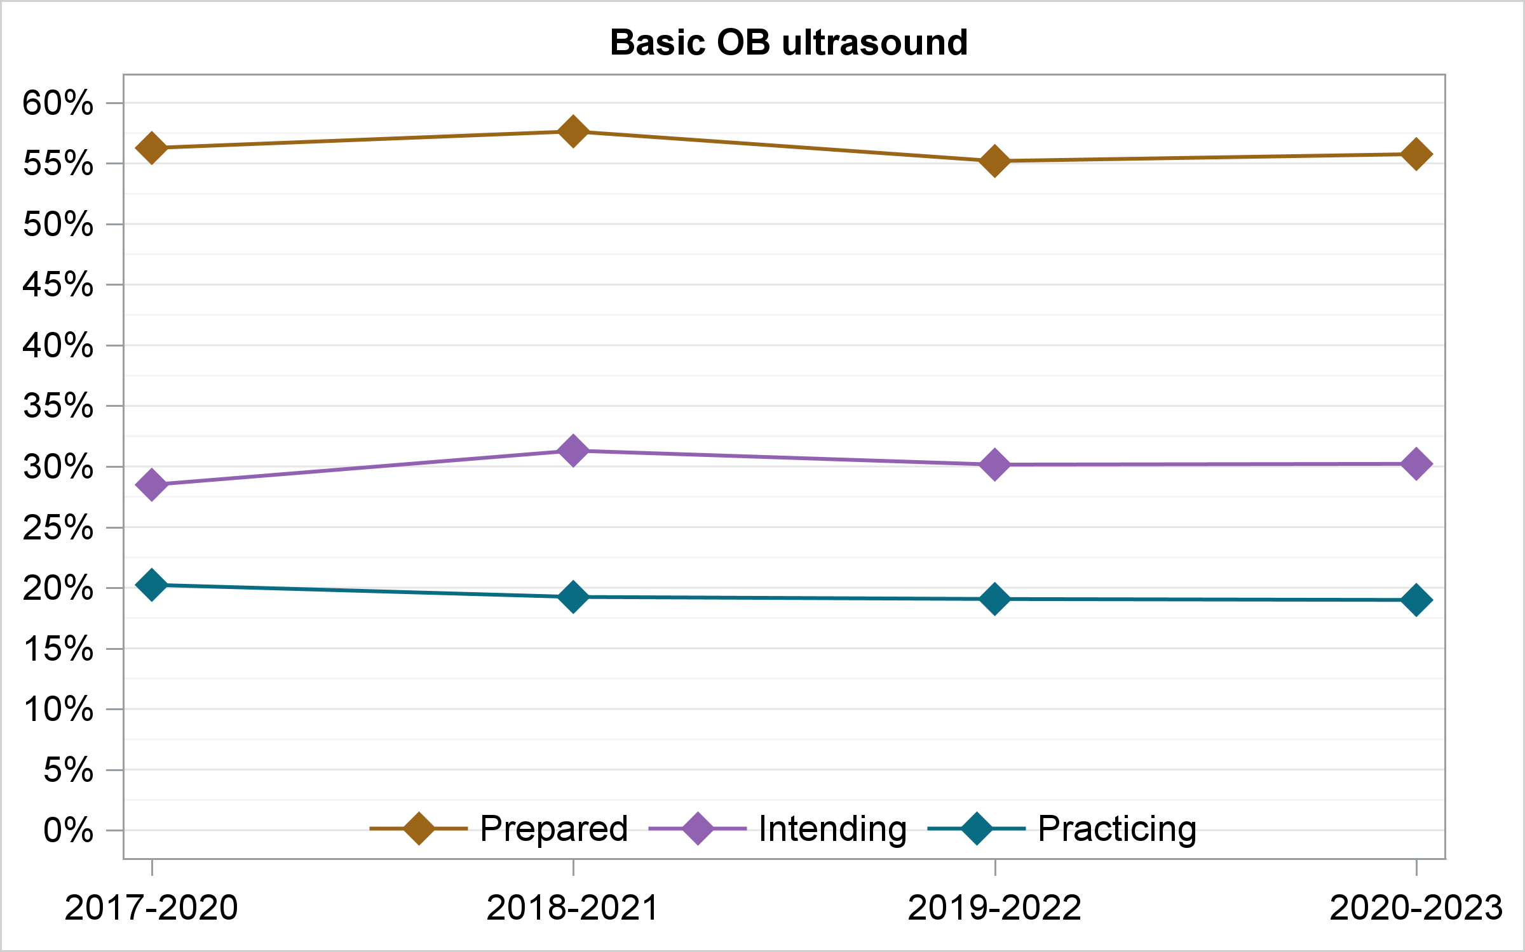

Slide 25
% of PGY-2’s Intended to Provide Each Service (NRS)
Notes:
From 2023 NRS.. Gender Affirming Care JABFM Policy Brief “in press”

Slide 26
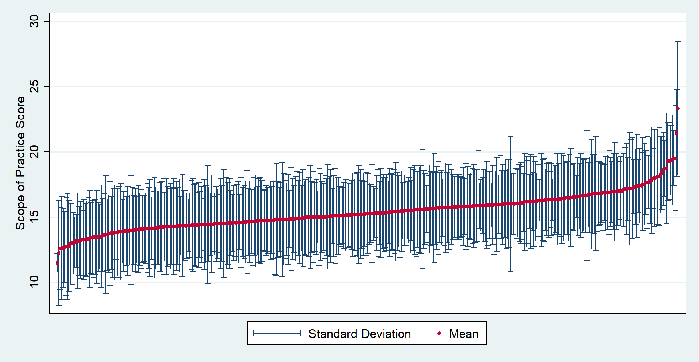
Scope of Practice Variation by Residency (CCQ)
Coutinho AJ, Levin Z, et al. Residency Program Characteristics and Individual Physician Practice Characteristics Associated With Family Physician Scope of Practice. Academic Medicine 2019;94:1561-1566.

Slide 27
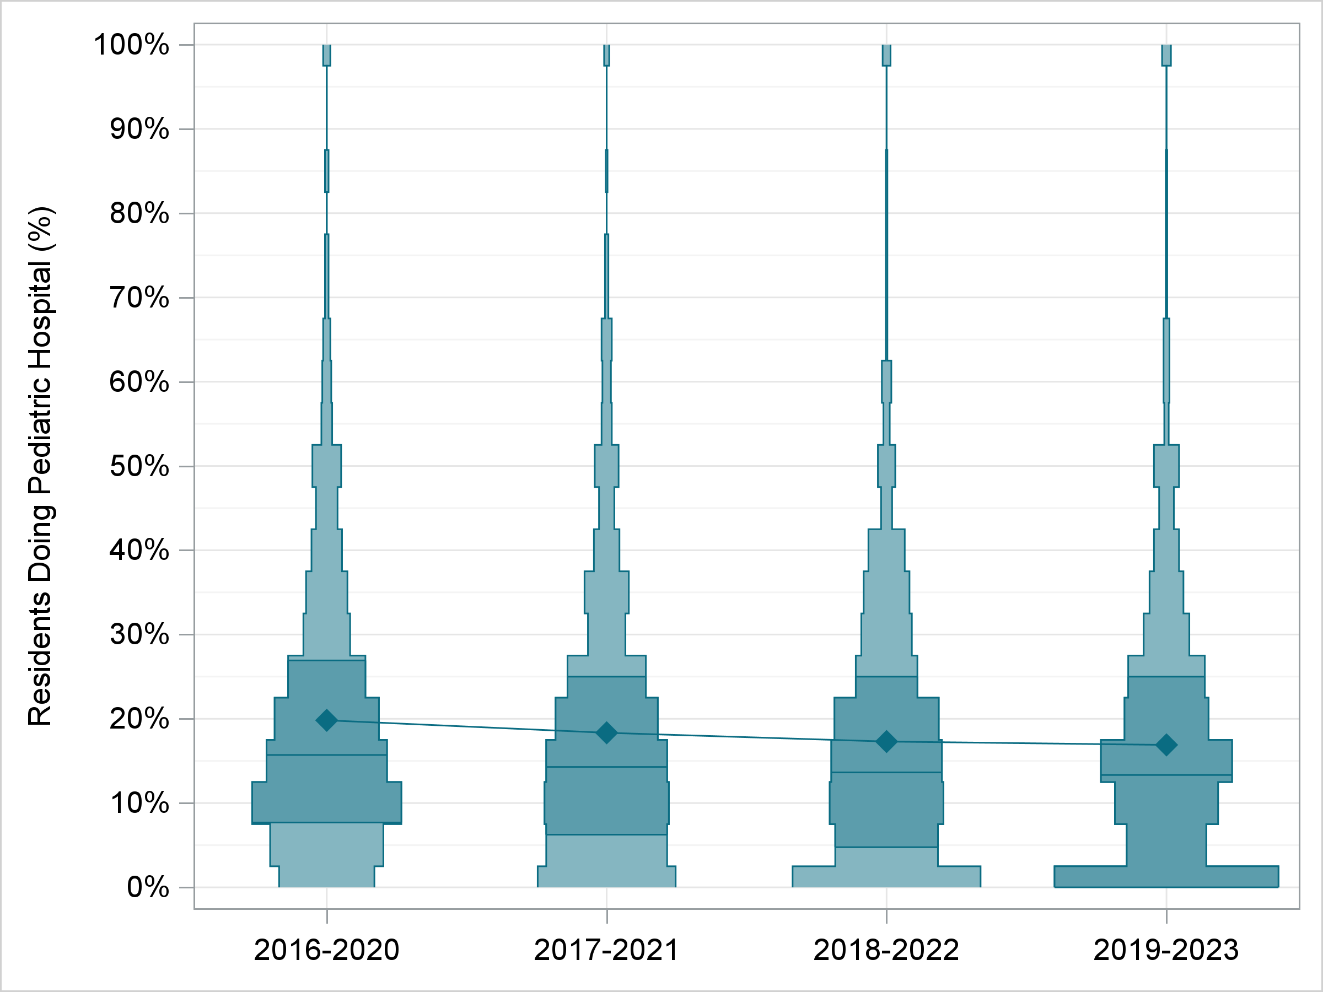
Residency Level - Pediatric Hospital Care (NGS)
Notes:
NGS data.. 5 year rolling averages.. Data are % of graduates of a program providing pediatric inpatient care

Slide 28
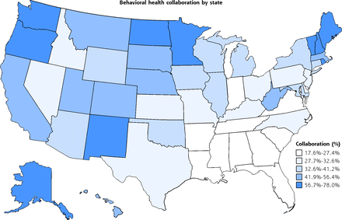
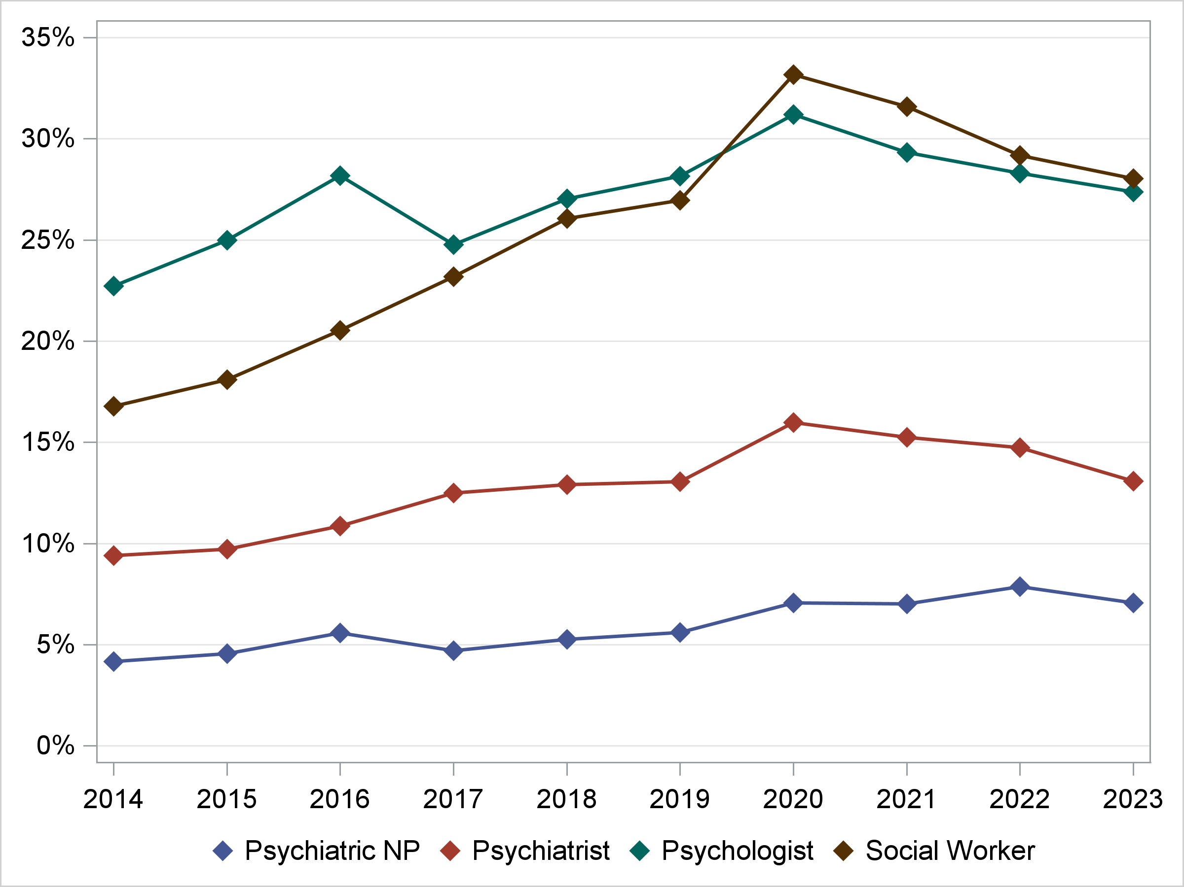
Mental Health Professionals in FP Practices (CCQ)
Tong ST, Morgan ZJ, et al. Characteristics of Family Physicians Practicing Collaboratively With Behavioral Health Professionals. AFM 2023;21:157-160
Notes:
Tong paper… The questionnaire asked FPs if they worked collaboratively with each of psychiatrists, psychiatric nurse practitioners, licensed social workers, psychologists, and/or other BHPs

