Slide 1
AAFP Advocacy Update
FMLC Meeting
August 2021

Slide 2
Today’s Agenda
Administration
AAFP Advocacy Activities
Government Relations Advocacy Revamp
Congress
Notes:
I want to thank you for the opportunity to present at XXXXX.
My name is XXXX
For today’s presentation, I plan to focus my remarks on four parts
First, I’d like to take a few minutes to walk you through our core advocacy areas of focus for 2021.
Second, I’ll share an overview of legislative/administrative/regulatory activity that occurred over the first 6 months of this year
Third, I will walk through what we expect to consume much of the activity for the remainder of this year
Lastly, I’ll talk through our legislative/regulatory priorities for the remainder of this year and tactics the AAFP will undertake to achieve wins for family medicine.

Slide 3
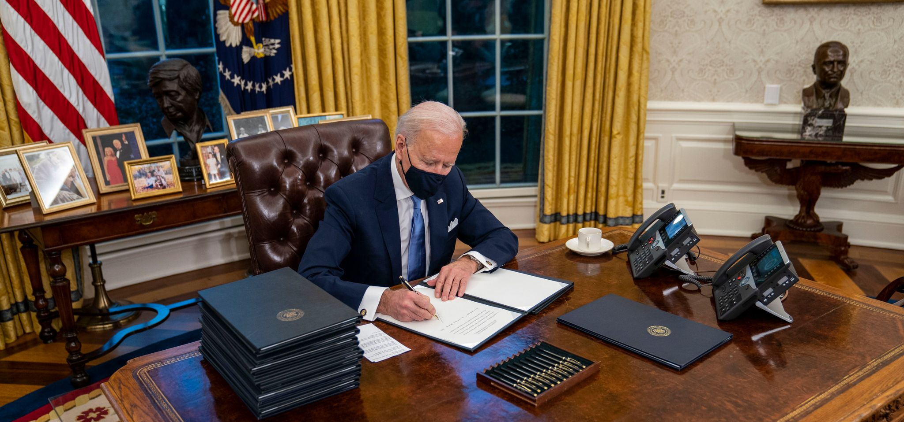
Administration
Medicare
Medicaid
CMMI Strategy Refresh
Preparedness
Vaccination Efforts
Competition EO

Slide 4
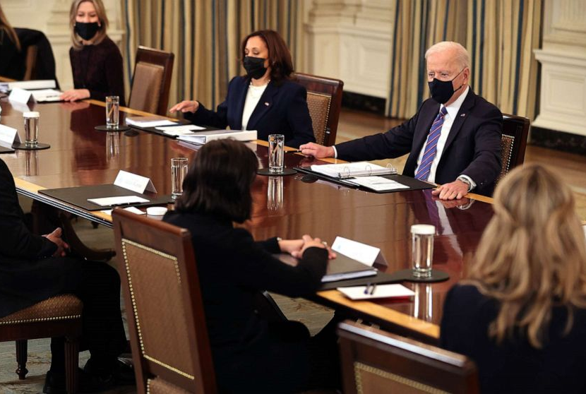
Congress Remainder of 2021
Budget/Appropriations/Debt Limit
American Jobs Plan American Families Plan
Other Health Items

Slide 5
Timing of Action
October-December: Congress advances key components of Biden’s American Jobs Plan and American Family Plan via reconciliation
August: Congress considers/adopts an FY22 budget resolution – setting up Round 2 of reconciliation
2021
July 28: Senate starts work on bipartisan infrastructure framework (BIF) – key components of President Biden’s American Jobs Plan
August 1st: Debt limit reinstated
December: Congress passes CR or omnibus appropriations bills – potential for addressing other health care priorities
October 1^{st:} Fiscal year 2022 begins – Congress needs to pass temporary funding to keep the government open and raise the debt limit

Slide 6
AAFP Advocacy Activities
AAFP Issue | Issue | Solution
Medicaid Pay Parity | Lack of parity between Medicaid and Medicare | Kids Access to Primary Care Act (H.R. 1025) Ensuring Access to Care for Women and Children Act (S.1833)
High Deductible Health Plan coverage | Costs preventing patients from seeking care | Waiving deductibles for primary care visits (Legislation forthcoming)
Telehealth | COVID-19 expanded telehealth utilization, but current flexibilities sunset when PHE ends | Permanently expand access to telehealth while protecting the physician-patient relationship and promoting high-quality, comprehensive, continuous care
Workforce | Facing primary care physician shortages – especially in rural & underserved communities | Permanent reauthorization and new funding for THCGMEs (DOC Act)
Administrative Burden | Reducing point of care burdens on family physicians | Seniors Access to Timely Care Act (H.R. 3173)
Physician Payment | Reduction to the conversion factor for 2022 | AAFP submitting comments to CMS and working with Congress to seek relief from cuts to family physician payment for 2022

Slide 7
AAFP Advocacy Tactics
Direct lobbying with key committees, legislators
Coalition engagement
Family Medicine Advocacy Summit (May virtual meeting)
FamMedPAC alignment with champions
Family Medicine

Slide 8
Advocacy Revamp
AAFP Advocacy Wins
Twitter:@aafp_advocacy
Key Contact Program
Congressional Primary Care Caucus

Slide 9
9

