Slide 1
AAFP Advocacy Update
FMLC Meeting
August 2021

Slide 2
Today’s Agenda
2nd Quarter Wrap-up
2021 Advocacy Priorities
AAFP Advocacy Activities
Government Relations Advocacy Revamp

Slide 3
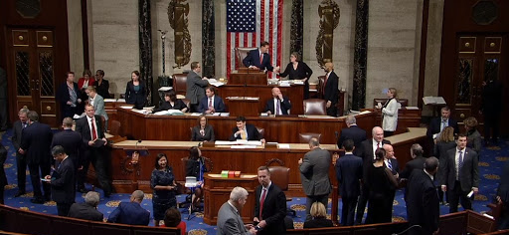
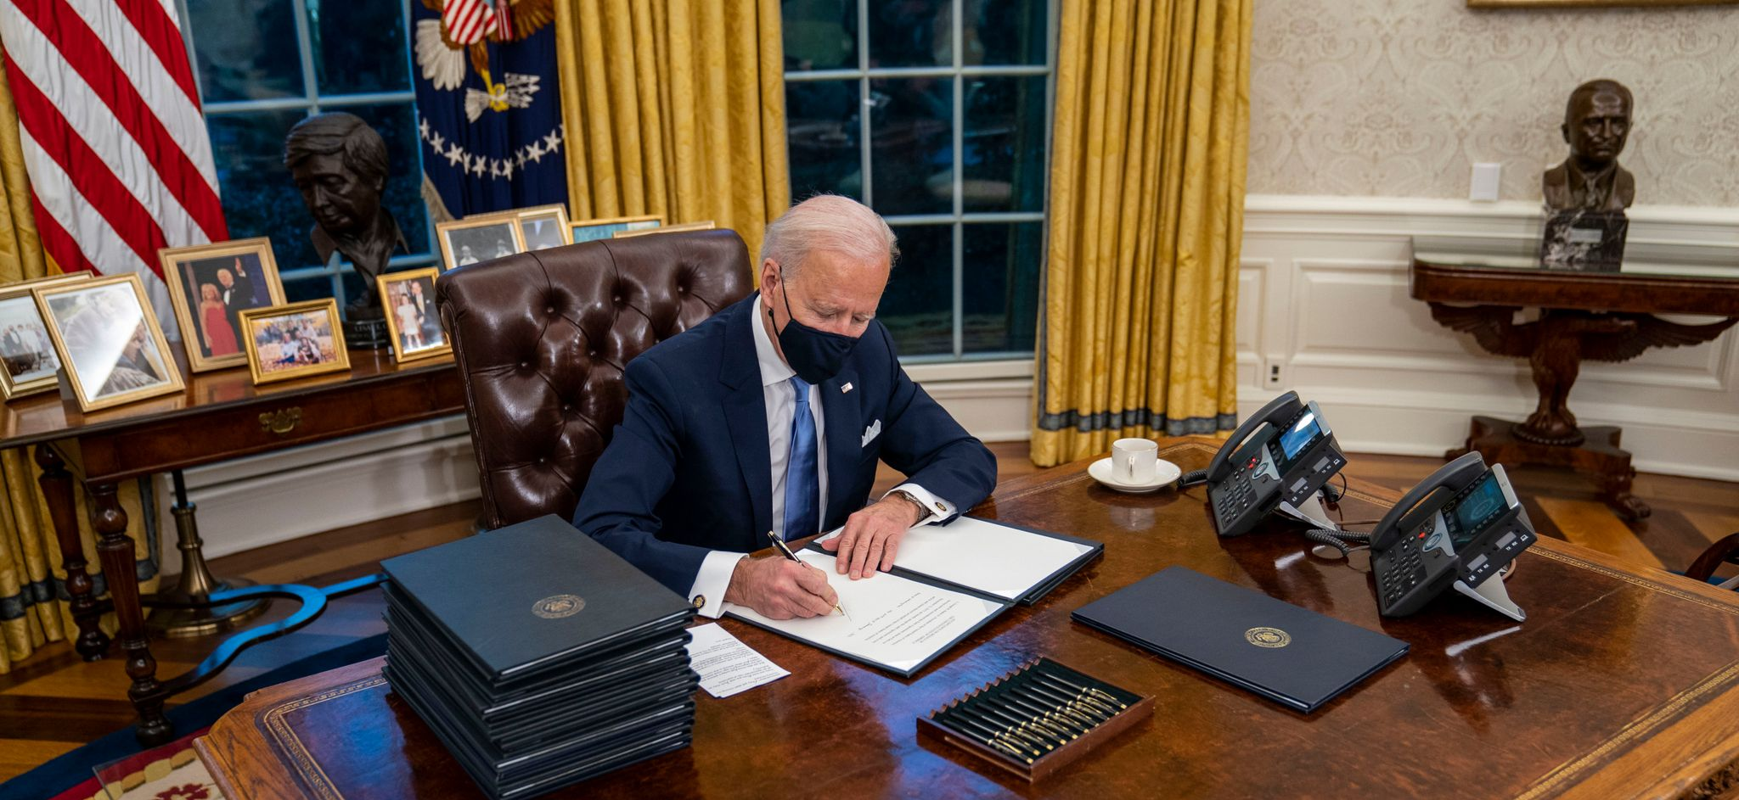
2nd Quarter Wrap up
American Rescue Plan
  Medicaid support
  Public health funding
  COBRA subsidies
  ACA premium tax credits
  THCGME expansion
FY2022 Budget/Appropriations
American Jobs/Family Plans Rollout

Slide 4
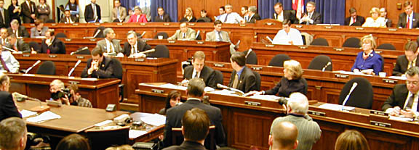
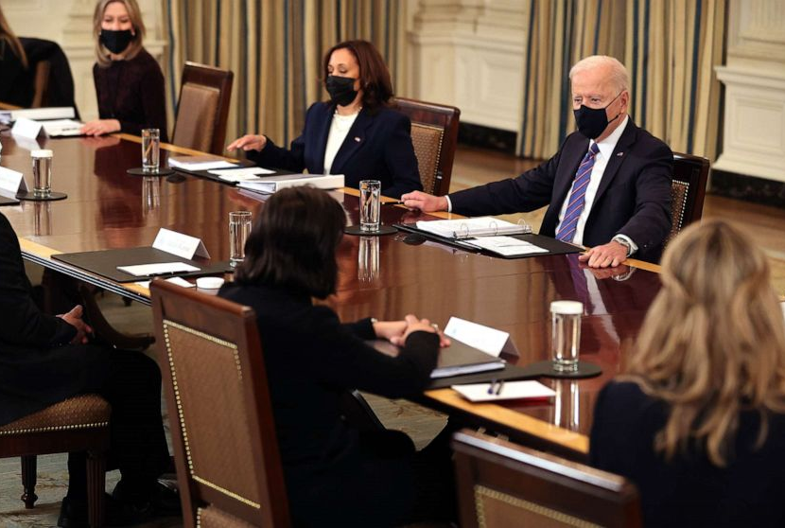
Remainder of 2021
Budget/Appropriations/Debt Limit
American Jobs Plan (Bipartisan)
American Families Plan (Partisan)
  Using budget reconciliation
Other Health Items
  Medicare sequester
  Telehealth flexibilities
  Behavioral health
  Pandemic preparedness
  Addressing social determinants of health (SDOH)
  Competition EO

Slide 5

Areas of Focus --
2021 and Beyond
Health care for all
Strengthening the workforce
Health equity
Value-based payment
Telehealth

Slide 6
AAFP Advocacy Priorities
AAFP Issue | Issue | Solution
Medicaid Pay Parity | Lack of parity between Medicaid and Medicare | Kids Access to Primary Care Act (H.R. 1025) Ensuring Access to Care for Women and Children Act (S.1833)
High Deductible Health Plan coverage | Costs preventing patients from seeking care | Waiving deductibles for primary care visits (Legislation forthcoming)
Telehealth | COVID-19 expanded telehealth utilization, but current flexibilities sunset when PHE ends | Permanently expand access to telehealth while protecting the physician-patient relationship and promoting high-quality, comprehensive, continuous care
Workforce | Facing primary care physician shortages – especially in rural & underserved communities | Permanent reauthorization and new funding for THCGMEs (DOC Act)
Administrative Burden | Reducing point of care burdens on family physicians | Seniors Access to Timely Care Act (H.R. 3173)
Physician Payment | Reduction to the conversion factor for 2022 | AAFP submitting comments to CMS and working with Congress to seek relief from cuts to family physician payment for 2022

Slide 7

AAFP Advocacy Tactics
Direct lobbying with key committees, legislators
Coalition engagement
Family Medicine Advocacy Summit (May virtual meeting)
FamMedPAC alignment with champions
Family Medicine

Slide 8


Advocacy Revamp
AAFP Advocacy Wins
Twitter:@aafp_advocacy
Key Contact Program
Congressional Primary Care Caucus

Slide 9

9

Slide 10


Slide 11

Overview of the Physician Fee Schedule
Key Proposals for Calendar Year (CY) 2022

Slide 12
PFS Conversion Factor and E/M Split Visit Proposals
CMS is proposing a $33.58 PFS conversion factor, a decrease of $1.31 from the CY 2021 conversion factor.
  This reduction reflects the expiration of the 3.75 percent increase to the PFS that was included in the Consolidated Appropriations Act, 2021 (CAA), PFS budget neutrality requirements, and adjustments to account for changes to RVUs of certain codes and other policies in the proposed rule.
    This could change if Congress addresses the issue legislatively.
CMS is proposing to refine its policies for split (or shared) E/M visits to reflect the “evolving” role of non-physician practitioners (NPP). These visits refer to where a physician and NPP personal perform a substantive portion of an E/M visit.
CMS is proposing the following changes:
  Defining split (or shared) E/M visits as E/M visits provided in the facility setting by a physician and an NPP in the same group.
  The practitioner who provides the substantive portion of the visit (more than half of the time spent) would bill for the visit.
  These visits could be reported for new as well as established patients, initial and subsequent visits, as well as prolonged services.
  Requiring reporting of a modifier on the claim to improve program integrity.
  Documentation in the medical record identifying the two individuals performing the visit, and the provider conducting the substantive portion must sign and date the medical record.
  Codifying the proposals and revised policies into regulation.

Slide 13
Teaching Physician Primary Care Exception
Under the “primary care exception” Medicare makes payments in certain teaching hospital primary care centers for specific services that are lower- to mid-level complexity furnished by a resident without the physical presence of a teaching physician.
CMS had expanded the list of services that residents could furnish for the duration of the COVID-19 PHE to include all levels of E/M services, including the higher complexity services.
  Once the PHE ends, the higher complexity level services (levels 4 and 5) will no longer be under the exception.
CMS proposes that under the primary care exception, only Medical Decision Making (MDM) can be used to select the E/M visit level.
Given teaching physicians can supervise up to four residents at one time, CMS wants to guard against residents furnishing high-level complexity visits.

Slide 14
Proposed Medicare Telehealth Policies
CMS added 135 new services to the Medicare telehealth list that are available during the COVID-19 PHE.
  CMS is proposing to make a subset of these services (added on a “Category 3” basis) available through 2023 in order to gain more information and ultimately determine whether they should be made permanent.
    Category 1: Services that are like professional consultations and office visits that are currently on the telehealth list
    Category 2: Services that are not like those on the telehealth list but there is a demonstrated clinical benefit for the beneficiary
    Category 3: Services that are on the list temporarily through the COVID-19 PHE for which there is likely a clinical benefit but not enough evidence to be made permanent
CMS is also proposing to implement a provision of the CAA that would permanently allow established patients to receive mental health treatment via telehealth from their home.
  The provider must have an in-person visit within six months prior to the first telehealth visit.
CMS is proposing to allow the use of audio-only technology for mental health visits, but the provider would have to certify that audio-only was used due to beneficiary choice or limitations.
  This also requires in-person visit within six months of the audio-only visit.

Slide 15
Vaccine Administration Requests for Information
Medicare vaccine payment rates have been frozen at a low rate for the past several years.
CMS seeks feedback on various issues to provide a more appropriate payment rate for vaccines, which includes:
  Differences in costs for furnishing COVID-19 vaccines compared to other Part B-covered vaccines (e.g., flu, pneumococcal, Hepatitis B)
  Resource costs associated with furnishing vaccines (e.g., labor, infrastructure, vaccine storage and handling, procurement and coordination, supplies, reporting requirements)
  Whether Medicare should continue to pay differently for non-COVID-19 vaccines based on setting
    For example: The average physician rate is $16.94 versus $40 for outpatient hospital departments
  Whether CMS should use a different process to update preventative vaccine payments
  Whether there are major differences in what Medicare pays physicians compared to what commercial insurers pay

Slide 16
Health Equity Request For Information
CMS seeks feedback on ways to address health inequities across programs and policies.
CMS notes that belonging to a racial or ethnic minority group; living with a disability; sexual orientation; living in a rural area; or living in poverty is associated with worse health outcomes.
Therefore, CMS is soliciting feedback on the collection of data and how it can advance health equity for beneficiaries.
For example, CMS is soliciting feedback on improving data collection through the creation of confidential reports that allow providers to look at patient impact through a variety of data elements, including, LGBTQ status; Race and ethnicity; Dual-eligibility (i.e., enrolled in both Medicare and Medicaid); Disability; and Rural population
CMS is also requesting comment on how the agency can incorporate health equity into quality measures for MIPS and the MIPS Value Pathways

Slide 17
Quality Payment Program Proposals: MIPS Category Weights
CMS is statutorily required to weight the cost and quality performance categories equally beginning with Performance Year (PY) 2022
MIPS Individuals, Groups, and Virtual Groups:
  Quality: 30% (ten percent decrease from 2021)
  Cost: 30% (ten percent increase from 2021)
  Promoting Interoperability: 25% (no change)
  Improvement Activities: 15% (no change)
There are no proposed changes to the weights for APM entities or those participating in the APM Performance Pathway.

Slide 18
Quality Payment Program: MIPS Value Pathways (MVPs) Transition
CMS is continuing to move forward with MVPs to eventually replace traditional MIPS.
CMS envisions that MVPs would help drive value, reduce burden, and facilitate movement to APMs.
MVPs are intended to focus on a given specialty, condition, and/or episode of care that can better measure value compared to traditional MIPS.
Beginning in CY 2023, CMS is proposing to allow reporting on MVP participants to report on an MVP, and CMS is considering, but not proposing, to sunset traditional MIPS by 2027.
MVP Implementation Timeline
Proposal:
CY 2023 MIPS Performance Period | An initial set of seven MVPs are available for reporting; MVP reporting is voluntary.
For Future Consideration:
CY 2024- CY 2027 MIPS Performance Periods | The existing MVP portfolio would be gradually updated to include newly developed MVPs that are available for reporting. MVP reporting is voluntary.
End of CY 2027 MIPS Performance Period and Corresponding Data Submission Period | Considered sunset of traditional MIPS.
CY 2028 MIPS Performance Period, and Future Years | Considered mandatory MVP reporting.

Slide 19
Quality Payment Program: MIPS Value Pathways (MVPs) Reporting Requirements
In general, MVPs are intended to have similar reporting requirements as traditional MIPS.
Overview of proposed reporting requirements:
  Quality: MVP participants would select 4 quality measures, 1 must be an outcome measure (or a high priority measure if an outcome is not available or applicable)
  Improvement Activities: MVP participants would select 2 medium weighted improvement activities or on high weighted improvement activity; OR participates in a certified or recognized patient-centered medical home or comparable specialty practice
  Cost: MVP participants would be scored on the cost measures included in the MVP they select and report.
  Foundational Layer: MVP participants would select 1 population health measure and results are added to the quality score. Additionally, MVP participants would be required to meet the promoting interoperability performance category requirements at § 414.1375(b)

Slide 20
Quality Payment Program: MIPS Value Pathways (MVPs) Proposed MVPs Pathways
CMS is proposing the following seven MVPs to be available for 2023.
Proposed Advancing Rheumatology Patient Care MVP Beginning with the CY 2023 MIPS Performance Period/2025 MIPS Payment Year. The proposed MVP focuses on the clinical theme of providing treatment and management of rheumatological conditions and is most applicable to clinicians who specialize in treating patients with rheumatologic conditions.
Proposed Coordinating Stroke Care to Promote Prevention and Cultivate Positive Outcomes MVP Beginning with the CY 2023 MIPS Performance Period/2025 MIPS Payment Year. The proposed MVP focuses on providing fundamental prevention and treatment of those patients at risk for or that have had a stroke. This proposed MVP would be most applicable to clinicians who treat clinically varied patient types within the practice of neurology and vascular surgery.
Proposed Advancing Care for Heart Disease MVP Beginning with the CY 2023 MIPS Performance Period/2025 MIPS Payment Year. The proposed MVP focuses on the clinical theme of providing fundamental treatment and management of costly clinical conditions that contribute to, or may result from, heart disease. This proposed MVP would be most applicable to clinicians who treat clinically varied patient types within the practice of cardiology.
Proposed Optimizing Chronic Disease Management MVP Beginning with the CY 2023 MIPS Performance Period/2025 MIPS Payment Year. The proposed MVP focuses on the clinical theme of providing fundamental treatment and management of chronic disease such as diabetes, coronary artery disease, chronic obstructive disease, and major adult depression. This MVP would be most applicable to clinicians who treat clinically varied patient types with those chronic clinical conditions including but not limited to family practice, internist, or geriatric care. (Primary Care MVP)
Proposed Adopting Best Practices and Promoting Patient Safety within Emergency Medicine MVP Beginning with the CY 2023 MIPS Performance Period/2025 MIPS Payment Year. The proposed MVP focuses on important assessors of the care emergency clinicians provide to patients with undifferentiated high-risk conditions. This proposed MVP would be most applicable to clinicians who treat clinically varied patient types within the emergency department.
Proposed Improving Care for Lower Extremity Joint Repair MVP Beginning with the CY 2023 MIPS Performance Period/2025 MIPS Payment Year. The proposed MVP focuses on the clinical theme of providing fundamental treatment and management of patients with osteoarthritis and lower extremity surgical repair, such as fracture and total joint replacement, to ensure appropriate care and reduce costs. This proposed MVP would be most applicable to clinicians who treat clinically varied patient types and who may also be assessed for, or who have undergone, lower extremity surgical repair, including pre- and post-operatively.
Proposed Patient Safety and Support of Positive Experiences with Anesthesia MVP Beginning with the CY 2023 MIPS Performance Period/2025 MIPS Payment Year. The proposed MVP focuses on increasing quality of anesthesia care, improving postoperative outcomes, promoting patient safety, and enhancing satisfaction for patients receiving anesthesia. This MVP would be most applicable to clinicians who provide anesthesia services to patients within the surgical setting or those who are considered anesthesiologists or other qualified anesthesia professionals.

Slide 21
FMLC
CAFM Government Relations Update
Workforce & Research
Hope R. Wittenberg
Director, Government Relations
August 14, 2021

Slide 22
2021 Congress and Administration efforts
117th Congress
American Rescue Plan Act (THCGME)
THC Permanence legislation
Rural GME legislation
Senate Budget Resolution/Budget Reconciliation
FY2022 appropriations – Research/Title VII/ARPA-H
Authorization Cures 2.0 - ARPA-H
Administration/non-Congress
PCORI Draft National Priorities
CAA Implementation
  1,000 slots
  RTT
  Rotator
President’s Budget:
  AHRQ
  ARPA-H

Slide 23
Teaching Health Center GME
American Rescue Plan
  $330 million
  3 NOFOs
          Development grants
          Developmental TA grant
          New and expanding grants
          Applications due Aug 31 for the first two; Sept 21 for the latter one
        Increase PRA by $10 K (to $160K)
The DOC Act
  THC permanence: The Doctors of Community (DOC) Act
          S. 1958 Sen Murray
          HR 3671 Rep. Pallone

Slide 24
Rural GME Legislation
S. 1893 Tester/Barrasso: Rural Physician Workforce Production Act of 2021
Support from: CAFM, AAFP, ACOFP, NRHA, AACOM, AOA, GME Initiative
Grassroots efforts to amplify our coalition ask
Trying to get House Introduction
Effort to get it included in Budget Reconciliation
Biggest opposition – AAMC, their 14,000 slot bill

Slide 25
Resident Physician Shortage Reduction Act of 2021
S. 834 – Menendez (D-NY), Boozman (R-AR), Schumer (D-NY)
HR 2256 – Sewell (D-AL), Katko (R-NY), Suozzi (D-NY)
Similar, but not = to additional 1000 slots included in Consolidated Appropriations Act, 2021
  14,000 slots over 7 years; 2,000 per year
  Demonstrated likelihood of filling (difficult for rural)
  10% set asides (200 slots per year) for:
    Rural (but urban-based rural referral centers fit in this category)
    Hospitals Located in HPSA
    States with new medical schools or branch campuses (since 2000)
    Over cap hospitals
  House version has 1/3 of remaining positions going to over-cap hospitals; but only if at least 10 FTE’s over cap and 25% primary care and gen surgery, and maintain for 5 yrs

Slide 26

Senate Budget Resolution
$3.5 Trillion - Passed Partisan vote: 50-49; House to vote later this month
Finance Committee
  Addressing health care provider shortages (Graduate Medical Education)
  Health equity (maternal, behavioral, and racial justice health investments)
HELP Committee
  Investments in primary care, including Community Health Centers, the National Health Service Corps, the Nurse Corps, and Teaching Health Center Graduate Medical Education
  Health equity (maternal, behavioral, and racial equity health investments)

Slide 27
FY2022 Labor/HHS Approps
House-passed bill – no Senate action yet:
Current Levels – Title VII Primary Care Training and Enhancement
AHRQ – Success!
  $5 million for AHRQ’s Center for Primary Care Research
  Cites Rand and NASEM reports
  $3 m for health equity
  $7.3 m Improving Maternal Morbidity and Mortality, and data
USPSTF – added specialty representation and more outside comment
SAMSHA – increase of $5 million for Primary and Behavioral Health Care Integration
Increase in firearm safety and violence funding for CDC and NIH
$3 billion for ARPA-H; in addition to Cancer, Diabetes and Alzheimer's, added ALS

Slide 28
ARPA-H Authorization
(part of Cures 2.0)
Language to be included in Cures 2.0
E&C Request for information:
  AAFP extensive response to larger bill
  CAFM response – directed at ARPA-H
    Include and Prioritize primary care research within its portfolio; diseases identified have major primary care involvement
    Organizational leadership of the new Agency should include primary care researchers
CAFM will discuss these points with White House Office of Science and Technology later this month.

Slide 29
PCORI Draft National Priorities
Open for public comment until Aug 27
Overly general and broad
Primary care isn’t mentioned at all, while hospitals and health systems are
Some good points inclusion of community-based, whole person care; section on health equity
CAFM asks:
  Add a priority for primary care
  Add primary care wording in critical places – including strategies and examples
  Include PBRNs especially under infrastructure needs.
  Point out some examples from STFM (health equity) and NAPCRG (PBRNs and participatory research) that PCORI should be aware of
  Add rural – also not mentioned in the document other than they could fall under “populations which are historically underrepresented.”

Slide 30
CAA GME provisions: Implementation
CAFM/AAFP joint response to IPPS proposed rule
  1000 slots
  Rural Training Tracks (RTT)
  Rotator bill
Two conversations with CMS; one prior to issuance of proposed rule, one during comment period.
Meetings with Committees of Jurisdiction staff in House and Senate
House W&M letter to CMS supporting our RTT comments
Final IPPS Rule published – without the GME provisions

Slide 31
GME Outcomes Assessment and Accountability
Working with Farley Center (Univ Colorado) and GME Initiative (national consortium) to finalize authorizing language for CMS for Senate Finance and House W&M
Update: Senate Finance Cmte staff want an external push to garner Senate and House co-sponsors rather than take a lead. Preparing to do so currently.

Slide 32
Payment Adjustment for Social Risk
Successful workshop with CMS, CMMI, ASPE, AHRQ, and other stakeholders January 2021
CMS asks that we continue to “pre-digest” policy options for them that they might incorporate across Medicare, Medicaid
2 philanthropies considering funding workshop series for this purpose
ASPE arranged presentation to PTAC
Goal: get more resources to you to manage patients’ social needs

