Slide 1
Implementing High-Quality Primary Care: Rebuilding the Foundation of Health Care
Nationalacademies.org/primarycare
primarycare@nas.edu

Slide 2
Committee Members
Linda McCauley, Emory University (Co-Chair)
Asaf Bitton, Ariadne Labs
Tumaini Coker, University of Washington School of Medicine and Seattle Children’s
Carrie Colla, Geisel School of Medicine at Dartmouth
Molly Cooke, University of California, San Francisco
Jennifer DeVoe, Oregon Health & Science University
Rebecca Etz, Virginia Commonwealth University
Susan Fisher-Owens, University of California, San Francisco School of Dentistry
Jackson Griggs, Heart of Texas Community Health Center, Inc.
Robert Phillips, Jr., American Board of Family Medicine (Co-Chair)
Shawna Hudson, Rutgers University
Shreya Kangovi, University of Pennsylvania
Christopher Koller, Milbank Memorial Fund
Alex Krist, Virginia Commonwealth University
Luci Leykum, University of Texas at Austin
Mary McClurg, Eshelman School of Pharmacy at University of North Carolina at Chapel Hill
Benjamin Olmedo, Dignity Health
Brenda Reiss-Brennan, Intermountain Healthcare
Hector Rodriguez, University of California, Berkeley
Robert Weyant, School of Dental Medicine at University of Pittsburgh
Staff: Marc Meisnere, Sharyl Nass, Tracy Lustig, Sarah Robinson, Samira Abbas
NAM Fellows: Kameron Matthews, Lars Peterson, Dima Qato

Slide 3
Committee Expertise
Clinicians including physicians (family medicine, internal medicine, pediatrics), nurses, dentist, pharmacist, physician assistant
Community health worker program Executive Director
Health center CEO
State and federal health policy experts
Economist
Medical and cultural anthropologists
Sociologist

Slide 4
Study Sponsors
Agency for Health Research and Quality
American Academy of Family Physicians
American Academy of Pediatrics
American Board of Pediatrics
American College of Physicians
American Geriatrics Society
Academic Pediatric Association
Alliance for Academic Internal Medicine
Blue Shield of California
The Commonwealth Fund
Department of Veterans Affairs
FMA Health
Health Resources and Services Administration
New York State Health Foundation
Patient-Centered Outcomes Research Institute
Samueli Foundation
Society of General Internal Medicine
Notes:
Broad coalition of professional societies, federal agencies, and private foundations

Slide 5
Statement of Task
NASEM committee will examine the current state of primary care in the United States and develop an implementation plan to build upon the recommendations from the 1996 IOM report, Primary Care: America's Health in a New Era, to strengthen primary care services in the United States, especially for underserved populations, and to inform primary care systems around the world.
Notes:
The implementation plan considers the following:
Barriers to and enablers of innovation to achieve high-quality primary care;
Comprehensive integration to address the needs of individuals, families, and communities;
Primary care’s role in achieving population health outcomes and equity goals;
Team-based interprofessional practice and the range of primary care providers;
The evolving role of technological and other innovations;
Education and training needs for the changing workforce;
The evolution and sustainability of a variety of care delivery and payment models;
Approaches to meaningful measurement and improvement of care quality;
The primary care needs of different populations, including rural and other underserved communities;
Behavioral and social determinants of health, and community-oriented, whole person care; and
The infrastructure needed for evaluation and data-informed decision-making.

Slide 6
The Committee’s Process
5 meetings, a webinar, and many conference calls
3 public information-gathering sessions
3 commissioned papers: the historical evolution of primary care; the effects of the pandemic; and payment reform
Literature review (~6,000 articles) and synthesis of findings and conclusions
Recommendations driven by consensus
External peer-review by 16 experts in variety of disciplines
Notes:
1st meeting was January 2020 and was in person; rest were virtual
Public sessions included sponsors, patient advocacy groups, and subject matter experts.
Commissioned papers:
The Story of General Practice and Primary Medical Care Transformation in the United States since 1981, by William Miller (Lehigh Valley Health Network)
What a Pandemic Reveals about the Implementation of High Quality Primary Care, by Kurt Stange (Case Western Reserve University)
Strengthening Primary Care Delivery through Payment Reform, by Robert Berenson, Adele Shartzer (both Urban Institute), and Roslyn Murray (Phd candidate at University of Michigan)
The committee’s recommendations are its implementation plan

Slide 7
Study Context
Primary care is only part of health care system that results in longer lives and more equity.
It is weakening in the U.S. when it is needed most.
Systems, localities, and states have had success implementing high-quality primary care.
Notes:
The COVID-19 pandemic and longstanding health inequity demonstrate how important primary care is in the U.S.
Primary care provides comprehensive, person-centered, health care for individuals, families, and communities
Countries with high-quality primary care experience better health outcomes and greater health equity
Primary care in the U.S. is financially under-resourced and lacks a unified voice within HHS
Primary care is inaccessible for large portions of the population
Visits to primary care are in decline and the workforce is shrinking
Primary care workforce shortages can be linked to reduced life expectancy

Slide 8
Visits vs Expenditures in Medical Care
SOURCES: Johansen et al., 2016; Martin et al., 2020
All categories are not included in the figure and thus do not add up to 100 percent.
Notes:
Figure details:
Visit volume data comes from the 2012 MEPS, expenditures come from 2016 MEPS data.
Expenditures include direct payments for care (insurance payments or out of pocket payments).
Primary care and specialty care include office-based and outpatient clinics.
Primary care data include physicians in family medicine, general practice, geriatrics, general internal medicine, and general pediatrics only.
Nurse practitioner, physician assistant, and midwife data were not broken down by setting and are not represented in this figure.
Home health includes both formal (i.e. paid) and informal (i.e. unpaid) care. Informal care includes only individuals who live outside the house.
All categories are not included in the figure and thus do not add up to 100%.

Slide 9
Study Context
Share of total health care spending on primary care is decreasing in majority of states
COVID-19 pandemic amplified economic, mental health, and social health inequities
Exacerbated access to care problems and financial pressures on practices
Some meaningful policy changes, including relaxation of telehealth rules
SOURCES: Johansen et al., 2016; Martin et al., 2020
Notes:
Underinvestment leads to health inequity, financial pressures on practices, clinician burnout, and suboptimal care including erosion of life expectancy gains of the last 100 years
OECD countries devote 14% of health care spending to primary care on average compared to about 5% in the US
Primary care neglected so far as distributer of vaccines

Slide 10
An Updated Definition of Primary Care
High-quality primary care is the provision of whole-person, integrated, accessible, and equitable health care by interprofessional teams that are accountable for addressing the majority of an individual’s health and wellness needs across settings and through sustained relationships with patients, families, and communities.
Notes:
This definition reflects key societal and sector shifts from 1996 to now:
shift from provision of services to integrated, whole-person health
foundational, sustained relationships at the core
importance of communities and their roles in the provision of high-quality primary care
need for primary care to be equitable
interprofessional care teams that deliver primary care
diversity of settings and modalities used to deliver primary care

Slide 11
Primary Care as a Common Good
Primary care has high societal value among health care services yet is in a precarious status
Requires public policy for oversight and monitoring
Needs strong advocacy, organized leadership, and public awareness
Notes:
A common good is:
rivalrous (limited, so more for one person means less for another)
non-excludable (users cannot be prevented from accessing it, regardless of whether they have paid)
The committee strongly believes that because of its societal value and that it is designed for everyone to use throughout their lives, primary care deserves to be treated as a common good. The committee believes its implementation plan will elevate primary care to the common good status it deserves and that the country needs.
Patient choice is important but we are not going to compete our way to a stronger role for primary care in our delivery system any more than we compete our way to a stronger elementary and secondary education system

Slide 12
The Committee’s Implementation Plan
System View
Accountability
Policy Window
Target recommended actions to 3 levels of U.S. health care
Need for strong federal function
Establish unified body for oversight and assessment
Create public scorecard to track progress
Health Equity
Behavioral Health/opioids
COVID-19 pandemic recovery
Notes:
The committee’s implementation plan builds on a three-element implementation strategy:
An implementation framework, with three levels of change that accounts for the complexity of the U.S. health care system and its public and private sector actors.
Levels: Macro (government / policy); Meso (health systems); Micro (practice / delivery level)
An accountability framework that establishes a structure and process for assessing the adequacy and completeness of implementation activities.
A public policy framework that prioritizes developing government policy to implement high-quality primary care, consistent with its status as a common good.
Implementation phases:
Planning: recommendations are formally considered and tailored. Designated actors identify and develop the steps and resource capacity, and leadership sets the vision, mission, and “social message.”
Adoption: recommendations are implemented in an accountable environment. Based on experience and evaluation, steps are adjusted and resources identified.
Scaling: recommendations and facilitating elements replicated during the adoption period are implemented in more and progressively broader settings to reach the population as a whole.

Slide 13
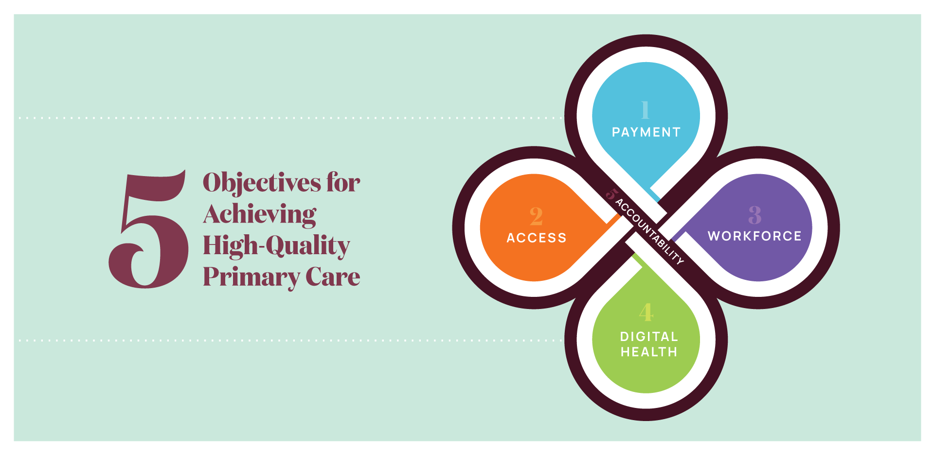

Slide 14
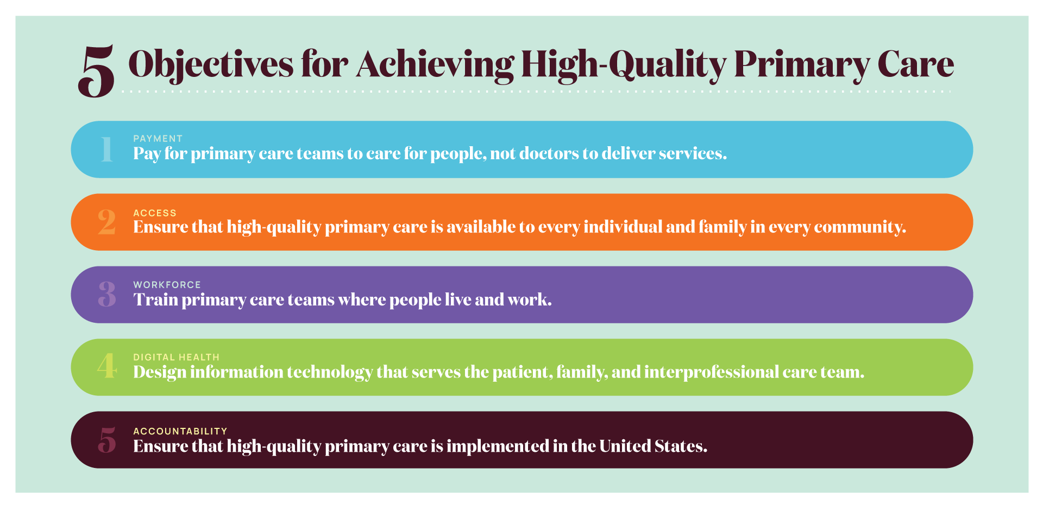
Notes:
The committee’s recommended actions that make up its implementation plan seek to achieve 5 major objectives to achieve high-quality primary care.
Pay for primary care teams to care for people, not doctors to deliver services.
The nation gets what it pays for, and payment reform that supports and encourages high-quality primary care, rather than actively discouraging it, is fundamental to the committee’s vision of high-quality primary care.
Ensure that high-quality primary care is available to every individual and family in every community.
Everyone in the country should have easy access to high-quality primary care that is person-centered, relationship-oriented, and responsive to the needs of its community.
Train primary care teams where people live and work.
When primary care training is interprofessional and located in community settings, it is more effective at developing the skills that will keep people connected and healthy.
Design information technology that serves the patient, family, and interprofessional care team.
New health information technology standards should prioritize and facilitate integrated care that is person-centered, supports relationships, and is responsive to the needs of its community.
Ensure that high-quality primary care is implemented in the United States.
Implementing high-quality primary care requires clear and meaningful measures of whole-person care, ongoing research, and leadership in the federal government to assure federal policies support its development.

Slide 15
Actions Since
Five workshops on each report objective (all recorded on website), 6th in October
Featured key stakeholders including former HHS Secretary
Independent presentations
CMS, CMMI (6 overall), AHRQ, HRSA, ASPE
House and Senate committee staff
Gates Foundation, PCC, Harvard Primary Care Consortium
AAFP, ADFM, STFM, NAPCRG
Several payer groups

Slide 16
Actions Since
Working with OASH, HHS Agencies, Philanthropy to establish a Secretary’s Council for Primary Care and creation of up to 3 staff to support
Payment reform discussions: federal, payers, health systems;
Koller, Pham, Berenson leading discussions
Last NASEM workshop to focus on funds reaching primary care

Slide 17
Download the report and view more resources at: Nationalacademies.org/primarycare
Questions? E-mail primarycare@nas.edu

