Slide 1




Time to Invest in Primary Care Research: Findings from an Independent
Congressionally Mandated Study
Notes:
Total Elective Rural Sustainability Payment – National TERSA; set at Median Direct Costs (GAO report) for 2015, updated by CPI-U Medicare Services
Rural Training Tracks – Get full TERSA; for full training time no matter location
Urban TERSA – set at half the National TERSA
Rural Hospitals – Receive National TERSA minus any payments they receive from Medicare (Direct costs, IME or DME).
Urban Hospitals – Receive the Urban TERSA minus any payments they receive from Medicare (IME or DME)

Slide 2
Primary Care Research
Jack Westfall, MD, MPH
President NAPCRG

Slide 3
Why this study on PC Research?
Concerns that primary care research has been underfunded for the past 2 decades
Concerns that primary care research may just be part of what the NIH and AHRQ already do
Who is facilitating, managing, guiding any federal investments in primary care research
Is there overlap?
The Administration’s FY 2018 budget recommended moving several AHRQ activities to the NIH.
Congress felt it was important for AHRQ to fund a study to look at these questions related to Primary Care Research funding, coordination, and impact.

Slide 4
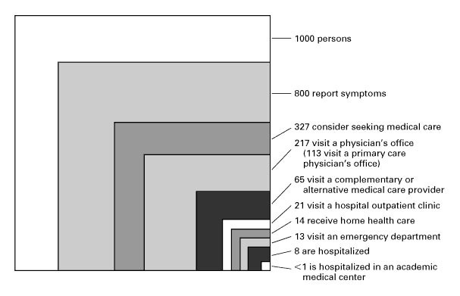
Notes:
Describe KW box. – Where is prima
Early example of transformative primary care research by the great primary care physician Kerr White.
1000 people in the community
In a given month
750 experience illness or injury
250 seek primary care
10 hospitalized
1 hospitalized in an academic health center
Repeated in 2000 with similar findings.
we know a lot about the 1 per 1000. Primary care research begins to help us understand the bigger boxes, the 250, the 750, and maybe even the 250 who are well this month. The border between well and ill, between ill and care seeking, between primary care and hospital may be crucial to understand how to provide access, high quality, and patient-centered care.
Primary care and family medicine

Slide 5
Each year about half of the US population see a primary care physician.
And about half of office-based visits are to primary care.
NAMCS 2016
All Primary Care Office-based Visits | 410,258,271 | 46%
All Office-based Visits | 883,725,178 | 100%
MEPS 2017
US population seeing PC physician | 172,002,242 | 53%
Total US population | 324,779,896 | 100%
Notes:
Primary care is about 46% of all ambulatory office-based clinic visits
And about 53% of the total population see a primary care provider each year.

Slide 6
Where do people go for their respiratory illness? Primary care, and hospital care for COVID-Like Illness
Notes:
Congressional Briefing 4.29.2020
Jack Westfall, MD, MPH – Director, Robert Graham Center
Thank you for the opportunity to share date from the Robert Graham Center for Policy Studies in Primary Care and HealthLandscape. The need for ambulatory primary care has increased over the past month. Patients with COVID-19 symptoms, illness, and questions are flooding primary care practices. And other illness is not sheltering in place; acute and chronic diseases did not go on holiday.
Primary care has had to dramatically change the way it delivers care. Physical distancing coupled with patient fear and uncertainty are changing the way patients contact their primary care provider. Patients have COVID-19 related symptoms and questions. And patients continue to have the acute, chronic, and preventive health needs they always have, from chest pain to asthma to well child checks and immunizations, primary care has worked hard to balance the need for in-person visits with the opportunity to provide telehealth visits. While facing an increase in patient need, the manner in which the care is delivered has shifted with a significant amount provided by telehealth, with a steady need for in-person care as well. Unfortunately, there has been inadequate support for both in-person visits and telehealth visits. The constant has been that patients continue to need primary care.
While there is urgency at the acute hospital setting, the vast majority of COVID Like Illness is seen out in the community and primary care setting. Last week, just 4.7% of emergency department visits reported to the CDC National Surveillance Program were due to COVID Like Illness (CLI).
Most patients with a respiratory illness receive care in the primary care. For instance. As seen in slide 1, In a given year, 19.5 million patients are seen by primary care for an upper respiratory illness and a URI is part of 64 million primary care visits. 10.7 million patients are seen for bronchitis during 82.5 million PC visits.
Each year, primary care physicians care for 9 million patients with pneumonia
In contrast, just 900,000 patients are hospitalized due to pneumonia.
While trying to balance in-person and virtual patient care, the payment for telehealth has been inadequate and often just missing. For primary care practices that have relied on fee-for-service payment, this shift has been devastating.
In Primary Care (PC)
In a given year, 19.5 million patients are seen by primary care for a URI and 64 million primary care visits include a diagnosis of URI, 10.7 million patients for LRI/bronchitis and 82.5 million PC visits include a diagnosis of LRI/bronchitis and 9 million patients for pneumonia and 38 million PC visits include a diagnosis of pneumonia.
Hospitals
Each year, 263,000 patients are hospitalized for URI, 372,000 are hospitalized for LRI, and 890,000 are hospitalized for pneumonia. 416,000 hospitalizations include the diagnosis of URI, 888,000 include the diagnosis of LRI, and 1.5 million hospitalizations include the diagnosis of pneumonia.

Slide 7
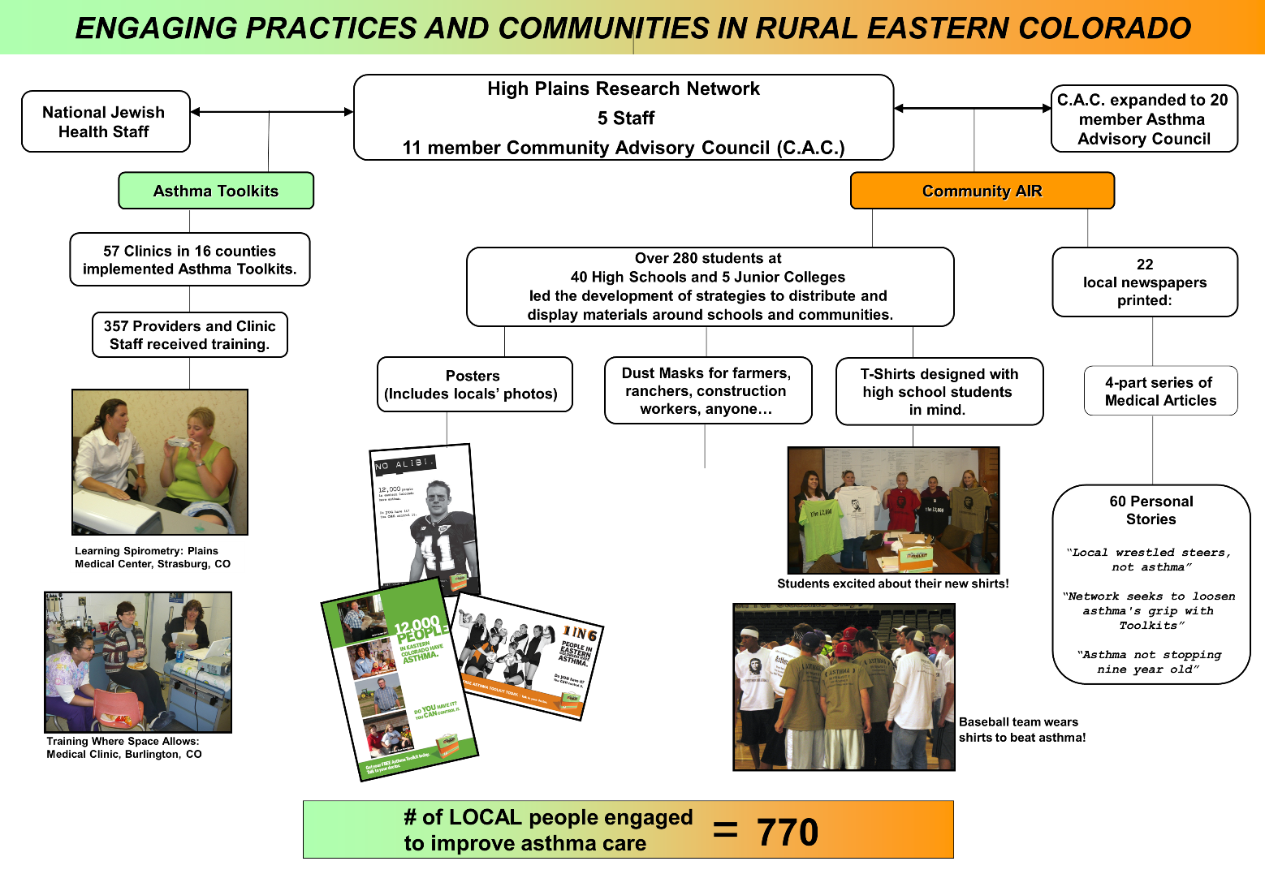

Each year in eastern Colorado, there are 50 fewer hospitalizations due to asthma
Notes:
This is a primary care research study in rural Colorado that brought together the community members and practices and physicians to implement asthma treatments. Asthma Toolkits studied the impact of outfitting every primary care practice with a spirometer and staff training in asthma diagnosis and management. Community AIR translated the complex medical jargon of national guidelines into locally relevant messages and actions. The goal was to support asthma patients in primary care practice.

Slide 8
Exhibit 2. Asthma Hospitalizations in Eastern Colorado
During and After Asthma toolkits
40% increase use of inhaled corticosteroids
53% increase in asthma action plans
79% increase in use of spirometry
Data from Colorado Dept. of Public Health and Environment: http://www.cdphe.state.co.us/Health/Asthma.aspx accessed February 2014.
Notes:
It worked. This primary care reaserch project increased the use of diagnostic testing and treatments.
And that led to lower asthma hospitalizations.
Primary care research can lead to better health outcomes.

Slide 9
Implementing Medication Assisted Treatment in
Rural Primary Care 2015-2020.
IT MATTTRs™
Notes:
Similar study on how best to implement opioid use disorder treatment in rural primary care. Training the primary care physicians and the whole care team led to increased treatment for OUD.

Slide 10
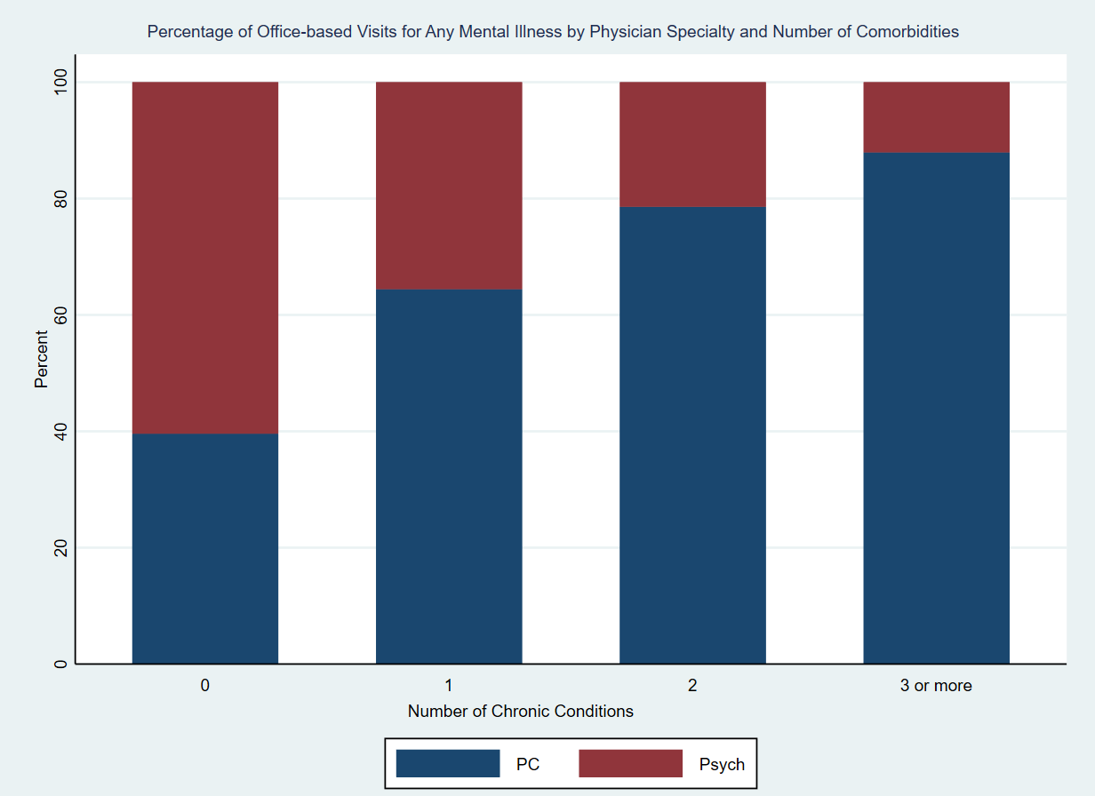
Percent of Encounters for mental illness
and co-morbid conditions
Notes:
And primary care is also where patient with complex medical conditions are most likely to receive care. for mental illness, about 40% of all mental health visits are in primary care. if the patient has any other chronic medical conditions, (heart disease, diabetes, COPD) the vast majority of visits are to the primary care provider.

Slide 11
What did the study find?
Primary Care Research is not the same as Health Services Research
Primary Care Research is a distinct science
Fund an entity (AHRQ) to address core primary care research needs and coordinate federal PCR efforts
Initiate a strategic planning process across federal agencies specifically dedicated to prioritizing PCR areas for funding investments
Provide targeted funding for a hub for federal PCR
Notes:
So what did the study find
Dr Mendell will go over the study in detail. Here are some high level findings

Slide 12
Basic Science of Primary Care –
The building blocks of PC Research
Research that spans the sites of care where primary care clinicians provide care in ambulatory, ER, hospital, and long-term care facilities
Population health research on the patients and communities cared for by primary care clinicians. This includes the social determinants of health at the individual and community level (Hotspots, Coldspots)
Primary care is not just a compilation of specialty practices
Primary Care Research is about the whole person, not just the organ or disease
Undifferentiated patients
  Patient symptoms and signs
  Diagnosis
  Team care
Health promotion, disease prevention, common illnesses
Complex medical conditions, Multi-morbidity
Notes:
And here is some additional stuff that was mentioned but may not have been included in the recommendations.

Slide 13
COVID-19 and Primary Care Research
There are research gaps included in this study that, if funded, might have mitigated aspects of our COVID-19 pandemic response, including racial and ethnic disparities for cases and deaths.
Rapid investments to eliminate these gaps now might help improve recovery efforts, and future responses to similar health crises.
  Care of patients with COVID Like Illness
  Links between primary care and public health
  Access to care – not coverage, access. Research on access
  Contact Tracing, serology testing, immunization
  All the other chronic disease care exacerbated by COVID-19. susceptibility, severity, recovery, wellness
Notes:
What might have been. Had we been funding primary care research over the past 2 decades, how different might this pandemic have been.

Slide 14
$5 million is a start.
Now is the time to begin.
We know we can’t fund all that needs to be done, but let’s get started.
An additional $5 million to provide a dedicated funding line for AHRQ’s Center for Primary Care Research can begin the coordination needed within the federal government to identify and support primary care research.

Slide 15
Time to Invest in Primary Care Research: Findings from an Independent
Congressionally Mandated Study
Notes:
Total Elective Rural Sustainability Payment – National TERSA; set at Median Direct Costs (GAO report) for 2015, updated by CPI-U Medicare Services
Rural Training Tracks – Get full TERSA; for full training time no matter location
Urban TERSA – set at half the National TERSA
Rural Hospitals – Receive National TERSA minus any payments they receive from Medicare (Direct costs, IME or DME).
Urban Hospitals – Receive the Urban TERSA minus any payments they receive from Medicare (IME or DME)

Slide 16



A Congressionally Mandated Assessment of Federally Funded Primary Care Research:
Findings from the Health Services and
Primary Care Research Study
Peter Mendel, PhD
September 25, 2020

Slide 17
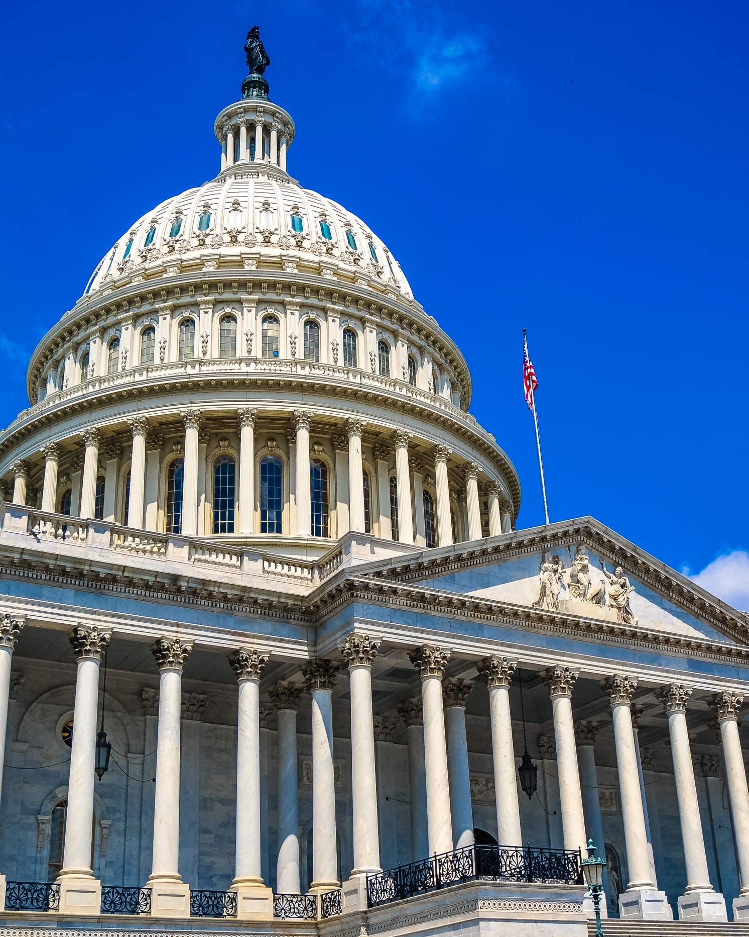
In 2018, Congress authorized an independent assessment of federally funded health services research (HSR) and primary care research (PCR)
Study objectives
Assess HSR and PCR portfolios funded by federal agencies
Identify potential areas of overlap and research gaps
Propose strategies to improve outcomes, value and impact of the federal HSR and PCR enterprise

Slide 18




We used data collected through multiple methods to assess the federal HSR and PCR enterprise
Environmental Scan & Portfolio Analysis
Technical Expert Panels (TEPs)
Stakeholder Interviews
All operating divisions within the U.S. Department of Health & Human Services (HHS)
Department of Veterans Affairs, Veterans Health Administration (VHA)
Research grants and contracts between FY 2012 -- 2018

Slide 19
Although HSR and PCR overlap, PCR is a distinct field
Health
Services Research
Primary
Care
Research

Slide 20
The study’s definition of PCR incorporated several commonly accepted concepts of primary care
Care provided by clinicians responsible for the large majority of personal health needs
Coordinating and prioritizing health care needs of individual patients
Family and community context, including addressing social determinants of health
Clinical research on common health conditions not addressed by specialty care
Institute of Medicine 1996, Starfield 1996, Park et al. 2018

Slide 21








Eight federal agencies fund PCR

Slide 22






NIH funded the largest number of PCR projects
750
149
150
Number of Projects
28
2
9

Slide 23
AHRQ and CMS dedicated the largest portions of their portfolios to PCR
13%
12%
Percent of Projects
5%
3%
3%
1%

Slide 24
The research portfolios of AHRQ and NIH both have a broad scope but different research objectives
Improve health care systems and outcomes
The only agency with a mandate to generate HSR
Authorized as the lead federal agency for PCR, but does not receive designated funding
Enhance health, lengthen life, and reduce illness
Focus on specific diseases, body systems, and populations
Other agencies’ PCR portfolios are more limited in scope based on their missions and operational needs

Slide 25
Overlap in agency PCR portfolios was less of a concern than prioritization and coordination
Size of PCR portfolios viewed as small compared to need
Lack of dedicated funding for coordination of PCR

Slide 26
We identified two overarching research gaps in PCR
Core functions of primary care to holistically address patient needs
Primary care transformation and role in the wider health care system

Slide 27
We proposed three recommendations specific to federally funded PCR
Initiate a strategic planning process across federal agencies dedicated to prioritizing PCR research areas (HHS and VA departmental leaders)
Establish a review process to proactively identify areas of potential PCR overlap across agencies (HHS and VA departmental leaders)
Provide targeted funding for a hub for federal PCR to both fund core PCR gaps and coordinate PCR across agencies (Congress)

Slide 28
We reviewed three options for Congress to create a funded hub for federal PCR
Provide targeted funding for PCR to AHRQ This is the most expeditious option
Create an independent PCR operating division within HHS
Create a PCR institute within NIH We recommend against this option

Slide 30
Time to Invest in Primary Care Research: Findings from an Independent
Congressionally Mandated Study
Notes:
Total Elective Rural Sustainability Payment – National TERSA; set at Median Direct Costs (GAO report) for 2015, updated by CPI-U Medicare Services
Rural Training Tracks – Get full TERSA; for full training time no matter location
Urban TERSA – set at half the National TERSA
Rural Hospitals – Receive National TERSA minus any payments they receive from Medicare (Direct costs, IME or DME).
Urban Hospitals – Receive the Urban TERSA minus any payments they receive from Medicare (IME or DME)

Slide 31

Society of General internal medicine
Jean S. Kutner, MD, MSPH
President, Society of General Internal Medicine
Professor of Medicine, University of Colorado School of Medicine
Notes:
Talking Points:

Slide 32

SGIM Mission & vision
What is our mission?
Our mission is to cultivate innovative educators, researchers, and clinicians in academic general internal medicine, leading the way to better health for everyone.
What is our vision?
Our vision is a just system of care in which all people can achieve optimal health.

Slide 33
Goals
Explain the difference between Primary Care Research (PCR) and Health Services Research (HSR)
Describe the need for PCR
Provide examples of PCR

Slide 34
Difference Between Primary Care Research (PCR) and Health Services Research (HSR)
HSR: fulfills at least one of two conditions:
  addresses at least one of three “output” domains (Quality of Care, Cost and Utilization, or Equity); and at least one of the “input” domains, OR
  addresses the Organization of Care “input” domain (Organization of Care, Financing of Care, Social Factors, and Personal Preferences and Behavior)
PCR includes:
  research on the delivery of primary care (which may use HSR methodologies); AND
  clinical studies of common conditions in primary care (without a HSR component)
PCR: addresses primary care professionals, services, or settings, regardless of whether it also meets criteria for HSR.

Slide 35
Difference Between Primary Care Research (PCR) and Health Services Research (HSR)
The distinction of PCR from HSR is in the specific focus on clinical primary care, recognizing the central role that primary care plays in leading to higher quality, safer, and more affordable care.
While HSR may address primary care topics, HSR often focuses on topics like insurance benefit design or health care policy changes.
Research questions addressed by HSR may yield findings important for primary care.
HSR and PCR are thus complementary

Slide 36
Need For Primary Care Research (PCR)
PCR can inform our attempts to enhance the quality, effectiveness, and value of clinical care, while also addressing important issues such as health care disparities and the care of underserved populations.
More PCR is needed to examine the core functions of primary care, and transform the role of primary care in the health care system, including its role in reducing disparities.
Realizing the full potential of improvements in primary care processes and outcomes requires research specifically focused on how clinical care is delivered in primary care settings.

Slide 37
Examples of primary care research (PCR): Innovative ways to provide primary care

Slide 38
An Effectiveness Evaluation Of A Primary Care–embedded Clinical Pharmacist–led Intervention Among Blacks With Diabetes
Examined impact of a primary care-embedded clinical pharmacist-led intervention on cardiovascular risk factor control (diabetes and blood pressure) among Black patients in a large healthcare system
  Co-managed complex patients along with primary care physicians
Results:
  Improved diabetes control (Hemoglobin A1c)
  Insignificant improvements in blood pressure
Demonstrated how a team-based primary-care intervention could improve diabetes control in vulnerable patients
Narain, K.D.C., Doppee, D., Li, N. et al. J GEN INTERN MED 35, 2569–2575 (2020). (https://pubmed.ncbi.nlm.nih.gov/32144694)

Slide 39
Randomized Trial Of Reverse Co-located Integrated Care On Persons With Severe, Persistent Mental Illness In Southern Texas
Examined effects of physically locating primary care within behavioral health settings (“reverse co-located integrated care”) on persons with severe, persistent mental illness and chronic medical diseases
  Predominantly Hispanic population; socioeconomically distressed area
Results:
  Improved: Systolic blood pressure, diabetes control (Hemoglobin A1c)
  No change: Diastolic blood pressure, cholesterol, body mass index, depressive symptoms
Showed that co-locating primary care services in mental health centers can improve physical health outcomes for patients with serious persistent mental illness in an underserved community
Errichetti, K.S., Flynn, A., Gaitan, E. et al. J GEN INTERN MED 35, 2035–2042 (2020). (https://pubmed.ncbi.nlm.nih.gov/32314132/)

Slide 40
Effectiveness Of Advance Care Planning Group Visits Among Older Adults In Primary Care
Evaluated a primary care-based group visit model to enhance advance care planning
Results: Increased advance care planning documentation
Demonstrated that integrating an ACP-focused structured group visit into primary care can increase ACP documentation, medical decision-maker documentation, and readiness to participate in ACP
Lum HD, Dukes J, Daddato AE, Juarez-Colunga E, Shanbhag P, Kutner JS, Levy CR, Sudore RL. J Am Geriatr Soc. 2020 Jul 29. doi: 10.1111/jgs.16694. Epub ahead of print. PMID: 32726475. (https://pubmed.ncbi.nlm.nih.gov/32726475/)

Slide 41
Example of primary care research (PCR): impact of primary care on “output” domains

Slide 42
Quality And Experience Of Outpatient Care In The United States For Adults With Or Without Primary Care
Nationally representative analysis of noninstitutionalized US adults who participated in the Medical Expenditure Panel Survey (MEPS) (2002-2014)
  Compared clinical quality and patient experience measures for those with and without primary care
Results: Receipt of primary care associated with receipt of more high-value care, slightly more low-value care and better healthcare access and experience
Quantified potential benefits of primary care on output domains of quality and experience of care
Levine DM, Landon BE, Linder JA. JAMA Intern Med. 2019 Mar 1;179(3):363-372. doi: 10.1001/jamainternmed.2018.6716. (https://pubmed.ncbi.nlm.nih.gov/30688977/)

Slide 43
Contact Us
Toll Free - 800-822-3060
Email – info@sgim.org
Website – www.sgim.org

Slide 44
Time to Invest in Primary Care Research: Findings from an Independent
Congressionally Mandated Study
Notes:
Total Elective Rural Sustainability Payment – National TERSA; set at Median Direct Costs (GAO report) for 2015, updated by CPI-U Medicare Services
Rural Training Tracks – Get full TERSA; for full training time no matter location
Urban TERSA – set at half the National TERSA
Rural Hospitals – Receive National TERSA minus any payments they receive from Medicare (Direct costs, IME or DME).
Urban Hospitals – Receive the Urban TERSA minus any payments they receive from Medicare (IME or DME)

Slide 45


Primary Care Research: Neglected & Functionally Homeless
AHRQ
Congressional mandate to provide a ‘home’ for primary care research, but no funding specific to primary care research
National Institutes of Health (NIH)
disease-based institutes & centers
greatest supporter of biomedical research in U.S.
uniquely positioned to drive new kinds of research
struggling to get science into practice to improve health
PCORI
Two studies of first rounds of funding revealing little attention to core primary care research or issues
2 lead investigators reviewing all early grants note that only 18% of PCORI studies involve ANY primary care sites, despite over 50% of US healthcare being conducted there
Notes:
Just for a little background, on the one hand [gesture], there's Family Medicine.
As you undoubtedly know, Family Physicians receive interdisciplinary training to manage patients' biological, psychological, and social issues within the contexts of the families and communities in which they live.
Family Physicians provide the greatest number of healthcare encounters in the U.S.
And due to their interdisciplinary expertise and enormous clinical presence, may be uniquely positioned to speed basic science into real world practice;
playing a critical role in translational research.
And yet Family Medicine is struggling to develop a research base and define its research identity.
On the other hand [gesture], there's the NIH.
Unlike FM, the NIH has historically not been very interdisciplinary but rather organized around disease, organ-system, or specialty-based institutes and centers.
But because the NIH is the greatest supporter of biomedical research in the U.S., it may be uniquely positioned to drive new kinds of research; playing a a critical role in translation.
And yet the NIH is struggling to get scientific discovery into clinical practice.
The question is how can we bring the two together for the mutual benefit of both? [gesture]
Certainly FM leadership is calling for more engagement, and recent developments at NIH may pave the road.

Slide 46




Summary: All NIH Grants - Results
(2006)
FM
154 grants
$45M
NIH
46,700 GRANTS
$20,200M
0.3% grants
0.2% dollars
Notes:
Reference:
Grant # (02-06): 89 → 154 (0.20% → 0.33% NIH total)
Grant $ (02-06): $26M → $45M (0.15% → 0.22% NIH total)
Modest increases between 2002 and 2003 (end of NIH doubling) no substantial growth after – And absolute levels as low or lower than historically

Slide 47
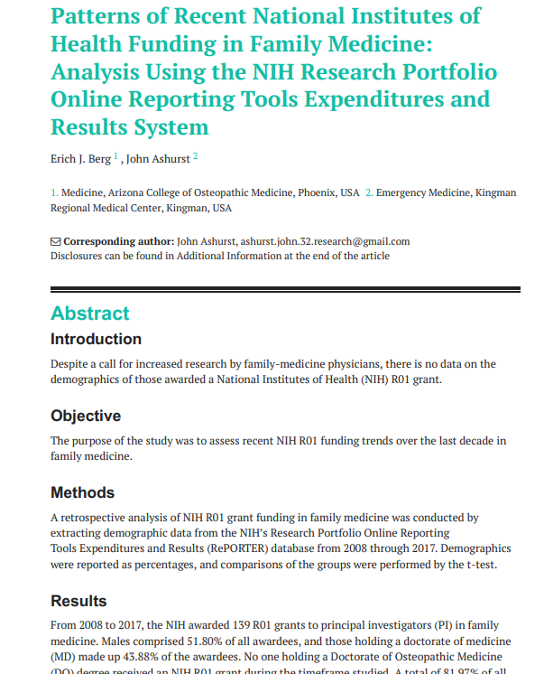
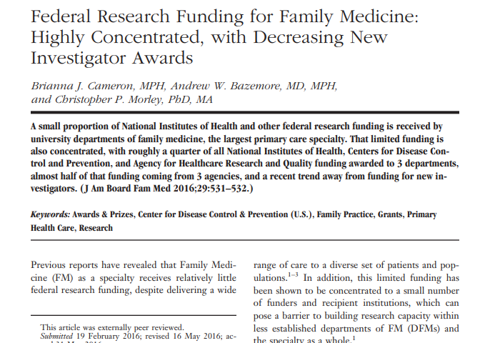
Not improving
(as 2016, 2019 Studies of NIH Funding confirm)

Slide 48



Committees - Results
The Bad News:
NIH
295 committees*, 5,464 members
FM
19 committees
21 members
6.4% committees
0.4% members
Notes:
Reference:
Committees = standing committees and subcommittees. Also 24 Special Emphasis Panels
In 2006, ~75% of ICs had no FM input on committees
~85% of FM committee involvement was on IRGs - Integrated or Initial Review Groups (IRGs) which provide the first-level of peer review for grants.
Only one FM committee Chair(an IRG at NCI).

Slide 49
I. Perceptions from NIH Directors:
(a) clinicians - strong patient & community ties; inter-disciplinary collaboration.
(hot) understand “complex systems”, “appreciate psychosocial, family” context
(hot) “collaborate”, “team approach”, “incredible bridgers to communities”
(cold) dismissively labelled “generalists”
(cold) “It's the specialist [not FP] who makes the complicated care decisions.”
(b) research - FPs do limited research & have weak research infrastructure.
(hot) FM research “is key”
(hot) FM research gives vital “real-world perspective”.
(cold) “more clinical than investigational” ,“don’t have research infrastructure”
(cold) “just health services research”, “More for AHRQ or HRSA.”
Notes:
Starting with category of perceptions of Family medicine,
The first subcategory was about clinicians. Overall, NIH officials valued family physicians clinically.
They felt we understand complex systems, collaborate across disciplines, and are incredible bridgers to communities.
Less encouragingly, Officials often referred to FPs as generalist or primary-care docs without making distinction from other primary care fields.
And some felt that FPs do the simple work but its specialists who make the complicated care decisions.
The second subcategory had to do with research, for which the general consensus was that FPs do little research and have weak research infrastructure.
Some officials who recognized family medicine research felt that the research we do is key; providing real world perspective.
Predominantly though, it was felt the FM as specialty is more clinical than investigational, and that most of the research being done is of the health services variety, more for AHRQ or HRSA than NIH

Slide 50
Perspectives - Results
II. Perceptions of NIH from Primary Care leaders:
(a) direction - NIH repackaged its stated research focus, but real change?
(hot) “doing it differently”, “created a whole new biomedical discipline”
(hot) “looking for a different perspective”, “really focused on community”
(cold) “translation” is “just a buzzword”,“a political game by a political appointee”
(cold) “just a different package”; “mission of NIH has always been the same”
(hot) emphasizing “bidirectional” communication: researchers ↔ clinicians
(hot) focused on “real world, in real practices, with real patients.”
(cold) only talking between specialists “not translating to practice communities.”
(cold) “too much focus on controlled trials / bench-to-bedside”, “not real world.”
(b) Initiatives - NIH still emphasizes basic-science & exclusionary trials.
Notes:
Officials also self-reflective in Perceptions of NIH.
The first subcategory had to do with the agency's direction.
Most officials thought NIH had repackage its stated focus but whether this represented true change was questionable.
Optimists (who tended to be those with the least time at the agency)
felt that NIH is really doing things differently now and creating a whole new discipline (translational research) that's really focused on community.
Veterans were more pessimistic. They felt translation is just a buzzword by a political appointee playing a political game.
They thought "translation" [gesture] is a different package, the fundamental mission of the NIH (to understand the pathophysiology of disease and discover cures) has NOT changed.
The second subcategory had to do with NIH initiatives like Roadmap and CTSAs.
Again there were optimists who felt these initiatives were emphasizing communication between scientists and clinicians, focusing on real practices and real patients.
Pessimists thought NIH was still only communicating between specialty scientist, not translating to the real world.
Additionally, the felt there was still too much emphasis on exclusionary, non-representative, clinical trials.

Slide 51


Summary
Primary Care Research is unique, if poorly understood (it’s easier to explain single diseases and organ systems)
It is also neglected and [functionally & fiscally] homeless
Currently, the only Congressionally mandated home for Primary Care Research in a federal research funding agency is within the one with the smallest budget,
  the Agency for Healthcare Research & Quality (approximately 1/100th the budget of NIH), and
  its even smaller Center for Evidence and Practice Improvement (CEPI),
  Within which (so not really a center on par with the others) lies the National Center for Excellence in Primary Care Research (NCEPCR)… and it has no dedicated budget line.
In short, Primary Care, the largest platform for health care delivery in the United States, deemed by the U.S. Institute of Medicine “the logical foundation of an effective health care system”…
  receives only 5-7% of all health care dollars spent
  Has no public financing of biomedical research dollars dedicated to it.
Notes:
So let me conclude by telling you what I think this all means.
The first conclusion is that perspectives were mixed: ranging from guarded optimism to outright pessimism.
Overall, Officials at NIH valued FM clinically, but saw FM research as underdeveloped, with 2 kinds of barriers to greater research and involvement at NIH:
Specifically on the FM side: limited research infrastructure, experience, and expertise
And on the NIH side: a disease-based model of organization with a focus on basic science
They also suggested 2 approaches for improvement:
On the FM side: self-advocacy, research training, developing areas of expertise
And on the NIH side: Roadmap & CTSAs, holding Director accountable for translational mission
Given this information, potential next steps may include:
- increasing collaborations and partnerships wiht researchers from other fields to build research infrastructure.
- career development work obtaining advanced degrees (e.g. MPH, MS, MBAs) to gain the necessary foundation in systematic approaches to answering questions with methodological rigor
- Most importantly, I think FM leaders should sit down with NIH leaders to discuss ways of achieving greater mutual benefit: this may include discussing how RFAs are worded and directed (particulary for CTSAs), or conceiving novel training mechanisms potentially supported by NIH.

Slide 52
Time to Invest in Primary Care Research: Findings from an Independent
Congressionally Mandated Study
Notes:
Total Elective Rural Sustainability Payment – National TERSA; set at Median Direct Costs (GAO report) for 2015, updated by CPI-U Medicare Services
Rural Training Tracks – Get full TERSA; for full training time no matter location
Urban TERSA – set at half the National TERSA
Rural Hospitals – Receive National TERSA minus any payments they receive from Medicare (Direct costs, IME or DME).
Urban Hospitals – Receive the Urban TERSA minus any payments they receive from Medicare (IME or DME)

Slide 53
Time to Invest in
Primary Care Research
September 25, 2020
Ann Greiner, President and CEO

Slide 54







Primary Care Collaborative
Vision
Mission
The Primary Care Collaborative advances comprehensive primary care to improve health and health care for patients and their families by convening and uniting stakeholders around research, care delivery and payment models, and policies.
PERSON AND FAMILY-CENTERED
TEAM-BASED & COLLABORATIVE
COMPREHENSIVE & EQUITABLE
COORDINATED & INTEGRATED
CONTINUOUS
ACCESSIBLE
HIGH-VALUE

Slide 55
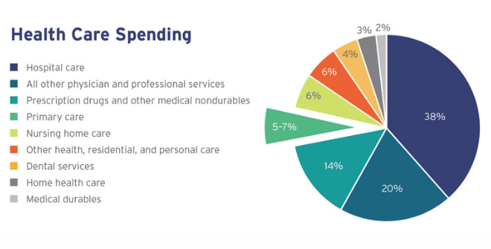
PC Spend: US 6% vs OECD 14%
Notes:
There are many aspects of primary care that we have limited data and research about, including for example how changes in where primary care services are being delivered and by who and through what medium affects patient outcomes, equity and costs. I am going to take one important metric – what we spend on primary care -- to illustrate why primary care research is so important to the health of all Americans and to the high performance of our health system.
While PC represents the majority of ambulatory visits, we do not have standardized national data on primary care spend. Many nations – both developed and developing -- are using the percentage of primary care spend as a percentage of total cost of care as a proxy to assess the primary care orientation of their health system. This measure helps us to understand the priority that a health system places on health prevention/promotion, management of chronic conditions, and a holistic approach to care.
Although the metrics are different so this is not necessarily an apples to apples comparison, US primary care spend is loosely half of the average across high income OECD countries.

Slide 56
Life Expectancy at Birth: 1980 – 2017; OECD Average = 80.7
Life
expectancy
PC
Spend*
10%
12%
N/A
18%
13%
12%
N/A
N/A
N/A
15%
6%
*Expenditure on primary care as share of current health expenditure, 2016 (or latest year)
Notes:
The US de-valuing of primary care as represented by lower PC spend – as well as comparatively less spending on social services -- may be contributing to our country’s lower life expectancy.
Note that the US spends twice as much as the average OECD country on health care as a share of the economy
Since this data was published, life expectancy in the US declined in 2017, 2018 and rose slightly in 2019. These years of life expectancy decline were the first on record since 1950. Life expectancy is expected to decline again in 2020 given COVID-19.

Slide 57
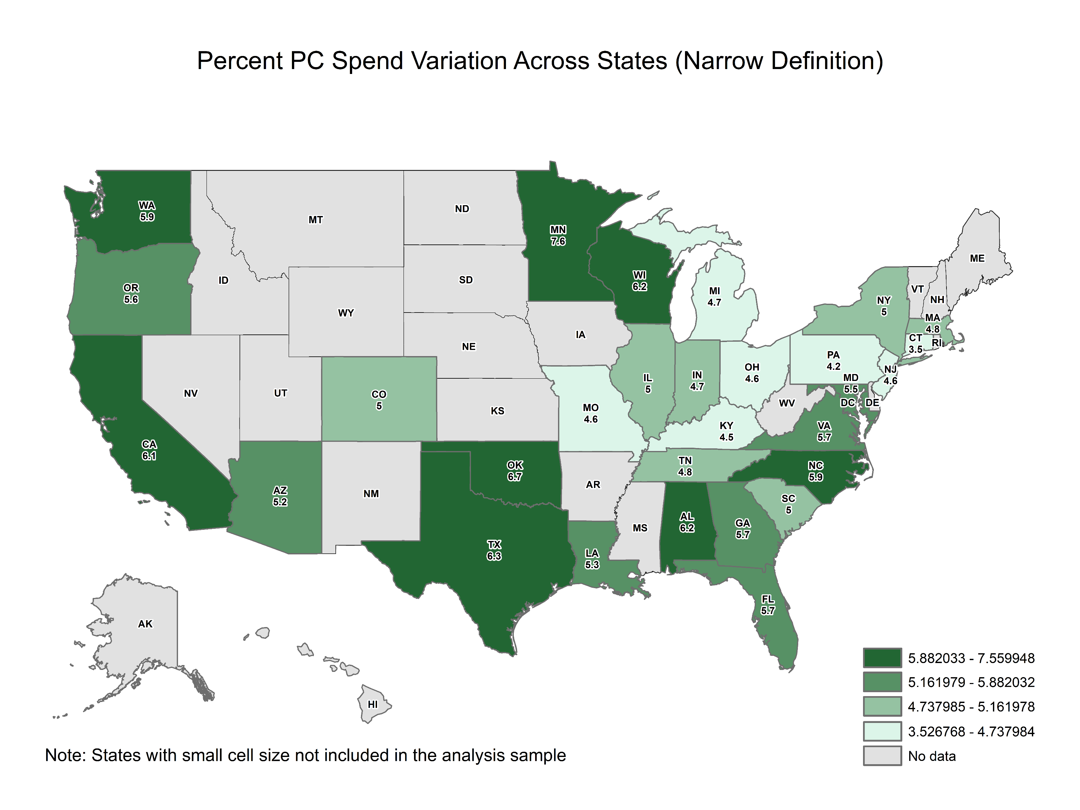
State | PC Narrow
National | 5.6
AL | 6.2
AZ | 5.2
CA | 6.1
CO | 5.0
CT | 3.5
FL | 5.7
GA | 5.7
IL | 5.0
IN | 4.7
KY | 4.5
LA | 5.3
MA | 4.8
MD | 5.5
MI | 4.7
MN | 7.6
MO | 4.6
NC | 5.9
NJ | 4.6
NY | 5.0
OH | 4.6
OK | 6.7
OR | 5.6
PA | 4.2
SC | 5.0
TN | 4.8
TX | 6.3
VA | 5.7
WA | 5.9
WI | 6.2
Notes:
And within the US, early reports show considerable state variation in primary care investment across all payers
The Commonwealth has also just published primary care spend at the state level and sees a great deal of variation as well.
https://datacenter.commonwealthfund.org/topics/primary-care-spending-share-total-ages-18-64

Slide 58
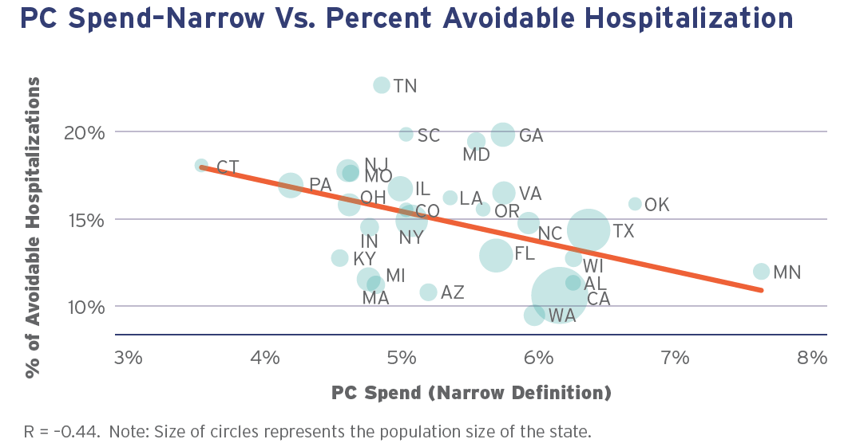
PC Investment & Hospitalizations
Data source: Investing in Primary Care (PCC 2019 Evidence Report)
Notes:
The data suggests that these differences in primary care spend are related to key patient indicators. PCC’s 2019 evidence report found a relationship between high primary care investment and lower overall hospitals, lower ambulatory sensitive hospitalizations and few ED visits

Slide 59





Momentum: PC Investment
13 states have introduced/passed legislation
6 states passed legislation/regulation in 2019 – CO, DE, VT, ME, WA and WV – focused on reporting primary care spending levels to achieve more comprehensive PC
5 states set targets for primary care spending
10.7%
CT
+1% in both 2021, 2022 & revisit
12%
CO
10%
12%
Notes:
This kind of data is important to states as they consider what they are spending on different sectors and whether their expenditures reflect their priorities and goals.
As this slide illustrates, a growing number of states are themselves producing detailed reports on primary care spending at the health plan level across all payers and some have used such data to set targets for increased primary care spending without growing total cost of care.

Slide 60
COVID-19: PC PRACTICE FINANCES & PATIENT HEALTH DECLINE
48% report in-person volume 30-50% below normal
26% report their previous pandemic financial support has run out or is about to
18% report insurers pulled back on telehealth
86% report higher levels of patient mental health concerns
40% see an increase in patient substance use
57% see an overall reduction in patient self care
34% see higher levels of food insecurity across patients
Source: Larry A. Green Center Primary Care COVID-19 Survey (thepcc.org/covid)
Notes:
This focus on the robustness of primary care and whether we are valuing it properly is heightened given the pandemic and concerns that it
will cause primary care in the US to deteriorate further.
More explicitly, that if primary care capacity collapses, it may result in poorer health outcomes for patients and potentially even higher costs. Recent data from the Green Center – a regular survey that we have been collaborating with them on since mid-March – shows recent, sobering results for both practices and patients.
Green Center survey – column one: series 20 fielded Sept 4-8, 2020
Green Center survey – column two: series 19 fielded Aug 21 -24, 2020

Slide 61
Discussion
Ann Greiner, President and CEO
agreiner@thepcc.org
202 417-2062
@agreiner1
www.thepcc.org

Slide 62
Time to Invest in Primary Care Research: Findings from an Independent
Congressionally Mandated Study
Notes:
Total Elective Rural Sustainability Payment – National TERSA; set at Median Direct Costs (GAO report) for 2015, updated by CPI-U Medicare Services
Rural Training Tracks – Get full TERSA; for full training time no matter location
Urban TERSA – set at half the National TERSA
Rural Hospitals – Receive National TERSA minus any payments they receive from Medicare (Direct costs, IME or DME).
Urban Hospitals – Receive the Urban TERSA minus any payments they receive from Medicare (IME or DME)

