Slide 1
Transgender care
Dr. Cantone
FM Core Clinical Experience

Slide 2
Pre Slides
Recognize medication names
Discuss ranges of effect time

Slide 3
Transitions
Behaviors/dress
Hormones
Surgery – colloquially “top” and “bottom,” don’t forget facial/vocal
  Plastics or general for top surgery, urology or ob/gyn
Endocrinology clinic for peds
PCPs for adults
Behavioral health for “dedication,” therapy for struggles but NOT to “fix” it, also required letter for surgery

Slide 4
Legal Implications
Know the age of consent for medical procedures (18yo general, some states at 15yo)
<<<<<Insert, if <18yo, if “cross-sex” hormone consent is at earlier age or not>>>>
For many insurers, patients are required to have parental consent and/or wait until 18
Puberty blockade agents are recommended for early teens, tanner stage needed
Medicaid requires at least TWO letters, one from mental health provider, “proving” dedication to the desired gender, for gender affirming genital surgeries
Non-binary is now a legal gender designation, offer name/gender change forms at visits
In children, 12-23% with gender dysphoria persist into adulthood, informally nearly 100% in adolescents

Slide 5
Teen options
Fully reversible: puberty suppression (starting 9-12yo) to gain time to explore – dysphoria must have worsened with puberty
  GnRH analogues, progestins to suppress menses
Partially reversible: Different management than adults due to somatic, emotional and mental development in the adolescent brain
  Endo to monitor development
Irreversible: Gender Affirming Surgery – need to have 12 months continuous in gender role and age of consent, chest surgery may be more negotiable
Estrogen injections and oral okay, Testosterone subQ okay – much lower doses (UCSF)

Slide 6
Threads of hormone therapy
Block undesired hormones
Augment wanted hormones

Slide 7
Medication options
Spironolactone, 25-100+ mg per day
Cyproterone acetate (progesterone)
Goserelin/Buserelin/Triptorelin (GnRH agonists)
Finasteride/Dutasteride (5alpha reductase inh)
Ethinyl Estradiol 1-4mg per day (okay)
Transdermal Estrogen (better)
Testosterone cypionate IM, 100-200mcg every 2-4 weeks, oral not available in US, transdermal an option
Depot medroxyprogesterone acetate- NOT for feminizing, okay for cessation of menstruation (also GnRH ags)

Slide 8
Time to Effect
Consider using WPATH standards of care tables here – not reproduced but accessible online at: https://www.wpath.org/publications/soc

Slide 9
Hormone RISKS
LIKELY:
  Fem: VTE, gallstones, elevated liver enzymes, weight gain, hypertriglyceridemia
  Masc: polycythemia, weight gain, acne, androgenic alopecia, sleep apnea
LIKELY if additional risks
  Fem: OSA
POSSIBLE
  Fem: hypertension, hyperprolactinemia
  Masc: elevated liver enzymes, hyperlipidemia
POSSIBLE if additional risks
  Fem: DM2
  Masc: destabilization of psych disorders, cardiovascular disease, hypertension, DM2
NOT PROVEN
  Fem: breast cancer
  Masc: loss of bone density, breast cancer, cervical cancer, ovarian cancer, uterine cancer

Slide 10
Surgical Criteria
Persistent, well documented gender dysphoria
Capacity to make a fully informed decision and to consent for treatments
Age of majority
Reasonably well controlled mental or physical health concerns
For genital surgery: 12 or more continuous months of hormone therapy, 12 months or more of living in desired gender role
TWO letters

Slide 11
Ongoing assessments
DESIRED benefit, not physical exam or provider declaration
Continued screening guidelines for birth sex, adjusted for changes
MTF: Suppress T below upper limit of normal female range, estradiol between perimenopausal and below supraphysiologic
FTM: T within range without suprephysiologic for male range
Exams and Labs

Slide 12
TODAY

Slide 13
Recap of pre slides
Highlight major points, use primacy model to make important information known

Slide 14
Medication options
Spironolactone, 25-100+ mg per day
Cyproterone acetate (progesterone)
Goserelin/Buserelin/Triptorelin (GnRH agonists)
Finasteride/Dutasteride (5alpha reductase inh)
Ethinyl Estradiol 1-4mg per day (okay)
Transdermal Estrogen (better)
Testosterone cypionate IM, 100-200mcg every 2-4 weeks, oral not available in US, transdermal an option
Depot medroxyprogesterone acetate- NOT for feminizing, okay for cessation of menstruation (also GnRH ags)

Slide 15
OBJECTIVES
Recall how to take a sensitive history, practice with a focus on gender identity and attention to sexual practices
Identify the basics of gender affirming care to utilize the patient’s name, pronoun, and goals for transition, with attention to each individual.
Understand the use of medications with a risk/benefit discussion in patient-friendly terms
Utilize resources to refer back to when seeing patients in clinical settings
Describe system “requirements” for proceeding with gender affirming care

Slide 16
OUTLINE
Why does this matter
Review sensitivity training
Discuss cases in groups
Review transgender care guidelines
Questions

Slide 17
POP QUIZ – Are these okay, and what do they mean?
Queer
Trans
Transgender
Transsexual
Transmasculine/transfeminine
Gender nonconforming
Bisexual
Androgyne
Gender Affirmation
Gender Outlaw
Gender non-confirming
Transsexual
Cross Dresser
Homosexual
Lesbian
Gay
Intersex
Non binary
Beyond binary
Affirmed
Gender Bender/Fluid
Genderqueer
Pan/poly gender
Transvestite
They as singular
Gender Identity
Gender Identity Disorder
Gender Dysphoria
Gender Expression
Gender
Sex
Transition
Gender Minority
Hermaphrodite
Stealth
Two Spirited
Bigender
Gender Affirmation Surgery
Butch
Shapeshifter
Boss Grrl
Boychick
Tranny Boi
Cisgender
Drag queen/king
Sexual Minority
Outing, process of
Sex Reassignment Surgery

Slide 18
Why Does This Matter?
Higher rates of psychiatric disorders
Higher rates of substance abuse
LGBT youth 2-3 times more likely to commit suicide
Higher rates of homelessness
Lesbians less likely to get cancer screenings
Gay men at higher risk of STDs
Elderly LGBT individuals face isolation
Violence
Victimization
Legal discrimination
Health Care Providers receive inadequate training
Gender identity and sexual orientation not asked on most surveys so obtaining data is difficult
Healthy People 2020, LGBT health (DATA2020)

Slide 19
Why Family Med?
What age do people identify as transgender?
When are they likely to present to a doctor? ARE they likely to bring this up?
How do you know if you’re helping them?

Slide 20
Why Am I talking?
Anyone who wants to do transgender care should
  Doesn’t matter on personal characteristics, specialty, or if primary focus
Family Medicine does it best
  Gender identity at age 4, present to docs in teen years
  FM gets to follow through transition to adulthood and not transfer care or continue someone else’s work
EVERYONE needs to know basics
I fell in love with a needle exchange, LGBTQI, HIV pos friendly clinic my intern year, spun out a suboxone and trans clinic from that in residency, and dedicated my “free time” to learning more about HIV, trans care and getting certified for suboxone

Slide 21
Pre-Clinical Training
What did you learn?
How do you ask?
What are the aspects of a sexual history?
How do you react?
Break up into pairs to practice – obtain a history from a non-binary identifying individual who uses they/them pronouns and has a partner who is transmasculine (has female organs at birth)

Slide 22
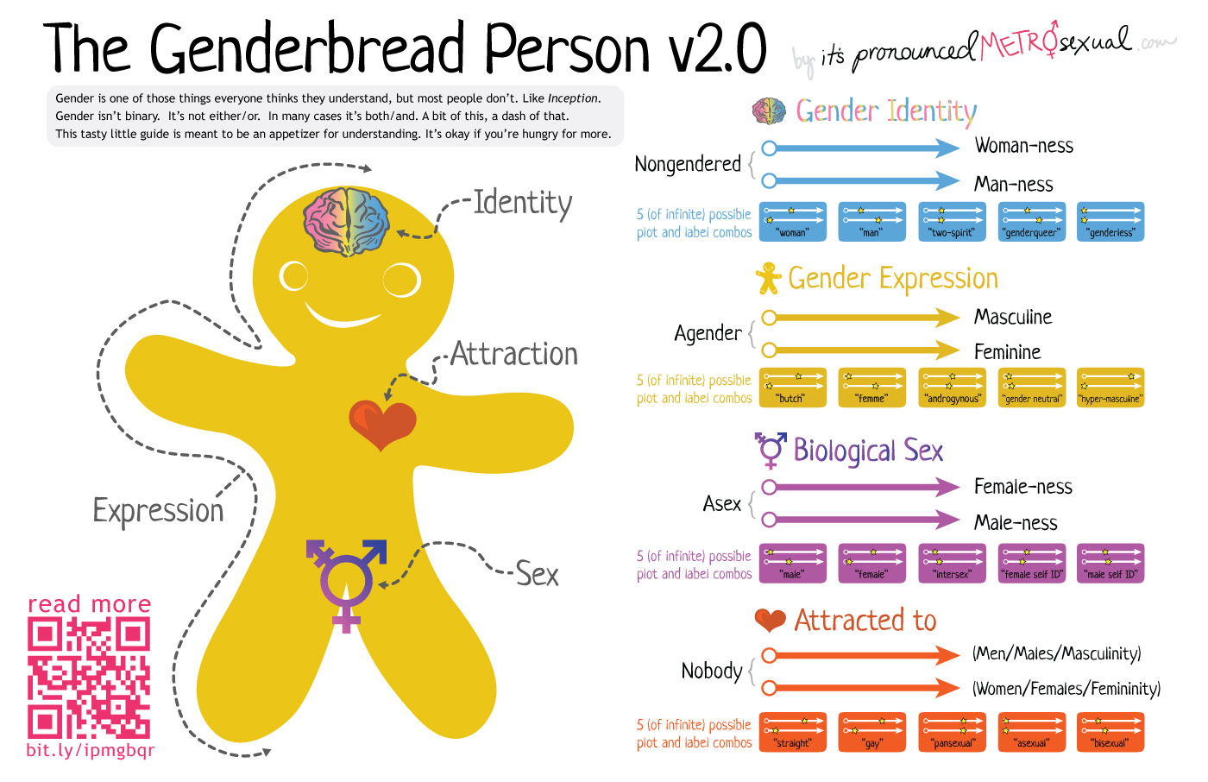
This is a non copyrighted image

Slide 23
Patient Stories – Let’s start bad and end today better
Pick a video of trans horror stories – plenty in the media constantly to peruse

Slide 24
15 yo establish care visit
To mom: what concerns do you have?
  She, I mean he, is acting more anxious. And just needs a doctor.
You notice the patient remains quiet and avoids eye contact

Slide 25
Questions to ask patient: HISTORY
Do you kick mom out of room?
What is appropriate to ask?
How do you ask it?
How do you address the patient?
Is this an opportunity? Good, bad or both?

Slide 26
EXAM? LABS?
What is NEEDED?
Curiosity is NOT appropriate
What do we need to screen, rule out, risk assess for discussing options?
What else does he need? How about at age 21?

Slide 27
Other Resources – DIVIDE INTO FOUR GROUPS
Fenway Health Transgender Health (for general and patient-friendly information)
University of California, San Francisco (UCSF) Center for Transgender Excellence (includes recommendations for providers)
The World Professional Association for Transgender Health (WPATH) (includes guidelines and overall guidance)

Slide 28
What do you do?
51 yo trans female, pushing for “everything.” for affirmation, has changed DMV gender to female. Last doc was a transwoman. Scared to discuss this in a new clinic.
10 minutes for each group to develop a plan
  Group 1: history
  Group 2: workup
  Group 3: recommendations for treatment
  Group 4: follow up and monitoring

Slide 29
Initial workup
History?
What matters? What risks may you create?
Labs? Exam?
Medications? Surgery?
Follow up?

Slide 30
Summary
Hormones and affirming surgery are medically necessary and may reduce mental health risks
Providers of all specialties should not be distracted by gender care for non-gender related visits
Hormones benefits may outweigh risks in transgender patients, but monitoring should be implemented
Hormone levels may be less important that screening for lipid disorders or heart disease
Mental health letters remain required for GAS but should not include therapy to diagnose or prevent transition

Slide 31
Discussion and Questions

