Slide 1
Core Outcomes, Milestones, Competencies & CBME
Understanding the Charge from the ABFM and the ACGME
Warren Newton, MD, MPH, President/CEO ABFM
KrisEmily McCrory, MD, MS MedEd, FAAFP
Notes:
Member of the STFM National Task force on Competency Based Medical Education. APD of Cheshire FMR in Keene, NH

Slide 2
Why Are We Here?
Notes:
2:00
Introduction of Core Outcomes at RLS and follow up articles in the Journal of the Board of Family Med and Annals of Family Medicine
Why now?
Why this?
What about the core competencies and milestones?
Don’t you understand what we are going through here?
Challenges:
Less resources
More institutional demands
COVID pandemic and subsequent exodus of physicians, providers, and other support staff
Increase telehealth
Political climate that creating both legal and cultural challenges to provision of care
Setting of overall national downtrend of ITE scores
More concerns about medical student readiness for residency training.

Slide 3
STFM CBME Taskforce: Charged with responsibility to develop faculty development and best practices for CBME implementation in family medicine residency
National Guidelines for Implementation of CBME in Family Medicine
Presentations on implementing CBME at RLS and STFM annual conference
CBME Webinar series
CBME Tool Kit including assessment and implementation tools
Mobile App for in the moment assessment
“Faculty Development Delivered” Workshops
Notes:
3:00

Slide 4
CBME Webinar Series
January 10, 2024: Reflections, Goals, & Objectives – Oh My! Best Practices for Creating Individualized Learning Plans
February 14, 2024: Let’s Talk About Entrustment
April 10, 2024: Assessment Tools for CBME and the Core Outcomes
May 15, 2024: Building CBME Into Faculty Development
June 12, 2024: Advisors and Coaches: The Evolving Role of Faculty and Resident Relationships
July 10, 2024: How to Have Reflective Feedback Conversations and Develop a Culture of Effective Feedback
August 14, 2024: Fostering Master Adaptive Learning and a Growth Mindset in Your Program
September 18, 2024: How to Effectively Use Electives to Help Residents Attain Competency in the Core Outcomes
October 9, 2024: The Role of Resident Portfolios in Competency-Based Assessment
November 13, 2024: Managing Assessment Burden in CBME
Notes:
3:30

Slide 5
Audience Poll 1: Finding out who’s here?
What’s your primary role:
Time in GME?
Program Director
Associate Program Director
Core Faculty
Program Coordinator
Other
Less than five years
5-10 years
10-20 years
>20 years
Notes:
4:30

Slide 6
Reminder of Roles
Maintain requirements for individual board eligibility:
Minimum training time
Minimum continuity clinic
Maximum time away
PI project and KSA
Full medical license
Core Outcomes
Maintain requirements for GME program accreditation
(Review Committee for FM):
Rotation requirements
Learning Activities
Program leadership & faculty qualifications/responsibilities
Clinical curriculum content guidelines
Core Competencies & Milestones
Cole SZ, Olmos KE (2022)
Notes:
5:30

Slide 7
Learning objectives
List key differences between the ABFM Core Outcomes and the ACGME Milestones.
Describe the timeline of attestation for the Core Outcomes proposed by the ABFM.
Identify expectations on the CCC for implications of the Milestones & Core Outcomes beyond individual resident assessment.
Notes:
6:30
Three difference between:
Core Outcomes are comprised of more than one of the six core competencies.
The milestones are the guideposts/benchmarks that residents need to demonstrate on their way to entrustment of the core outcomes
Milestones are developmental and Outcomes are the end point
Expectations for CCC
-

Slide 8
Competency Based Medical Education
Motivation
Growth Mindset
Resilience
Curiosity
Master Adaptive Learner
Ability to Self Reflect
Ability to Self Assess
Ability to Self Direct
Cutter et al, 2019
Notes:
8:30
Master adaptive learners have the ability to self reflect and in the self-reflection the ability to self assess and using that information self direct to move forward with Planning, Learning, Assessing, and Adjusting.

Slide 9
Consider…
What have I heard about the Core Outcomes that makes sense?
What am I most concerned about and what barriers do I perceive to implementing this?
What do I need to address those concerns and barriers?
Notes:
9:30
“Competence represents the goal of an educational programme and a curriculum provides the mechanism through which competence is to be acquired” (McGaghi et al 1978)

Slide 10
CBME: Basic Tenets
Outcomes based approach
De-emphasis of “Time Spent”
Organizing curriculum around hierarchy of competencies
Centering education around learners
Curricular emphasis on societal needs
Holmboe, 2021
Lucey et al, 2018
Van Melle et al, 2019
Notes:
15:00
Outcomes-based: Link to Core Competencies/milestones
Time spent: Traditional GME model assumes “everyone learns at the same pace, in the same way to end up at the same place”
A need for institutional acceptance of adaption of pace intensity, duration to ensure master of essential competencies.
No enough to have spent time--need to demonstrate trustworthiness.
While time matters, it is only one feature of training. Link to Electives, concept leaners all learn at different speeds, need for flexibility to ensure competency.
Ultimately a paradigm shift away from an assumption of competence at the end of a predetermined training period to observing/qualify competence of candidates for specific, critical, profession activities.
Hierarchy of competencies: Link to core competencies
Centering education around learners: ILP/Portfolios, coaching/advising, Assessment and the CCC
Societal emphasis-link to responsibility to society, community, and our patients.

Slide 11
Thinking about Time Differently?
Is the learner at the desired benchmark?
No:
What experiences and opportunities does a learner need now to get (closer) to the desired benchmark?
Yes:
What can the learner do with time and resources to further enrich their learning?
Lucey et al, 2018
Notes:
16:30
Distinction between achievement variability or individual time to mastery versus duration of training variability
Shifting the role of time from threat to resource (lucey, 2018)
Need for additional time not “punishment” but a resource for additional opportunities to meet competency mastery—allowing necessary flexibility within a normal training. (Lucey et al, 2018)

Slide 12
Core Competencies
Milestones
Medical Knowledge
Patient Care
Systems Based Practice
Interpersonal & Communication
Practice Based Learning & Improvement
Professionalism
Defined, step-wise, observable markers of a learner’s ability along a developmental continuum
Novice
Competent
Proficient
Advanced Beginner
Expert
Holmboe, 2021
Notes:
18:30
Here are the core competencies that we know and love-Not going to spend a lot of time on their details-you know them in and out
Milestones: Developmental bridge for implementing an outcomes within a competency framework. Guidepost along the journey to competence (and daresay excellence) and fully independent practice.
remind that these are the guideposts towards competencies. Don’t mistake them for grades. Levels do not necessarily correspond to specific PGY years.
Flexibility in getting there—based on your individual learner needs and characteristics, your program resources, your curricular and rotational timeline.
Focus on the extent to which the program exemplifies integrity to key concepts rather that specific practices…Promote local innovation while fidelity is maintained (Van Melle et al, 2019)

Slide 13
Core Outcomes
Incorporates multiple core competencies to capture the broad scope of practice that society can expect of a family medicine physician who has been entrusted with independent practice.
Kelly & Diaz, 2023
Newton et al, 2023
Notes:
19:00

Slide 14
Role of the CCC
Engage learners
Shared Mental Model
Identify Performance Gaps
Identify Program Gaps
Faculty Development
Collects, review, & interpret data
Holmboe, 2021
ACGME, 2020
Notes:
22:00
Each residency program exists within a unique context and each program’s CCC operates within that context.
CCC must be well versed in the shared standards used as benchmarks for assess residents (rooted in the competencies and milestones with the ultimate end point being entrustment in the Core Outcomes.
CCC must have transparency in how the identify performance gaps, what residents should be doing to meet expected standards, and using this information to enhance learner self-awareness and develop self-monitoring skills. Empowering learners to seek direct observation and engage in self audits, review and synthesize assessment data to create ILPs.
CCC engage learner in reflective feedback conversations-supported and facilitated by faculty advisors, mentors, and coaches. A co-production or interdependent work of learners and faculty deliberately designed to attain the desired educational outcomes of learners AND desired health outcomes (ind and Pop).
CCC must identify curricular and assessment gaps so that the program can address them.
CCC provides opportunities for faculty development in context of core competencies, milestones, and core outcomes
CCC collects, reviewed, and interprets that data on individual resident performance, cohort performance, and program progress.

Slide 15
Challenges to Implementation (and how to overcome)
Inexperience with CBME
Lack of Resources
Assessment Burden
Unpredictable learning experiences
Resident expectations
Notes:
25:00
Inexperience of faculty and residents---use the webinars, RLS/STFM conferences, and other learning events to become more familiar
Lack of resources—take stock of what you have already done in terms of the milestones. ACGME protected faculty time. Use resident learning networks to share resources.
Assessment shifting away from exclusively “expert” given grade at the end of rotation or periodic, high stakes, knowledge focused test towards and ongoing process of assessment that is geared at engaging the learner to guide personal learning and improvement. (lucey et al, 2018) look to
Webinar on assessment, ACGME assessment webinar, and STFM CBME tool kit.
Use electives in a meaningful way, incorporate other WBAT (chart audits, 360 surveys) and simulation activities as adjuncts to clinical experiences
Reframe resident expectations around time as a resource, learner responsibilities in CBME, and the differences in learner journeys.

Slide 16
Bring it Home
Engage your residents and faculty:
How might the the Core Outcomes challenge your program specifically?
How could the work you have already done for milestones help you when it comes to incorporating the Core Outcomes?
What resources will you use to help in the implementation of CBME?

Slide 17
References
ACGME. Clinical Competency Committees: A guidebook for programs. 3rd ed. 2020
Cole SZ, Olmos KE. From AFMRD: Who to go to for what: The ABFM or The ACGME. Ann Fam Med. 2022; 20:182-185.
Cutter W, Pusic M, Gruppen LD, Hammoud MM, & Santen SA. The Master Adaptive Learner. Elsevier Health Sciences; 2019.
Hoang NS, Lau JN. Call for mixed mentods in CBME. Acad Med. 2018; 93(7):96-1001.
Holmboe E. The Transformational Path Ahead. Fam Med. 2021; (53): 21-27
Kelly K, Diaz, K. CBME is here-The time is now. Ann Fam Med. 2023; 21:472-474.
Lucey CR, Thibault GE, ten Cate O. Competency-based, time-variable education in health professions: A crossroads. Acad Med. 2018; 93(3).
Newton WP et al. Implementing Competency based ABFM Board Eligibility. J Am Board Fam Med. 2023
Van Melle et al. A core components framework for evaluation implementation of CBME. Acad Med. 2019; 94(7): 1002-1009

Slide 19
An Introduction to ABFM Competency Based Board Eligibility
Warren P. Newton, MD, MPH
President & CEO, ABFM
December 8, 2023

Slide 20
Thank you!

Slide 21
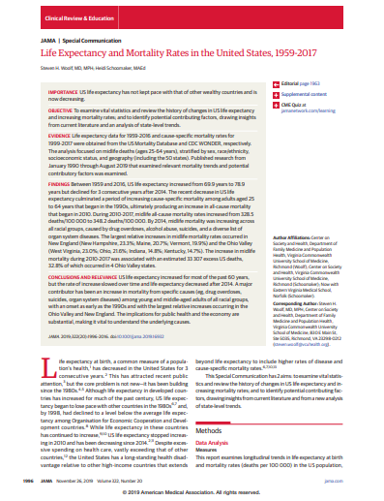
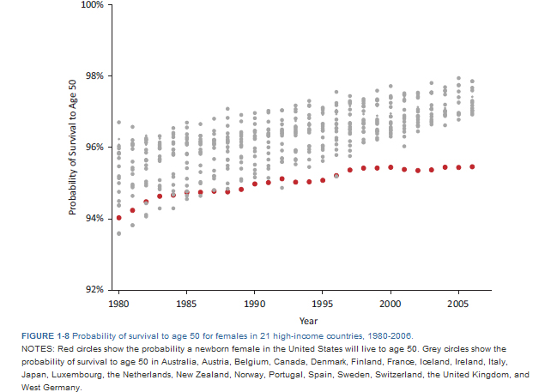
Remember the Why…

Slide 22
Family Medicine Residency Redesign – Key Elements
The Practice is the Curriculum
Community Engagement to address disparities and social determinants of health
Residency Learning Networks
Flexibility for residencies and residents
Competency Based Medical Education
Faculty Time for Education
One of many goals: means to the end…

Slide 23
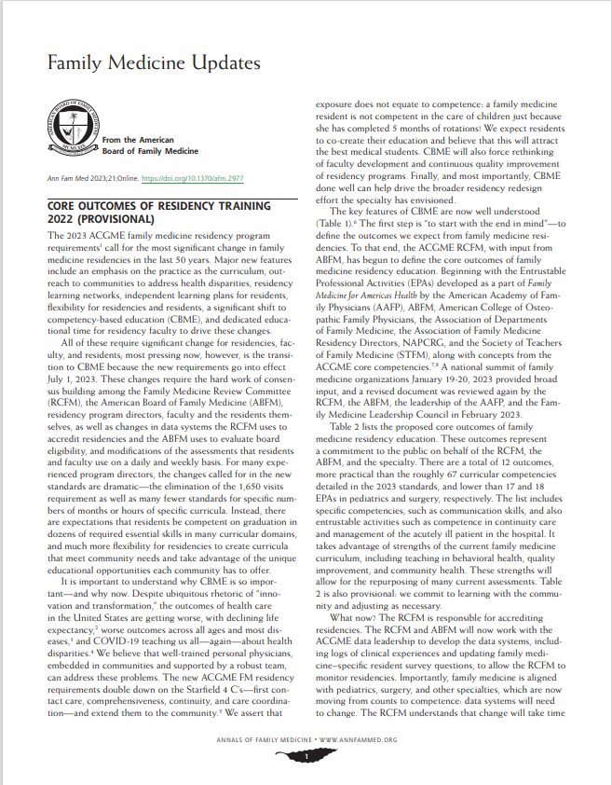
Family Medicine Residency Core Outcomes
“Start with the end in mind”
Based on FM EPAs
Driven by ACGME FM RC and ABFM, with input from FM Organizations
Called the “core outcomes,” similar to EPAs
There are 12…
This set of core outcomes will drive ACGME WebAds, resident and faculty survey and ABFM requirements for board eligibility.

Slide 24
Competency Based Board Eligibility: ABFM Strategy for Implementation
In June 2024, we will ask program directors to attest that each resident has completed residency and that they are competent in specific outcomes required for 2024
We assume that CCCs will be involved
Start with 5 outcomes and build over 3 years
By 2027, we’ll ask PDs to attest to competence in all core outcomes for each resident as a condition of ABFM Board Eligibility

Slide 25
Requirements for 2024
Practice as personal physicians, providing first contact, comprehensive and continuity care, to include excellent doctor-patient relationships, excellent preventive care , care of chronic disease and effective practice management.
Diagnose and manage acute illness and injury for people of all ages in the emergency room or hospital.
Provide comprehensive care of children, including diagnosis and management of the acutely ill child and routine preventive care.
Develop effective communication and constructive relationships with patients, clinical teams, and consultants
Model Professionalism and be trustworthy for patients, peers, and communities.
Chosen to underscore breadth of scope and ease transition…
Whence assessments?
Adjust existing rotation evaluations
Behavioral health evaluations
Precepting “shift reports”

Slide 26
Where will assessments come from?
Start with adapting what currently exists…and then add/innovate
The perfect is the enemy of the good.
Simple, practical, scalable are priorities along with integration with learning management systems…
Look for what the STFM CBME Task Force will recommend—both general principles and specifics
Evaluate and share what works at RLS, STFM meetings, in writing—we need to learn together…
Make case for what society needs from family doctors…link what you assess to what society needs—and will need.

Slide 27
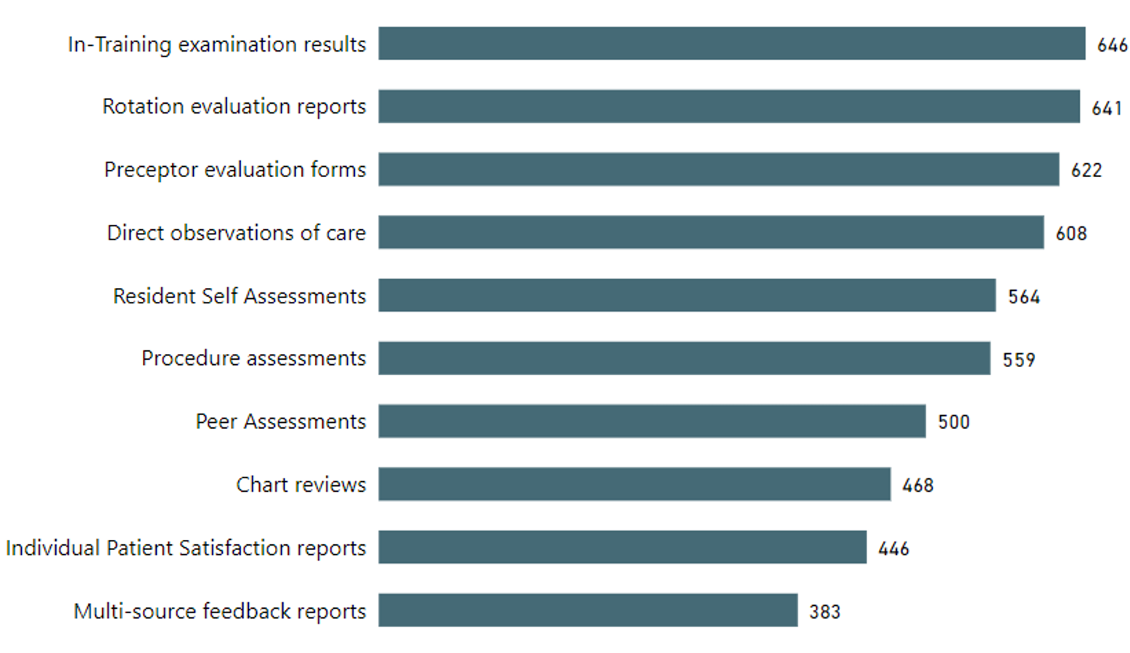
What assessments are residencies using now? Attestation Survey: >50% residencies use (Total=655 Residencies)

Slide 28
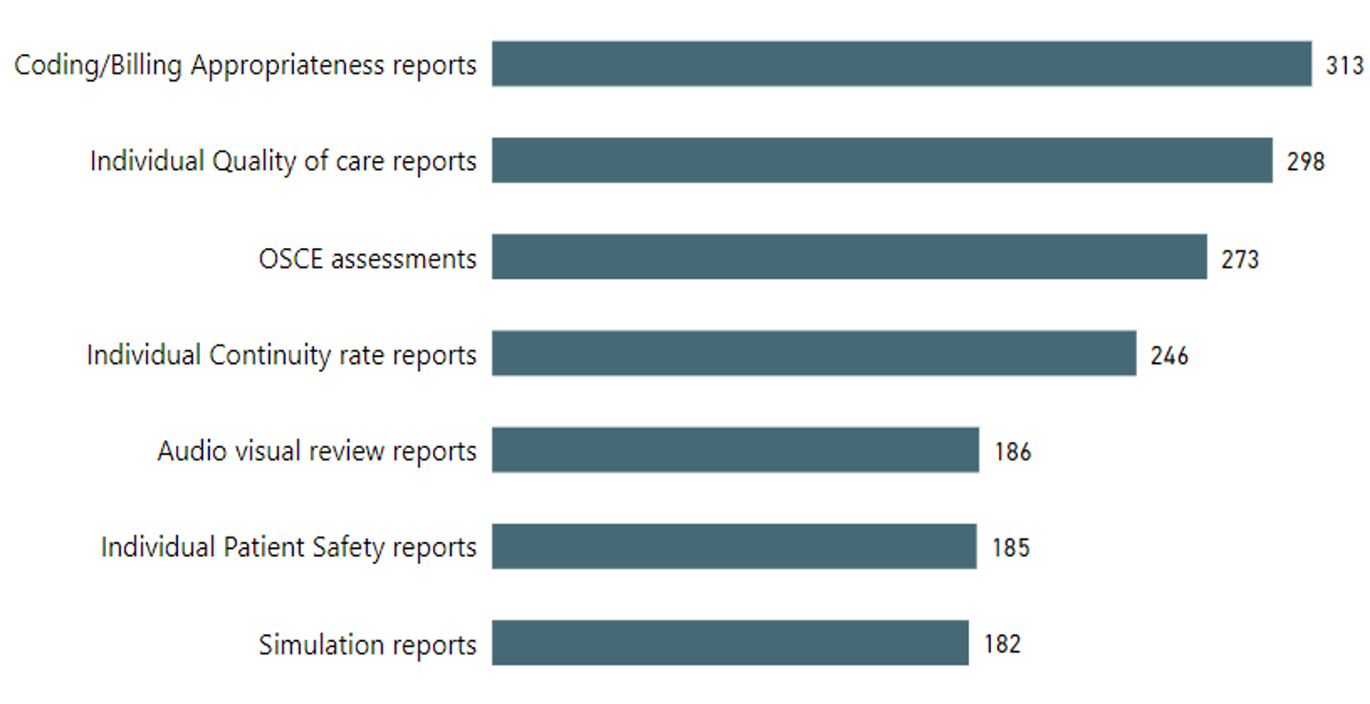
What assessments are residencies using? Attestation Survey: 25-50% residencies… (Total = 655 residencies )

Slide 29
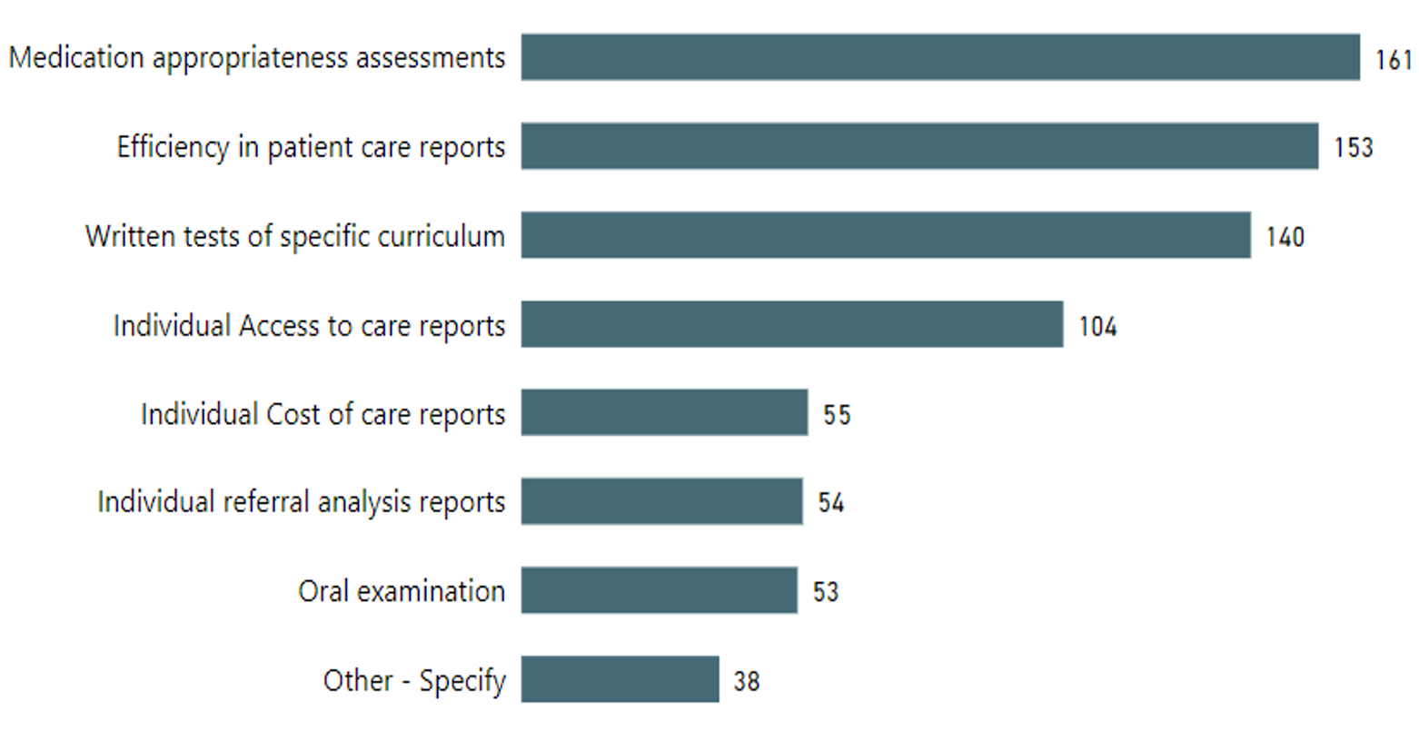
What assessments are residencies using? Attestation Survey: <25% (Total=655 residencies)

Slide 30
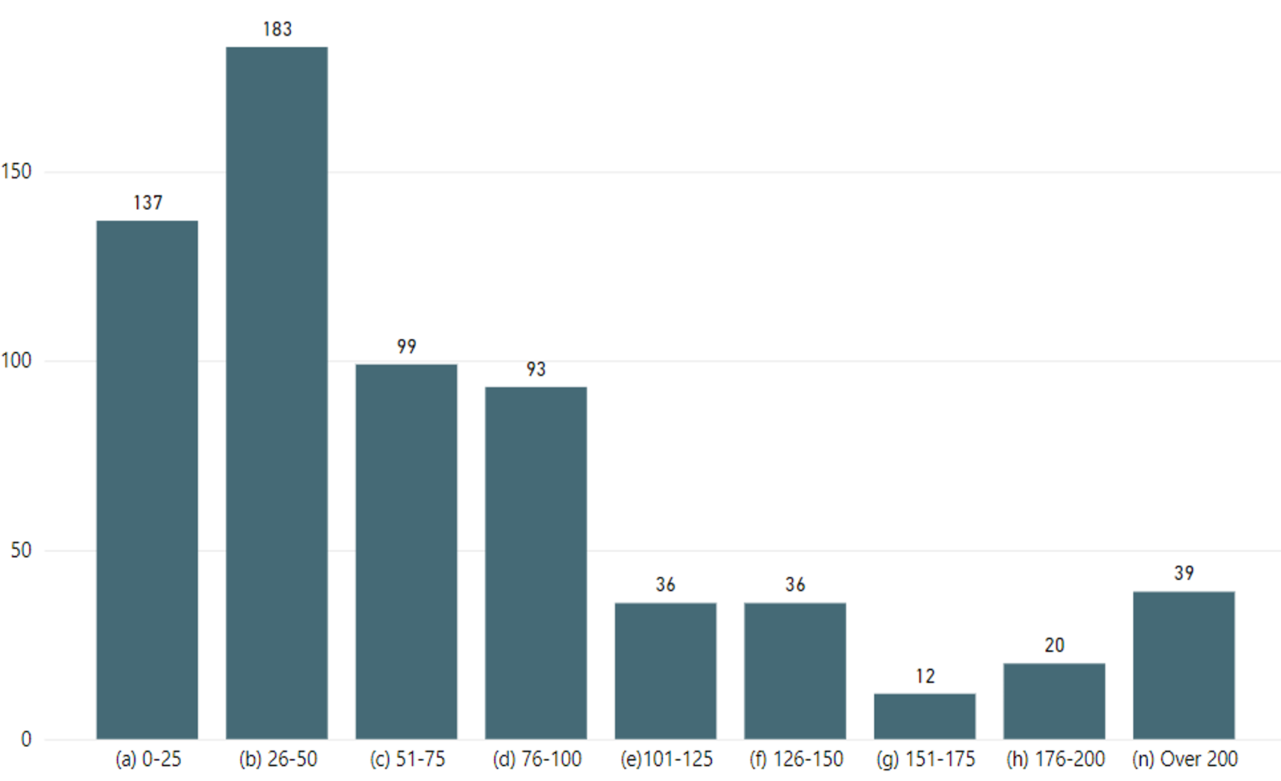
How Many? Number of Assessments at 2023 graduation
655 residencies
Median residency has 50-75 assessments/resident at graduation

Slide 31
How to get there…
Think clinically: revise rotation evaluations to focus on core clinical behaviors/competencies
Develop shared mental model of competency/entrustability across faculty…
Optimize CCC function, integrating milestones and core outcomes
Residency Learning Networks: longitudinal learning from others.
AIRE: what is the ideal training for personal physicians to meet the needs of society?

Slide 32
How you can help…
Develop, evaluate and report on new assessments
Help STFM, AFMRD, ADFM develop as learning communities…dialogue at the national meetings and in writing
2025 assessments include, practice quality (continuity, referrals, quality metrics), core procedures, obstetrics without deliveries, lifelong learning: what should we be using?
Have patience: this is a 5-10 year journey!

Slide 33
Other Questions?

Slide 34
Helpful Links
STFM CBME Toolkit:
https://stfm.org/cbmetoolkit
Faculty Development Delivered:
https://stfm.org/teachingresources/resources/cbme-toolkit/in-person-faculty-development/
ACGME Course: Developing Faculty Competencies in Assessment

